Slide 1


Annual Epidemiological Report
Survey: Seasonal Influenza Vaccination Among Long term/Residential Care Facility (LTCF/RCF)-based Health Care Workers (HCWs)
2025-2026 Season
A report from the Vaccine Preventable Disease Team, HPSC¹
Report prepared by: VPD Team, HPSC
^{Published October 2026}
Published by:
Health Protection Surveillance Centre, 25-27 Middle Gardiner St, Dublin 1 Ireland.
t: +353 1 8765300
© Health Protection Surveillance Centre, 2026
Citation Text:
HSE Health Protection Surveillance Centre (2025). Survey: Seasonal Influenza Vaccination Among Long term/Residential Care Facility (LTCF/RCF)-based health care workers (HCWs), 2025-2026 Season
Reproduction is authorised, provided source is acknowledged
¹The Vaccine Preventable Disease Team is part of the Health Protection Surveillance Centre, National Health Protection Office, Health Service Executive

Slide 2


Seasonal influenza Vaccination
Survey participation
Introduction
Surveys on RCF-based health care workers (HCWs) uptake of the seasonal influenza vaccine have been conducted annually each winter season since 2011-2012
Uptake among HCWs in all 173 public and private in 2025-2026 was 39.4%
Among HCWs in 104 public RCFs
  Uptake reached its peak at 66.3% in 2021-2022
  In contrast, the uptake in the latest 2024-2025 survey was 42.9%, a difference of 23.4%
  In 2025-2026, the Midwest Region with three reporting RCFs reported the highest uptake at 56.6% and the lowest in the West and North West region with 23 participating RCFs at 29.5%
  The South West region was the only region to show no increase in uptake.
  Across the six categories of staff, uptake increased since the last season
  In 2025-2026, uptake in public RCFs was highest among management & administrative staff at 58.6% and lowest among nursing staff at 39.1%
  Although an increase in uptake among the different staff compliment sizes in 2025-2026 wad observed, no visible link was discernible between staff compliment size and changes in uptake each season overall
Among 69 private RCF-based HCWs
  Uptake in the 2025-2026 survey was 37.2%, 5.7% less than among public RCF-based HCWs
  Uptake was highest among medical & dental staff at 75.2% and lowest other patient & client care staff at 31.1%
2025-2026 season marked a sharp downward trend in the level of participation by RCFs
Among public RCFs the numbers dropped from 157 last season to 104 this season, a reduction of 33.8%
Among private RCFs the numbers dropped from 130 last season to 69 this season, a decline of 46.9%
In addition to the 173 participating RCFs this season, there were 18 RCFs which provided no returns as part of their survey submission, 17 of which were located in the Dublin and South East region and one was in the North and North West region.
What are the key messages in this report?
1. In this 2025-2026 season HCW-based survey, vaccine uptake was for
public RCFs only: 42.9% for Seasonal influenza vaccine ( n=104 RCFs)
private RCFs only: 37.2% for Influenza vaccine (n=69 RCFs)
2. A marked upward inflexion in influenza vaccine uptake among HCWs from the 2024-2025 season was observed.
3. Participation by the 173 public (n=104) and private (n=69) RCFs in the latest annual survey has declined sharply on the 2024-2025 survey.
Note:
The raw data used to develop the content of this report are available in a link in Appendix 1 at the end of this power-point presentation.

Slide 3
Methodology
This HSE-HPSC survey report on the uptake of the influenza vaccine in HCWs for the 2025-2026 season.
The survey was undertaken on 2nd March 2026 for final returns. Validation of returns was completed on 2nd June 2026.
The survey presents results based on a number of data sources available to participants, focussing on returns obtained from RCFs. The survey was conducted online using the Qualtrics platform.
Among the key questions asked in the survey include:
  Number of eligible HCWs for each of the six official categories of staff (General Support Staff, Health & Social Care Professionals, Management & Admin, Medical & Dental, Nursing and Other Patient & Client Care)
  Sources of information to collate the number of eligible and vaccinated HCWs
Nationally, the HSE target influenza vaccine uptake for RCF-based HCWs of 75% remained unchanged from the previous season. All HSE manged/staffed/funded RCFs are obliged to participate in the annual survey whereas non HSE (section 38, 39 and privately run) RCFs are not but are welcome to.
What background information is relevant when reading this report?
What is the annual HPSC RCF-based HCW survey?
When was the survey conducted?
How were the survey returns collated?
What were the key questions asked in the survey?
What is the target vaccine uptake?

Slide 4
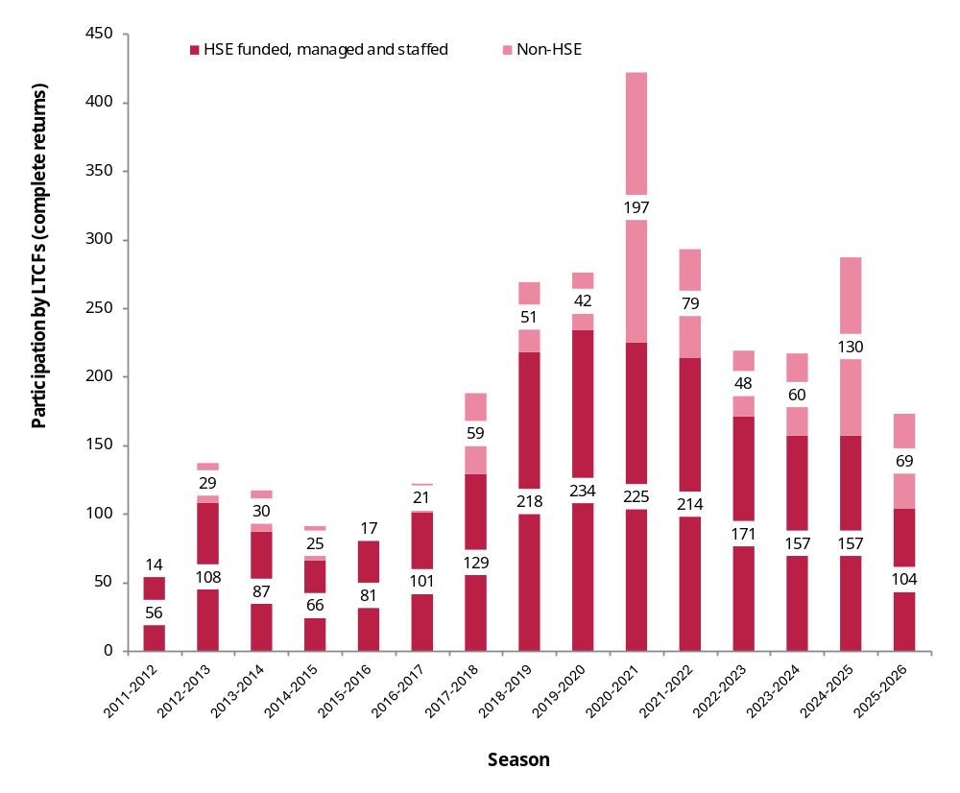
Results
Part 1 of 13
Figure 1. Number of survey participating RCFs by funding model by season, 2011-2012 to 2025-2026
Survey participation by RCFs
Completion of HPSC annual surveys on HCW vaccine uptake by private RCFs is not obligatory and it is one reason why the overall numbers of participating RCFs can vary season to season (Figure 1).
Between 2018-2019 and 2021-2022 participation by public RCFs has been generally high, but there has been a steady decline since 2019-2020 to date.
Between 2020-2021 and 2025-2026 participation by private RCFs has fluctuated considerably.
In April 2026, when Childcare Tusla RCFs are excluded, a total of 4,105 active RCFs were registered on the HSE service directory, of which 796 (19.4%) were elderly based, 1,060 (25.8%) were disability-based, 1,729 (42.1%) were disability residential based and 520 (12.7%) were mental-health based. In total 173 RCFs participated in the 2025-2026 survey, 5.7% of the total above.

Slide 5
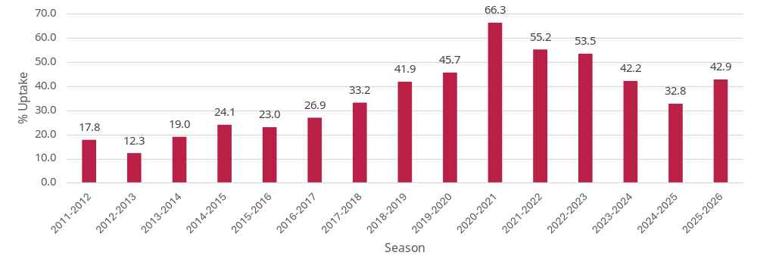
Results
Part 2 of 13
Table 1. Eligible and vaccinated public RCF–based HCWs for the seasonal influenza vaccine by season and key metrics, 2011-2012 to 2025-2026 seasons
Season | No. Eligible Staff | No. Vaccinated Staff | Overall % Uptake | Average % Uptake | Range % Uptake | No. LTCFs
2011-2012 | 3861 | 687 | 17.8 | 17.3 | 0-90.38 | 56
2012-2013 | 10823 | 1327 | 12.3 | 14.9 | 0-76 | 108
2013-2014 | 8704 | 1658 | 19.0 | 21.4 | 0-80 | 87
2014-2015 | 7031 | 1691 | 24.1 | 26.9 | 0-77.14 | 66
2015-2016 | 7058 | 1625 | 23.0 | 24.4 | 0-100 | 81
2016-2017 | 9633 | 2595 | 26.9 | 28.0 | 0-75 | 101
2017-2018 | 13928 | 4621 | 33.2 | 36.9 | 0-93.33 | 129
2018-2019 | 13205 | 5531 | 41.9 | 39.5 | 0-96.66 | 218
2019-2020 | 13926 | 6361 | 45.7 | 48.7 | 0-100 | 234
2020-2021 | 13537 | 8982 | 66.3 | 65.8 | 1.72-100 | 225
2021-2022 | 14390 | 7948 | 55.2 | 54.4 | 0-100 | 214
2022-2023 | 9134 | 4888 | 53.5 | 50.6 | 26.08-76.92 | 171
2023-2024 | 10182 | 4297 | 42.2 | 45.5 | 0-100 | 157
2024-2025 | 7323 | 2402 | 32.8 | 33.5 | 0-100 | 128
2025-2026 | 5568 | 2386 | 42.9 | 39.9 | 0-100 | 104
SECTION A: Seasonal influenza vaccine uptake among public RCF-based HCWs-The overall picture
Since the 2020-2021 season, the height of the COVID-19 pandemic, seasonal influenza vaccine uptake among public RCF based HCWs has declined sharply.
In 2020-2021, uptake was 66.3% and in 2025-2026 it was 42.9%, an absolute difference of 23.4% (Figure 2, Table 1).
Figure 2. Percentage uptake of influenza vaccine among public RCF-based HCWs by season, 2011-2012 to 2024-2025 seasons

Slide 6
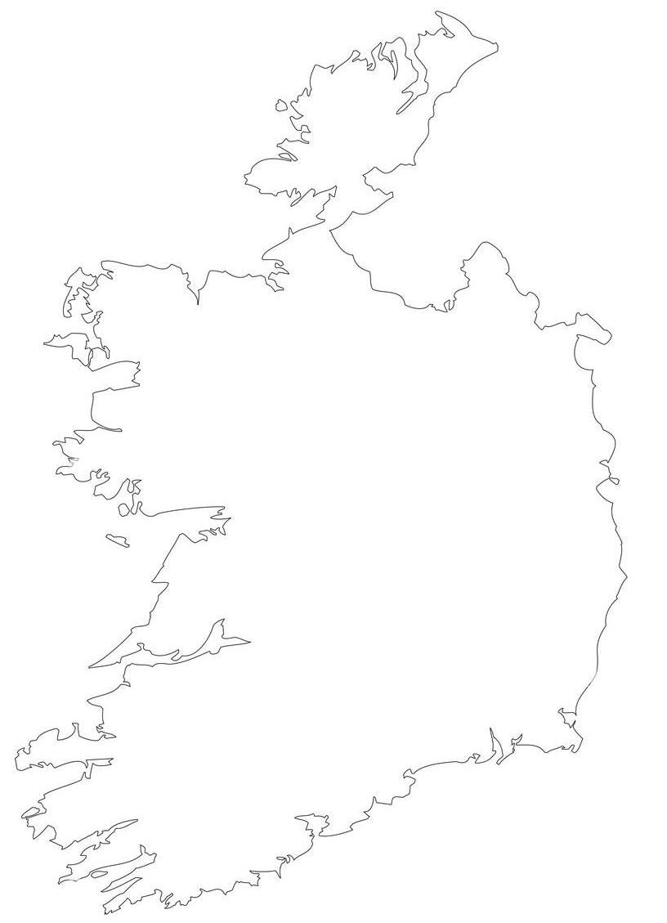
Results
Part 3 of 13
Table 2. Uptake of the seasonal influenza vaccine among public RCF-based HCWs by staff type and region, 2025-2026 season
SECTION A: Seasonal Influenza vaccine uptake among public RCF-based HCWs by region
HSE Regional Health Area-Location | No. LTCFs | % Uptake Total | % Uptake Management & Administration | % Uptake Medical & Dental | % Uptake Health & SocialCare | % Uptake Nursing | % Uptake General Support | % Uptake Other Patient & ClientCare
HSE Dublin and Midlands | 8 | 41.0 | 53.2 | 90.0 | 36.2 | 39.8 | 47.1 | 30.9
HSE Dublin and North East | 8 | 36.7 | 41.9 | 50.0 | 29.1 | 44.4 | 36.8 | 30.4
HSE Dublin and South East | 48 | 50.1 | 65.8 | 33.0 | 69.2 | 41.7 | 54.4 | 51.9
HSE Midwest | 3 | 56.6 | 67.7 | 62.5 | 42.4 | 55.3 | 70.8 | 66.7
HSE South West | 14 | 43.2 | 54.8 | 77.8 | 28.0 | 37.2 | 35.5 | 55.4
HSE West and North West | 23 | 29.5 | 57.6 | 93.3 | 28.8 | 26.8 | 27.4 | 20.3
Total-public | 104 | 42.9 | 58.6 | 50.3 | 44.8 | 39.1 | 43.5 | 41.4
Overall uptake as 42.9%.
Midwest region reported the highest vaccine uptake at 56.6% and the West and North West region the lowest at 29.5%.
Uptake was highest among management & administration staff at 58.6%.
Uptake was lowest among nursing staff at 39.1% (Table 2).
Note: See slide #2 for details of the participating survey number of RCFs that did and did not report influenza vaccination data

Slide 7
Results
Part 4 of 13
Table 3. Uptake of the seasonal influenza vaccine among private RCF-based HCWs by staff type and region, 2025-2026 season
SECTION A: Seasonal influenza vaccine uptake among private RCF-based HCWs by region
HSE Regional Health Area-Location | No. LTCFs | % Uptake Total | % Uptake Management & Administration | % Uptake Medical & Dental | % Uptake Health & SocialCare | % Uptake Nursing | % Uptake General Support | % Uptake Other Patient & ClientCare
HSE Dublin and Midlands | 13 | 37.1 | 46.1 | 71.7 | 44.0 | 34.7 | 38.3 | 28.5
HSE Dublin and North East | 11 | 49.3 | 54.0 | 81.5 | 65.5 | 50.3 | 36.0 | 42.2
HSE Dublin and South East | 15 | 38.8 | 43.8 | - | 39.9 | 42.2 | 41.9 | 34.5
HSE Midwest | 8 | 29.8 | 51.6 | - | 28.4 | 43.0 | 37.3 | 18.0
HSE South West | 15 | 35.1 | 41.7 | 73.7 | 29.3 | 33.6 | 27.0 | 44.2
HSE West and North West | 7 | 21.3 | 37.2 | 100.0 | 12.7 | 24.6 | 18.4 | 21.2
Total-private | 69 | 37.2 | 46.1 | 75.2 | 39.3 | 39.5 | 34.5 | 31.1
Overall uptake was 37.2%, lower than what was reported for public RCFs (slide #7)
Dublin and North East region reported the highest vaccine uptake at 49.3% and the Midwest the lowest at 29.8%.
Uptake was highest among medical & dental staff staff at 75.2%.
Uptake was lowest among other patient & client care staff at 31.1% (Table 3).
Note: See slide #2 for details of the participating survey number of RCFs that did and did not report influenza vaccination data

Slide 8
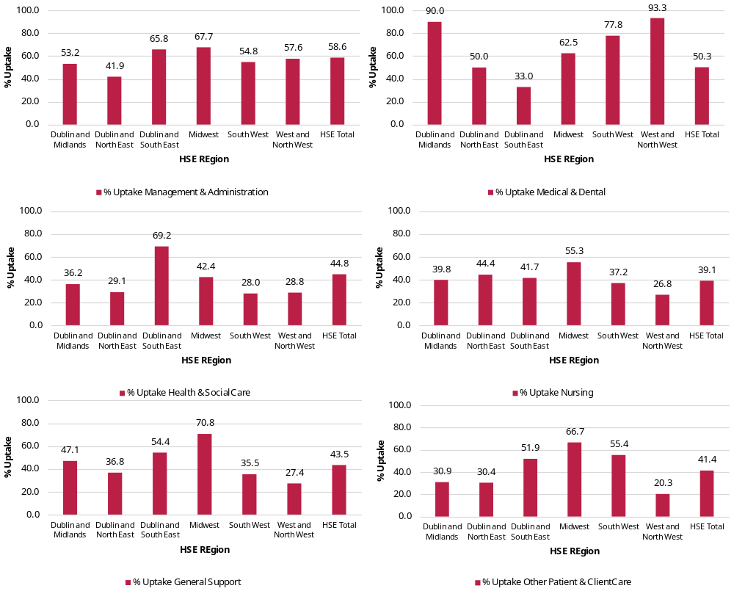
Results
Part 5 of 13
Figures 3a-3f. Uptake among HCWs for the seasonal influenza vaccine by public RCF, region and staff type, 2025-2026 season
SECTION A: Seasonal influenza vaccine uptake among different categories of staff type and region in public RCFs
Uptake was generally higher among management & administration in public RCFs (Figures 3a-3f) compared to private RCFs (Figures 4a-4f, see next slide), and this was also true for other categories of staff, apart from medical & dental staff (see graph left in top-right corner).

Slide 9
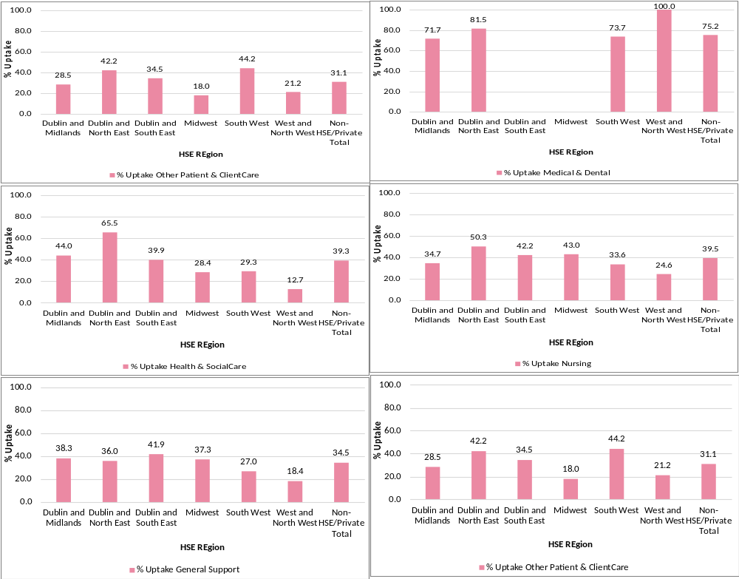
Results
Part 6 of 13
Figures 4a-4f. Uptake among HCWs for the seasonal influenza vaccine by non-HSE/private RCF, region RCF and staff type, 2025-2026 season
SECTION A: Seasonal influenza vaccine uptake among different categories of staff type and region in private RCFs
Among private RCFs, uptake was highest in medical and dental staff (Figures 4a-4f).

Slide 10
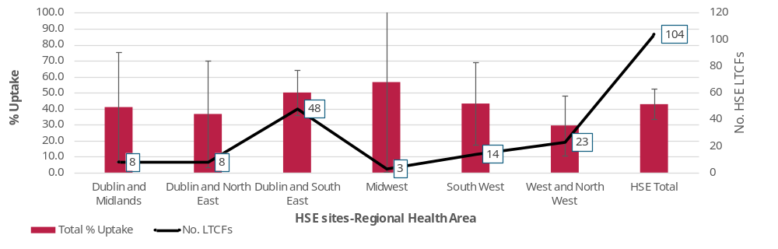
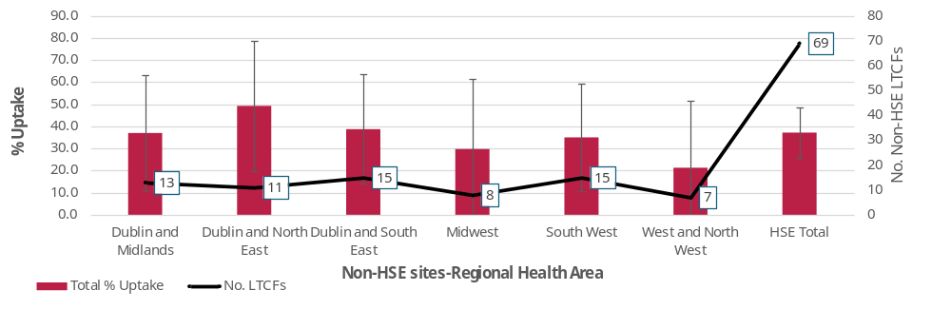
Results
Part 7 of 13
Figure 5a. Uptake among HCWs for the seasonal influenza vaccine by public RCF and region, 2025-2026 season, with 95% CIs
SECTION A: Seasonal influenza vaccine uptake by region
No public or private RCF had a seasonal influenza vaccine uptake that was significantly different from the overall uptake (Figures 5a, 5b).
Figure 5b. Uptake among HCWs for the seasonal influenza vaccine by private RCF and region, 2025-2026 season, with 95% CIs

Slide 11
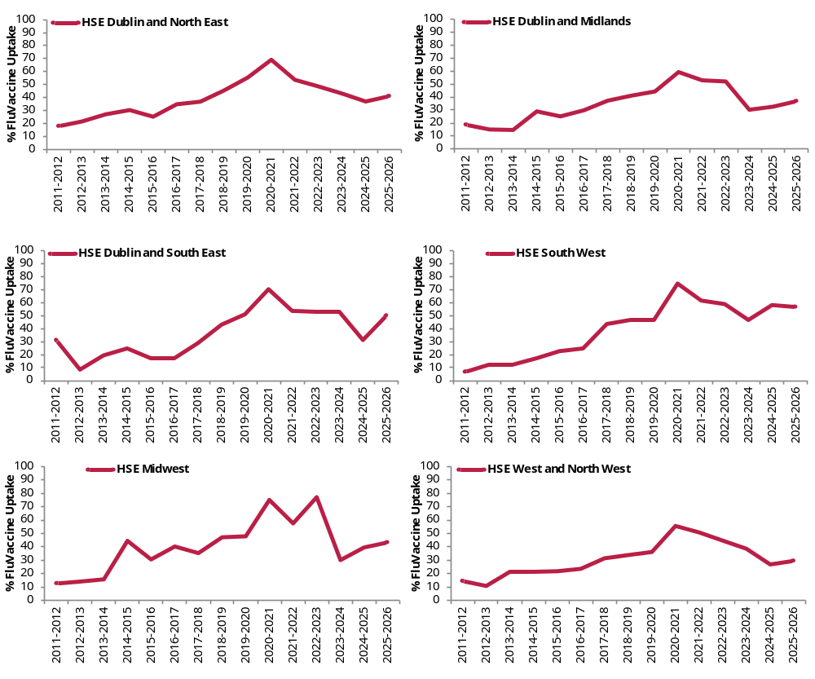
Results
Part 8 of 15
Figures 6a-6f. Percentage uptake of seasonal influenza vaccine among HCWs by public RCF, region and season, 2011-2012 to 2025-2026
SECTION A: Seasonal influenza vaccine uptake by region in public RCFs-Seasonal Trends
A mixed trend in seasonal influenza vaccine uptake is evident across in public RCFs in all regions (Figure 6a-6f). Apart from the South West, all regions registered an increase in uptake in 2025-2026, some more so than others, such as Dublin and South East and the Midwest.

Slide 12
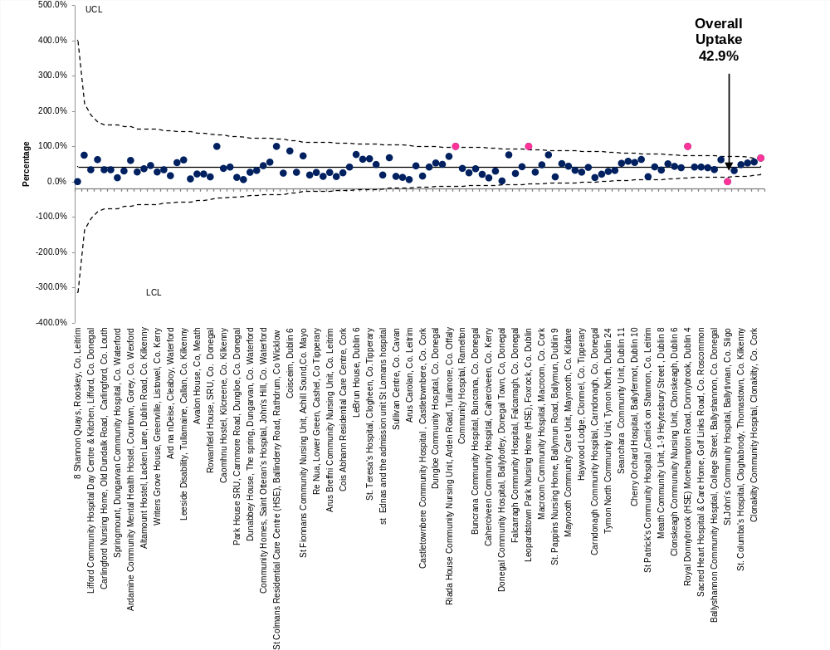
Results
Part 9 of 13
Figure 7. Funnel chart of percentage uptake of seasonal influenza vaccine among HCWs by public RCF with mean uptake with 95% confidence limits (CL), 2025-2026
SECTION B: P prime funnel chart of public RCF-based HCW seasonal influenza vaccine uptake
A funnel chart was applied to the influenza vaccine uptake among HCWs in the participating RCFs to identify the true performance outliers by accounting for differences in RCF size (sample size variation).
Four public RCFs reported a seasonal influenza vaccine uptake that was significantly above the overall uptake of 42.9% (shown in the graph), (three of which were in the HSE Dublin & South East region) and one was significantly below this level (Figure 7).
See supplementary notes on slide #26 for explanatory notes about P prime funnel charts

Slide 13
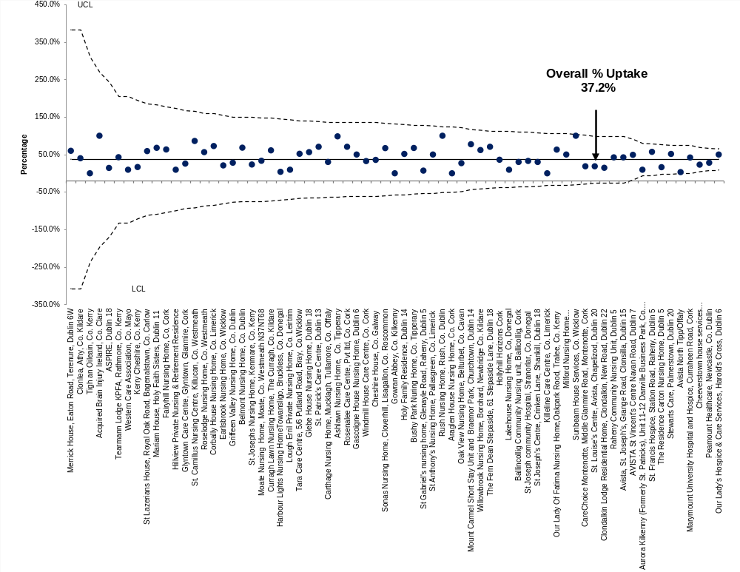
Results
Part 10 of 13
Figure 8. Funnel chart of percentage uptake of seasonal influenza vaccine among HCWs by private RCF with mean uptake with 95% confidence limits (CL), 2025-2026
SECTION B: P prime funnel chart of private RCF-based HCW seasonal influenza vaccine uptake
No private RCF reported a seasonal influenza vaccine uptake that was either significantly above or below the overall uptake of 37.2% (Figure 8) (indicated in the graph).
See supplementary notes on slide #26 for explanatory notes about P prime funnel charts

Slide 14
Results
Part 11 of 13
Figure 9. Percentage uptake of seasonal influenza vaccine among HCWs in public RCFs by staff compliment size, region, 2025-2026 with 95% CIs
SECTION C: Seasonal influenza vaccine uptake by staff compliment size and region
In 2025-2026, no statistical difference in the uptake of either seasonal influenza by staff compliment size (<100, and 100+) and by RCF funding model (Figure 9) was observed.

Slide 15
Results
Part 12 of 13
Table 4. Number of survey participating RCFs by primary remit and funding model, 2025-2026
Type of LTCF (primary remit) | HSE | % HSE Total | Non-HSE | % Non-HSE Total | Total | % Total
Elderly | 60 | 46.2 | 45 | 40.6 | 105 | 60.7
Mental Health | 32 | 34.4 | 0 | - | 32 | 18.5
Intellectual Disability | 3 | 14.3 | 12 | 29.2 | 15 | 8.7
Other Disability | 3 | 33.3 | 2 | 45.2 | 5 | 2.9
Hospice Care | 1 | 42.3 | 2 | 52.2 | 3 | 1.7
Other Care (not listed above) | 0 | - | 2 | 69.2 | 2 | 1.2
Mixed / Combination Care | 5 | 29.6 | 6 | 29.7 | 11 | 6.4
Total | 104 | 42.9 | 69 | 37.2 | 173 | 100.0
SECTION C: Primary remit of RCF and funding model
Elderly-older person RCFs accounted for well over half of the survey participants in 2025-2026 (n=105; 43.8%), followed by mental health (n=32; 34.4%) and by intellectual disability (n=15; 28.9%) (Table 4).
All 32 of the participating mental health RCFs were HSE managed.

Slide 16
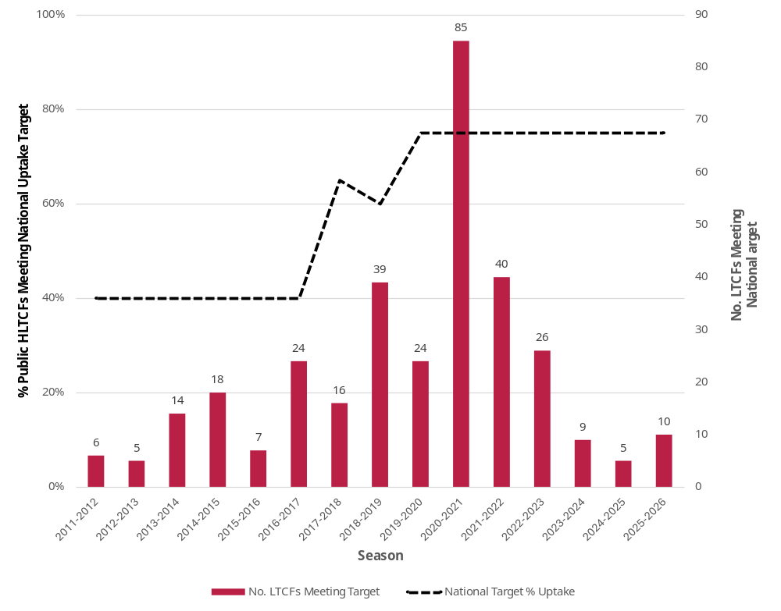
Results
Part 13 of 13
Figure 10. Number of participating public RCFs meeting the national influenza vaccine target by season, 2011-2012 to 2025 -2026
SECTION D: National vaccine uptake targets
Seasonal influenza vaccination:
The percentage of participating public RCFs that met the national uptake of 75% reached its highest level of 40.8% during the 2020-2021 season when the uptake was 71.4% (Figure 10).
Since then the percentage meeting that same target has fallen sharply and for the 2025-2026 season, it was 9.6%, which is higher than the 3.9% recorded in 2024-2025.

Slide 17
Caveats
There are limitations in these data…
Reporting bias
RCFs that have access to NIIS/COVAX dashboard/portal for vaccination details of their staff or that maintain their own staff vaccination records are more likely to submit a completed survey return.
2 . Representation Bias
According to the HSE service directory in April 2026 there were 21,660 active, services in the country, of which 9,234 has a maximum bed capacity recorded that was greater than zero:
Of these 9,234 residential services, 5,128 were children care/Tulsa based and of the remaining 4,105
  796 (19.4%) were elderly/’older person’ based
  2,789 were’ disability’ or ‘disability residential’ (67.9%) (designated centres for adults, children and mix services)
  520 (12.7%) were mental health based
There is evidence to suggest that participation in terms of their numbers by
  elderly/older person RCFs was over-represented (19.4% vs 60.7%; n=105/173 RCFs)
  disability RCFs was under-represented (67.9% vs 11.6% ; n=20/173 RCFs)
  by mental health services was somewhat over-represented (12.7% vs 18.5%; n=32/173 RCFs).
What do I need to know about how the data for this report was collected?
Results from HPSC vaccination surveys are subject to both reporting and representation/participation bias
Factors:
  Administrative: out of date contact details held by HPSC, high turnover in local reporting staff
  Technical: Lack of IT hardware, software, knowhow by local staff, online access
  Access to data: RCFs not having access to or maintaining their own vaccination records
Judging from the nature of the response to this survey, many RCFs did not have access to seasonal influenza vaccination data, in addition, some did not report their own staff category numbers
3. Sources of Information-Limited access to NIIS/COVAX portal or dashboard
NIIS/COVAX was cited by 17 (9.8%) as a data source exclusively or in combination with others, suggesting that the remaining 156 had no access to the NIIS/COVAX portal or dashboard or possibly because the quality of their own staff vaccination rata sources was more accurate or that there was no other alternative available to them.
Note: NIIS/COVAX= HSE National Integrated Information Services (IIS) and COVAX Implementation system

Slide 18
General Conclusions
The recent marked seasonal upward trend in HCW influenza vaccine uptake is a positive move
On-going issues contributing to possible under-reporting of influenza vaccine uptake by HCW place of work
What can we interpret from the findings in this report about vaccination?
Between 2020-2021 and 2024-2025, uptake among public RCF-based HCWs fell from 66.3% to 32.8% (For private RCFs the decline was from 60.9% to 37.2%).
In 2025-2026 however, a marked improvement was noted, increasing to 42.9% among public RCF-based HCWs but remaining unchanged among private RCFs.
This turnaround has occurred on foot of a number of HSE initiatives and the allocation of considerable resources that were designed to arrest and reverse this worrying trend including:
  On-going development and expansion of the NIIS/COVAX influenza vaccination record system
  Review and updating of infectious disease infection and control guidelines
  Improvements in the monitoring and surveillance of cases and outbreaks, including biostatistical modelling
  Concerted social media and communications campaigns to promote the protective health benefits of vaccines
Local RCF managers using the NIIS/COVAX system being unable to validate where staff were working and in what capacity (staff category) if their staff choose to get vaccinated elsewhere, in GP clinics or in pharmacies, for example.
Local managers not having the means to query/correct inconsistencies and omissions on GP and pharmacy NIIS/COVAX records.
Training of vaccinators and administrators on the NIIS/COVAX input systems being subject to significant turnover and a lack of consistency in relation to how HCW details are assigned to their correct place of work/vaccination and, to a lesser extent, their staff category type.
Unlike most hospitals that have their own occupational health departments who organise vaccination clinics for their staff, RCF managers rely far more on their access to NIIS/COVAX for vaccination data and are less likely to be in a position to maintain their own staff records whose accuracy depends much on the willingness of staff to disclose their vaccination status.
Seasonal influenza vaccination
The recent increase in the uptake of the seasonal influenza vaccine among RCF–based HCWs is an encouraging development.
This improvement was widespread in that it occurred across all types of staff, all categories of staff compliment sizes and most regions (except the South West)
Only 9.6% of all participating RCFs exceeded the national influenza vaccine uptake target of 75% in the most recent 2025-2026 survey
Four public RCFs and no private RCF reported an uptake that was significantly above the overall mean percentage uptake.

Slide 19
General Conclusions
Underlying factors that impact vaccine uptake
Implications of low vaccine uptake among RCF-based HCWs
What can we interpret from the findings in this report about vaccination?
Bridging the gap between actual and reported uptake is an on-going technical challenge for any data collection process, but as long as it is undertaken consistently over time, the trends observed in this survey are probably genuine.
Although RCFs are not subject to the same level of winter related overcrowding as acute hospitals, unvaccinated RCF-based HCWs are nevertheless vulnerable to season influenza infections, which can impact on the quality of care provided to residents during those months because of absent staff due to illness.
For the forthcoming 2026/2027 vaccination season, the National Immunisation Advisory Committee (NIAC), in July 2026, recommended that HCWs Healthcare workers, including those who are pregnant, receive the influenza vaccine ‘for their own protection and to protect patients who may have a suboptimal response to influenza vaccinations’.
The marked improvement in the uptake of the seasonal influenza vaccine among RCF-based HCWs is positive step and stems largely from the considerable resources and efforts that have been ploughed into addressing a downward trend for some time.
The fact that RCFs face greater challenges in organising clinics for staff and gaining access to data on NIIS/COVAX portal /dashboards probably accounts why uptake among RCF-based HCWs is lower compared to hospital-based ones.
The likelihood that the key performance target of 75% for seasonal influenza vaccine uptake will be reached in the next few seasons is low without further concerted public health efforts, significant input of additional resources, including financial, and a turnaround in vaccine hesitancy by HCWs generally.
Local RCF operational activities
Most RCF based HCWs are vaccinated by HSE team clinics, or in their local GP clinic or pharmacy, so unless local management have access to the NIIS/COVAX portal/dashboards and unless they maintain their own vaccination records, they have no means whatsoever of knowing or reporting on what their staff uptake is.
Importance of HPSC vaccine uptake survey
The survey itself fulfils a useful purpose as it provides a comprehensive profile of RCF-based HCW uptake that other reports do not provide

Slide 20
General Conclusions
Addressing data reporting/ validation concerns
A number of issues has been raised during the 2024-2025 season and unfortunately some persist including the need for
Data providers to access one single source of information, rather than a range of different data sources, in order to compile an accurate set of staff uptake figures that can then be reported.
Agreement among data providers that denominator values (eligible staff counts) are taken from the same point in time, for example, either from the beginning of the winter vaccination campaign or at the end of it.
Greater consistency with which HCW job titles are assigned by data providers to their correct HSE official category of staff
Increasing RCF survey participation/reporting
Compared to hospitals, RCFs face additional reporting challenges
  Smaller compliment sizes and higher turnover of staff
  Limited IT resources and less familiarity with online surveys etc
  Limited access to NIIS/COVAX portal and vaccination dashboards
  Limited resources to build and maintain their own staff vaccination records
Access to NIIS/COVAX resources should be granted to all RCFs, including private ones, in relation to their staff influenza vaccination uptake counts
Recommendations
A number of issues have been highlighted by RCF managers in relation to the accuracy with which uptake figures are collated for reporting
Increasing RCF survey participation/reporting
Role of Research help gain insights that can guide more effective public health strategies
Ensure HCW status is accurately captured on NIIS
Role of Research help gain insights that can guide more effective public health strategies
There is a need for a more in-depth understanding of the personal, cultural, and contextual factors influencing HCWs' vaccination decisions and underlying barriers to vaccination

Slide 21
Appendices (continued)
Appendix 1 : List of participating RCFs in the 2025-2026 survey with details of their eligible and vaccinated staff numbers for both seasonal influenza
An excel file listing of the participating RCFs in the 2025-2026 survey with details of the eligible and influenza (flu) vaccinated staff by HSE category is available to download here.
173 reporting RCFs submitted online survey returns

Slide 22
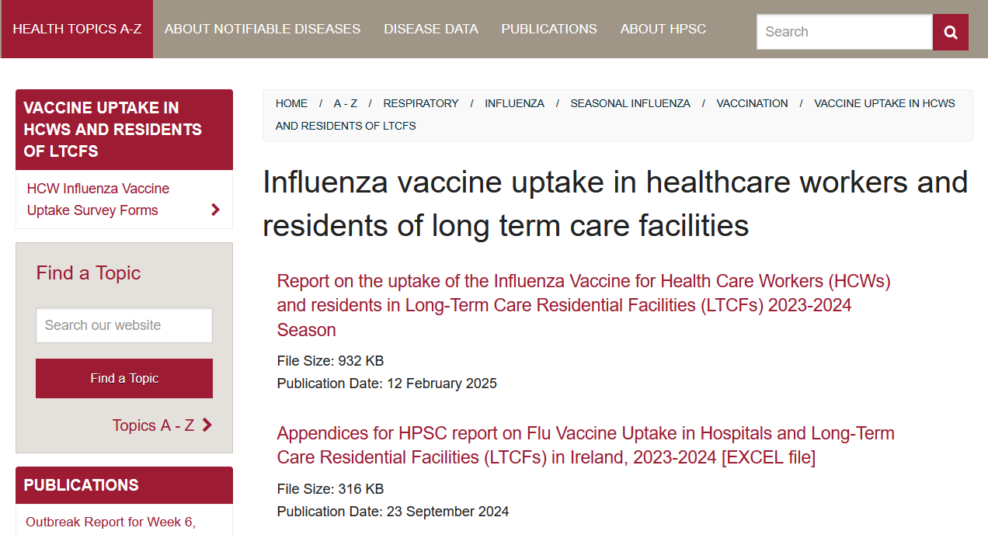
Acknowledgements & Further Information
Acknowledgements
Thanks to all LTCFs/RCFs that provided information for this report. All gratefully received.
Further information available on HPSC website:
Link here to survey reports on seasonal influenza vaccine uptake in healthcare workers and residents of long -term care residential facilities

Slide 23
Supplementary Materials
Part 1 of 8
Supplementary Table 1a. Eligible and vaccinated public RCF-based HCWs for the seasonal influenza vaccine by staff type and region, 2024-2025 season
HSE Regional Health Area-Location | No. LTCFs | Total Eligible | Total Vaccinated | Eligible Management & Administration | Vaccinated Management & Administration | Eligible Medical & Dental | Vaccinated Medical & Dental | Eligible Health & SocialCare | Vaccinated Health & SocialCare | Eligible Nursing | Vaccinated Nursing | Eligible General Support | Vaccinated General Support | Eligible Other Patient & ClientCare | Vaccinated Other Patient & ClientCare
HSE Dublin and Midlands | 8 | 614 | 252 | 47 | 25 | 10 | 9 | 47 | 17 | 231 | 92 | 140 | 66 | 139 | 43
HSE Dublin and North East | 8 | 411 | 151 | 31 | 13 | 6 | 3 | 103 | 30 | 126 | 56 | 76 | 28 | 69 | 21
HSE Dublin and South East | 48 | 1993 | 999 | 117 | 77 | 100 | 33 | 237 | 164 | 809 | 337 | 366 | 199 | 364 | 189
HSE Midwest | 3 | 429 | 243 | 31 | 21 | 16 | 10 | 85 | 36 | 217 | 120 | 65 | 46 | 15 | 10
HSE South West | 14 | 842 | 364 | 62 | 34 | 18 | 14 | 100 | 28 | 296 | 110 | 124 | 44 | 242 | 134
HSE West and North West | 23 | 1279 | 377 | 118 | 68 | 15 | 14 | 118 | 34 | 473 | 127 | 299 | 82 | 256 | 52
Total-public | 104 | 5568 | 2386 | 406 | 238 | 165 | 83 | 690 | 309 | 2152 | 842 | 1070 | 465 | 1085 | 449
Seasonal Influenza vaccine uptake among public and private RCF-based HCWs by region
Supplementary Table 1b. Eligible and vaccinated private RCF-based HCWs for the seasonal influenza vaccine by staff type and region, 2024-2025 season
HSE Regional Health Area-Location | No. LTCFs | Total Eligible | Total Vaccinated | Eligible Management & Administration | Vaccinated Management & Administration | Eligible Medical & Dental | Vaccinated Medical & Dental | Eligible Health & SocialCare | Vaccinated Health & SocialCare | Eligible Nursing | Vaccinated Nursing | Eligible General Support | Vaccinated General Support | Eligible Other Patient & ClientCare | Vaccinated Other Patient & ClientCare
HSE Dublin and Midlands | 13 | 3084 | 1143 | 334 | 154 | 60 | 43 | 534 | 235 | 874 | 303 | 436 | 167 | 846 | 241
HSE Dublin and North East | 11 | 1203 | 593 | 113 | 61 | 27 | 22 | 116 | 76 | 541 | 272 | 150 | 54 | 256 | 108
HSE Dublin and South East | 15 | 1527 | 592 | 144 | 63 | 0 | 0 | 293 | 117 | 303 | 128 | 167 | 70 | 620 | 214
HSE Midwest | 8 | 978 | 291 | 62 | 32 | 0 | 0 | 109 | 31 | 151 | 65 | 233 | 87 | 423 | 76
HSE South West | 15 | 1335 | 468 | 120 | 50 | 19 | 14 | 191 | 56 | 345 | 116 | 348 | 94 | 312 | 138
HSE West and North West | 7 | 418 | 89 | 43 | 16 | 3 | 3 | 102 | 13 | 57 | 14 | 76 | 14 | 137 | 29
Total-private | 69 | 8545 | 3176 | 816 | 376 | 109 | 82 | 1345 | 528 | 2271 | 898 | 1410 | 486 | 2594 | 806

Slide 24
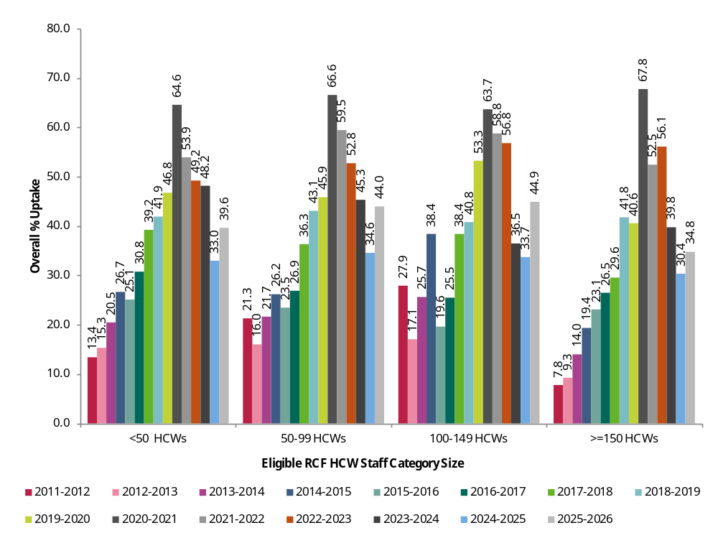
Supplementary Materials
Part 2 of 8
Supplementary Figure 1. Percentage uptake of seasonal influenza vaccine among HCWs in public RCFs by staff compliment size and season, 2011-2012 to 2025-2026
Seasonal influenza vaccine uptake by staff compliment size in public RCFs-Seasonal Trends
No obvious difference in seasonal influenza vaccine uptake between the different categories of staff compliment sizes in public RCFs is discernible over the course of the seasons since 2011-2012 (Supplementary Figure 1), all show an improvement in uptake however, in 2025-2026

Slide 25
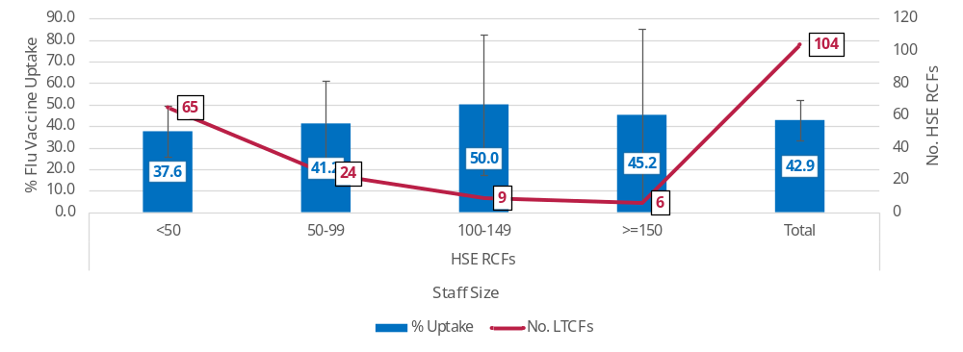
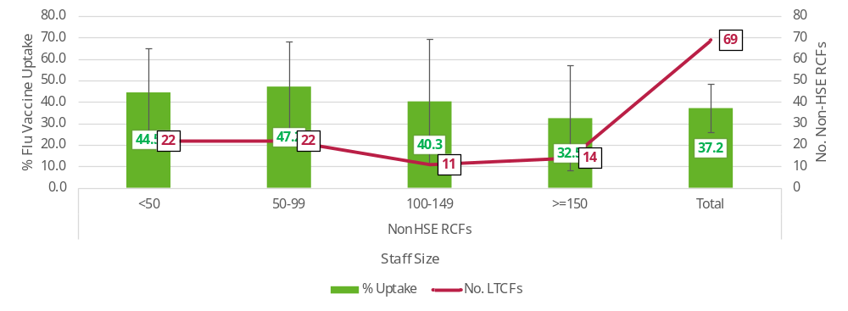
Supplementary Materials
Part 3 of 4
Supplementary Figure 2a. Percentage uptake of seasonal influenza vaccine among HCWs in public RCFs by staff compliment size, 2025-2026
Seasonal influenza vaccine uptake by staff compliment size in RCFs
In 2025-2026, seasonal influenza vaccine uptake was lowest in the <50 staff size category compared to all the others (50-99 100-149 and >150) in public RCFs unlike private RCFs where uptake was lowest in the >=150 category (Supplementary Figures 2a,2b), but this difference was not statistically significant.
Supplementary Figure 2b. Percentage uptake of seasonal influenza vaccine among HCWs in private RCFs by staff compliment size, 2025-2026

Slide 26
Supplementary Materials
Part 4 of 8
Eligible RCF staff denominator data used in this graph have been sorted from smallest to highest
Funnel plots are a form of scatter plot in which observed area rates are plotted against area populations. Control limits are then overlaid on the scatter plot. The control limits represent the expected variation in rates assuming that the only source of variation is stochastic (i.e. having a random probability distribution or pattern that may be analysed statistically, but may not be predicted precisely).
A p chart is an attributes control chart used with data collected in subgroups of varying sizes such as counties with different population densities.
A p prime chart is an alternative to the standard P chart when the denominators are large and when there is over or under dispersion in the data.
A p prime funnel chart is a variation of the p prime chart.
For more information on SPC charts and funnel plots, please refer to the Quality and Patient Safety Data for Decision Making Toolkit, available here: https://www.lenus.ie/bitstream/handle/10147/635034/Quality%20and%20Patient%20Safety%20Data%20for%20Decision%20Making%20Toolkit.pdf?sequence=10&isAllowed=y.
Explanatory notes about P prime funnel charts on slides #12,13

Slide 27
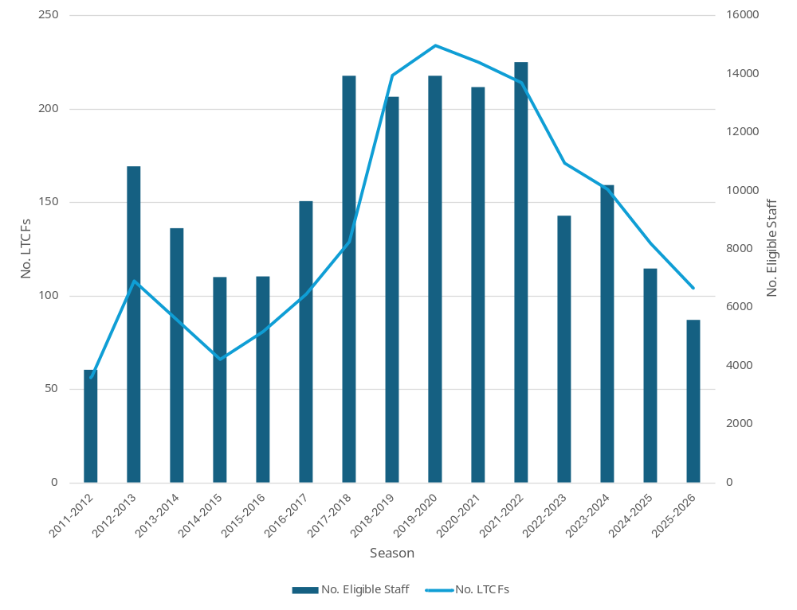
Supplementary Materials
Part 5 of 8
Supplementary Figure 3. Number of participating public RCFs and eligible HCWs by season, 2011-2012 to 2025-2026 seasons
Seasonal influenza vaccine uptake among public RCF-based HCWs-The overall picture
Since the 2021-2022 season, the number of eligible staff in the participating RCFs has risen.
Even though the overall vaccine uptake levels have increased in 2025-2026, the eligible staff count continues to fall as the level of RCF survey participation declines (Supplementary Figure 3).

Slide 28
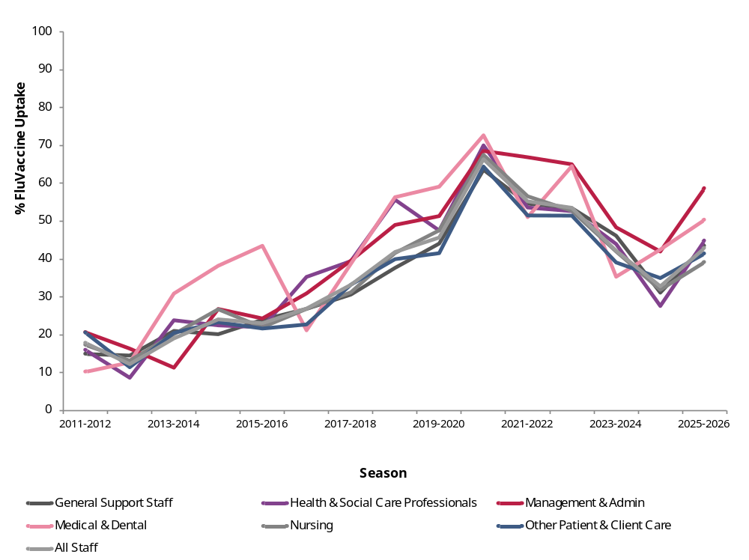
Supplementary Materials
Part 6 of 8
Supplementary Figure 4. Percentage uptake of seasonal influenza vaccine among public RCF-based HCWs by staff type and season, 2011-2012 to 2025-2026
Seasonal influenza vaccine uptake by staff type in public RCFs-Seasonal Trends
Uptake among all categories of staff mirrors the overall increase observed in 2025-2026 (Supplementary Figure 4).

Slide 29
Supplementary Materials
Part 7 of 8
Supplementary Table 3a. Sources of eligible HCW figures cited by participating RCFs, 2025-2026 season
Sources of information used to collate the number of ELIGIBLE RCF based HCWs | Total | % Total
Person In Charge | 76 | 43.9
HR office | 14 | 8.1
Other | 21 | 12.1
Person In Charge, Other | 8 | 4.6
Person In Charge, HR office | 7 | 4.0
HR office, Other | 2 | 1.2
HSE Region HR office, Other | 1 | 0.6
Person In Charge, HR office, HSE Region HR office | 1 | 0.6
Person In Charge, HR office, Other | 1 | 0.6
Person In Charge, HSE Region HR office | 1 | 0.6
Person In Charge, HSE Region HR office, National HR office of HSE, Other | 1 | 0.6
Person In Charge, National HR office of HSE | 1 | 0.6
Person In Charge,Unsure | 1 | 0.6
Unsure/Unspecified | 38 | 22.0
Total no. of survey participating RCFs | 173 | 100.0
Sources of eligible HCWs and vaccine uptake information cited by participating RCFs
76 of the 173 (43.9%) survey participating RCFs cited the person in charge as the sole source of information for eligible staff counts followed by HR office (n=14; 8.1%) and where the person in charge and some other data source (n=21; 12.1%) was used (Supplementary Table 3a).
38 RCFs (22.0%) were unsure or did not specify a data source.

Slide 30
Supplementary Materials
Part 8 of 8
Supplementary Table 3.2 Sources of vaccinated HCW figures cited by participating RCFs, 2025-2026 season
Sources of information used to collate the number of VACCINATED RCF-based HCWs | Total | % Total
Person In Charge | 39 | 22.5
Self-reporting by HCWs | 22 | 12.7
Local RCF records | 10 | 5.8
NIIS/COVAX system portal | 7 | 4.0
Other | 6 | 3.5
Person In Charge, Self-reporting by HCWs | 19 | 11.0
Person In Charge, Local LTCF records, Self-reporting by HCWs | 7 | 4.0
Person In Charge, Local LTCF records | 4 | 2.3
Person In Charge, NIIS/COVAX system portal, Local LTCF records | 1 | 0.6
Person In Charge, NIIS/COVAX system portal, Local LTCF records, Self-reporting by HCWs | 1 | 0.6
Person In Charge, NIIS/COVAX system portal, Self-reporting by HCWs | 1 | 0.6
Person In Charge,Self-reporting by HCWs,Other | 1 | 0.6
Person In Charge,Other | 1 | 0.6
NIIS/COVAX dashboard, Self-reporting by HCWs, Other | 1 | 0.6
NIIS/COVAX system portal, Local LTCF records | 2 | 1.2
NIIS/COVAX system portal, Local LTCF records, Self-reporting by HCWs | 2 | 1.2
NIIS/COVAX system portal, Self-reporting by HCWs | 2 | 1.2
Local LTCF records,Self-reporting by HCWs | 5 | 2.9
Local LTCF records,Self-reporting by HCWs,Other | 1 | 0.6
Self-reporting by HCWs,Other | 3 | 1.7
Unsure/Unspecified | 38 | 22.0
Total no. of survey participating RCFs | 173 | 100
Sources of eligible HCWs and vaccine uptake information cited by participating RCFs
39 of the 173 (22.5%) survey participating RCFs cited the person in charge as the sole source of information for vaccinated staff counts followed by self-reporting by HCWs only (n-22; 12.7%), local RCF records (n=10; 5.8%) and NIIS/COVAX system portal only (n=7; 4.0%) (Supplementary Table 3b).
38 RCFs (22.0%) were unsure or did not specify a data source or did not have access to data.
Note: NIIS/COVAX= HSE National Integrated Information Services (IIS) and COVAX Implementation system

