Slide 1


Annual Epidemiological Report
Survey: Seasonal Influenza Vaccination Among Hospital-based Health Care Workers (HCWs)
2025-2026 Season
A report from the Vaccine Preventable Disease Team, HPSC¹
Report prepared by: VPD Team, HPSC
^{Published October 2026}
Published by:
Health Protection Surveillance Centre, 25-27 Middle Gardiner St, Dublin 1 Ireland.
t: +353 1 8765300
© Health Protection Surveillance Centre, 2026
Citation Text:
HSE Health Protection Surveillance Centre (2026). Survey: Seasonal Influenza Vaccination Among Hospital-based HCWs, 2025-2026 Season
Reproduction is authorised, provided source is acknowledged
¹The Vaccine Preventable Disease Team is part of the Health Protection Surveillance Centre, National Health Protection Office, Health Service Executive

Slide 2


Introduction
Seasonal influenza Vaccination
What are the key messages in this report?
Surveys on hospital-based health care workers (HCWs) uptake of the seasonal influenza vaccine have been conducted annually each winter season since 2011-2012
Uptake among HCWs in all 59 public and private participating hospitals in 2025-2026 was 51.7%
Influenza vaccine uptake reached its peak among public hospital-based HCWs at 71.4% in 2020-2021
In contrast, the uptake for public hospital-based only HCWs in the latest 2025-2026 survey was 53.0%, an increase of 7.5% from the previous season
In 2025-2026, HSE Dublin and South East hospitals reported the highest uptake at 63.0%. The lowest uptake was reported in HSE West and North West hospitals at 39.9% (see slide #8)
Each of the hospital groups reported an increase in uptake since the previous season. Uptake among private hospitals (outside regional areas) also reported increased
Across all six categories of staff, uptake increased since the last season
Uptake was highest among health social care professional st 67.7%, followed closely by medical and dental staff (67.3%)
Uptake was lowest among other patient and client care staff at 34.7% (see slide #9)
Each category of staff compliment size showed an increase in uptake since the previous season
In the 2025-2026 season no difference in uptake between the different categories of staff sizes was apparent (see slide #26, Supplementary section)
1. In this 2025-2026 season HCW-based survey, vaccine uptake was
  53.0% for public hospitals only
  51.7% for public and private hospitals
2. The downward trend in influenza vaccine uptake among HCWs based in public hospitals that was observed since the 2021-2022 season has halted and uptake increased from 45.4% in 2024/2025 season to 53.0% in the 2025/2026 season
3. Participation by public and private hospitals in the latest annual survey has improved since the 2024-2025 with all 52 public hospitals (excluding the National Children’s Hospital*) providing returns. The number of private hospital survey returns remains (n=7) unchanged since the previous season.
Note: The raw data used to develop the content of this report are available in both Appendix 2 and in a link at the end of this power-point document.
*No influenza vaccine uptake data was reported for HCWs based at the National Children's Hospital Ireland (NCHI) (which has not yet opened as they were vaccinated in Children's Health Ireland Hospital at Crumlin

Slide 3
Methodology
This HSE-HPSC survey reports on the uptake of the influenza vaccine in HCWs for the 2025-2026 season.
The survey presents results based on a number of data sources available to participants, focussing on returns obtained from acute hospitals, of which there were 53 public (HSE managed/staffed and funded, which includes the not yet fully opened National Children Hospital) and 13 private targeted, a total of 66 in all.
The survey was undertaken on 2nd March 2026 for final returns.
Validation of returns was completed on 2nd June 2026. The survey was conducted online using the Qualtrics platform.
Among the key questions asked in the survey include:
  Number of eligible HCWs for each of the six official categories of staff (General Support Staff, Health & Social Care Professionals, Management & Admin, Medical & Dental, Nursing and Other Patient & Client Care)
  Sources of information to collate the number of eligible and vaccinated HCWs
Nationally, the HSE target influenza vaccine uptake for hospital-based HCWs of 75% remained unchanged from the previous season. All HSE manged/staffed/funded acute hospitals are obliged to participate in the annual survey whereas non HSE (section 38, 39 and privately run) hospitals are not but are welcome to.
What background information is relevant when reading this report and how was it conducted?
What is the annual HPSC Hospital-based HCW survey?
How many acute hospitals are there, both public and private?
When was the survey conducted?
How were the survey returns collated?
What were the key questions asked in the survey?
What is the target vaccine uptake?

Slide 4
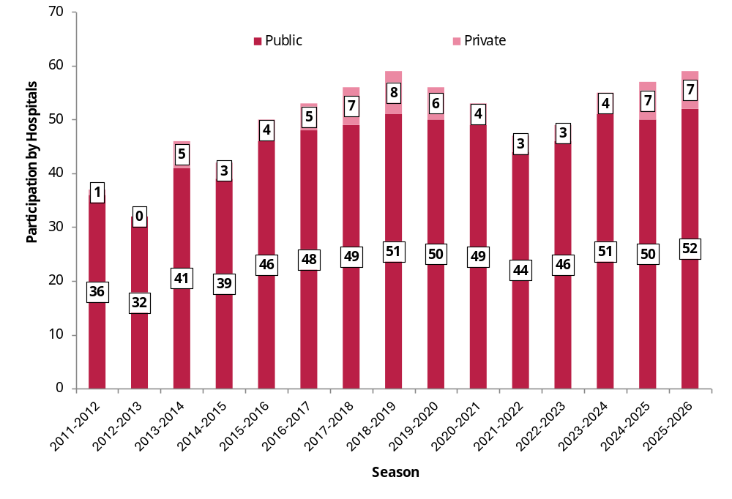
Results
Part 1 of 8
Figure 1. Number of participating hospitals by funding model by season, 2011-2012 to 2025-2026
Survey participation by hospitals/response rate as a percentage of total
In 2025-2026 season, 52 acute public hospitals (excluding the National Children's Hospital Ireland (NCHI*)) participated in the survey. In contrast 7 out of 13 (53.9%) private hospitals did so (Figure 1).
Completion of HPSC annual surveys on HCW vaccine uptake by private hospitals is not obligatory and it is one reason why the overall numbers of participating hospitals can vary season to season (Figure 1).
Since 2017-2018 participation by public hospitals has been generally high.
*No influenza vaccine uptake data was reported for HCWs based at the National Children's Hospital Ireland (NCHI) (which has not yet opened) as they were vaccinated in Children's Health Ireland Hospital at Crumlin

Slide 5
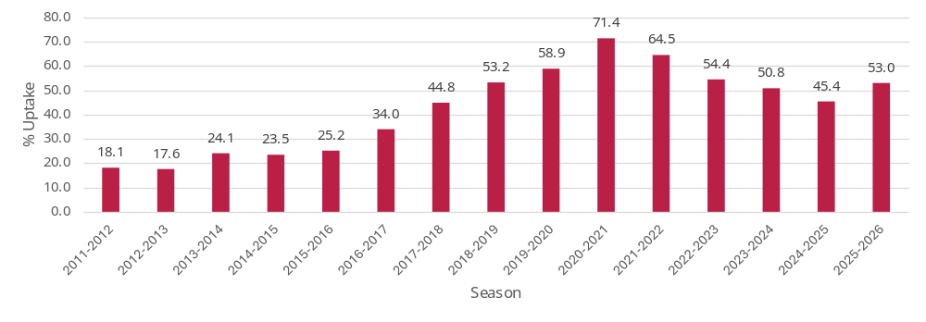
Results
Part 2 of 8
Table 1. Eligible and vaccinated public hospital HCWs for the seasonal influenza vaccine by season and key metrics, 2011-2012 to 2025-2026 seasons
SECTION A: SEASONAL INFLUENZA
Season | No. Eligible Staff | No. Vaccinated Staff | Overall % Uptake | Average % Uptake | Range % Uptake | No. Hospitals
2011-2012 | 45058 | 8157 | 18.1 | 19.1 | 5.01-39.98 | 36
2012-2013 | 41490 | 7293 | 17.6 | 15.3 | 3.48-38.79 | 32
2013-2014 | 47760 | 11517 | 24.1 | 20.7 | 2.56-45.87 | 41
2014-2015 | 49917 | 11723 | 23.5 | 22.0 | 1.12-47.53 | 39
2015-2016 | 57494 | 14474 | 25.2 | 22.6 | 6.89-47.04 | 46
2016-2017 | 62324 | 21195 | 34.0 | 32.0 | 6.41-63.7 | 48
2017-2018 | 64554 | 28947 | 44.8 | 44.2 | 13.75-74.76 | 49
2018-2019 | 66857 | 35585 | 53.2 | 52.3 | 21.95-84.78 | 51
2019-2020 | 67452 | 39721 | 58.9 | 56.6 | 26.19-91.32 | 50
2020-2021 | 70263 | 50183 | 71.4 | 70.8 | 34.69-89.2 | 49
2021-2022 | 65947 | 42541 | 64.5 | 63.0 | 37.34-91.64 | 44
2022-2023 | 72512 | 39477 | 54.4 | 53.8 | 24.42-89.84 | 46
2023-2024 | 77588 | 39411 | 50.8 | 50.4 | 18.37-80.74 | 51
2024-2025 | 83687 | 38031 | 45.4 | 45.1 | 17.2-72.81 | 50
2025-2026 | 86744 | 45944 | 53.0 | 51.3 | 25.84-78.14 | 52
Seasonal influenza vaccine uptake among public acute hospital HCWs-The overall picture
Between the 2021-2022 and 2024-2025 seasons there had been a decline in influenza uptake in public hospital HCWs from 64.5% to 45.4%.
In the latest 2025-2026 season, however, the uptake increased to 53.0% (Table 1, Figure 2).
The latest uptake is approaching the uptake level recorded in 2019-2020, when it was 58.9%, just before the COVID-19 pandemic.
Figure 2. Percentage uptake of influenza vaccine among public hospital HCWs by season, 2011-2012 to 2025-2026 seasons

Slide 6
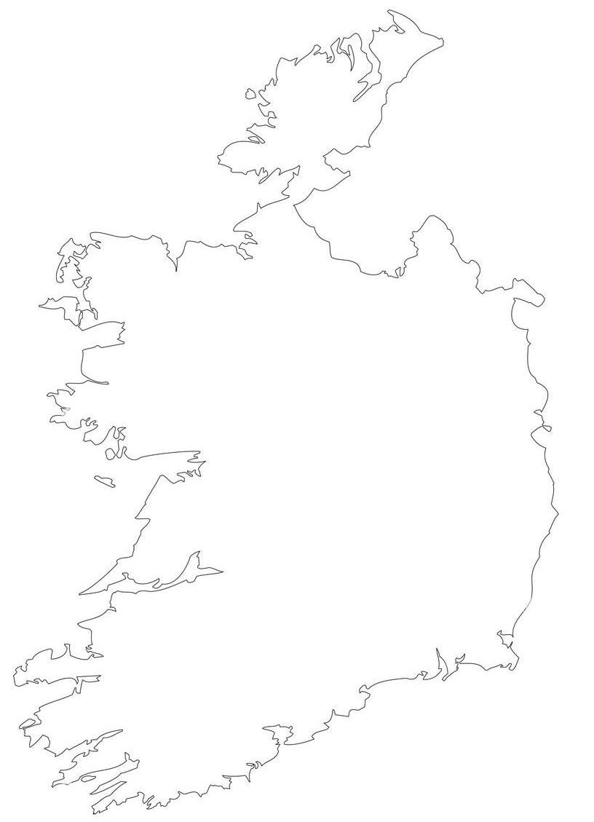
Results
Part 3 of 8
Table 2. Uptake of the seasonal influenza vaccine among hospital–based HCWs by staff type and HSE region, 2025-2026 season
SECTION A: SEASONAL INFLUENZA
HSE Region | No. Hospitals | % Uptake Total | % Uptake Management & Administration | % Uptake Medical & Dental | % Uptake Health & SocialCare | % Uptake Nursing | % Uptake General Support | % Uptake Other Patient & ClientCare
Dublin and Midlands Hospitals* | 11 | 59.8 | 50.5 | 74.0 | 74.4 | 60.6 | 48.0 | 38.1
Dublin and North East Hospitals | 11 | 47.8 | 37.8 | 57.5 | 58.4 | 50.5 | 37.9 | 31.3
Dublin and South East Hospitals | 11 | 63.0 | 57.8 | 74.3 | 88.5 | 56.4 | 60.9 | 46.7
Mid West Hospitals | 6 | 61.4 | 49.1 | 82.5 | 78.8 | 63.8 | 43.7 | 39.8
South West Hospitals | 7 | 46.4 | 45.2 | 57.3 | 57.4 | 46.0 | 32.6 | 30.5
West and North West Hospitals | 6 | 39.9 | 27.9 | 66.1 | 50.0 | 37.0 | 29.4 | 24.0
Outside Regional Areas/Private | 7 | 37.1 | 39.1 | 45.6 | 41.9 | 38.2 | 26.8 | 24.0
Total excl private | 52 | 53.0 | 44.8 | 67.3 | 67.7 | 52.2 | 42.9 | 34.7
Total incl private | 59 | 51.7 | 44.2 | 66.4 | 65.0 | 51.1 | 40.9 | 34.1
Seasonal influenza vaccine uptake among hospital-based HCWs by HSE region
HSE Dublin and South East reported the highest vaccine uptake at 63.0% and HSE West and North West the lowest at 39.9%.
Uptake was highest among health and social care staff at 67.7% (Table 2).
Uptake was lowest among other patient and client care staff at 34.7% (34.1% when private hospitals are included)
See supplementary slide #26 for more details on eligible staff numbers by HSE region and staff category
Note: Outside regional areas refers to private hospitals outside of HSE administration regions
*No influenza vaccine uptake data was reported for HCWs based at the National Children's Hospital Ireland (NCHI) (which has not yet opened) as they were vaccinated in Children's Health Ireland Hospital at Crumlin

Slide 7
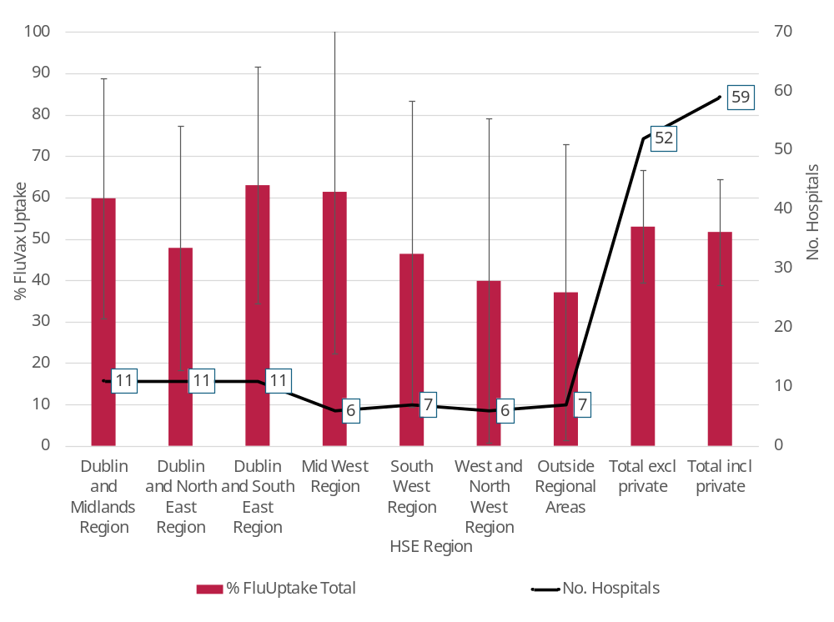
Results
Part 4 of 8
Figure 3. Uptake among hospital–based HCWs for the seasonal influenza vaccine by HSE region, 2025-2026 season, with 95% CIs
SECTION A: SEASONAL INFLUENZA
Seasonal influenza vaccine uptake by HSE region-The overall picture
No HSE region had a seasonal influenza vaccine uptake that was significantly different from the total uptake reported for all hospitals (Figure 3).
Note: Outside regional areas refers to private hospitals outside of HSE administration regions

Slide 8
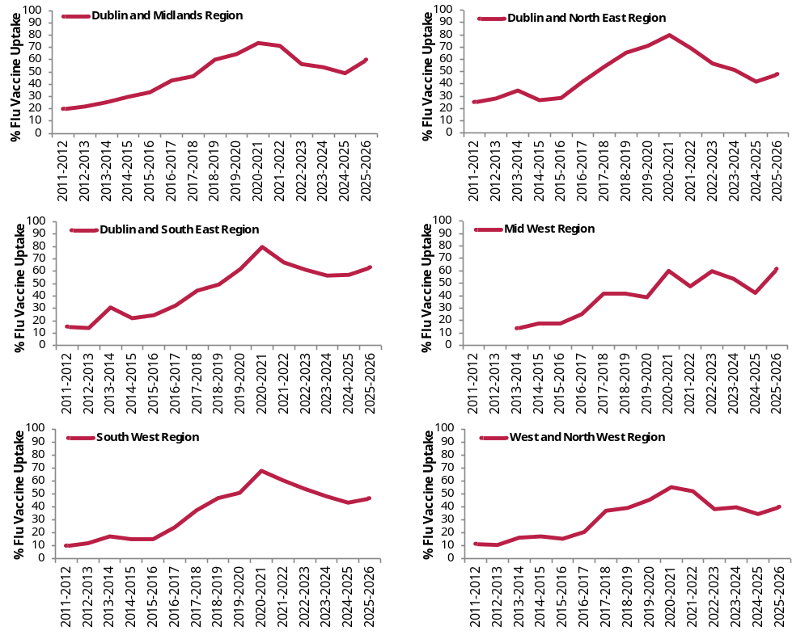
Results
Part 5 of 8
Figures 4a-4f. Percentage uptake of seasonal influenza vaccine among HCWs by HSE region and season, 2011-2012 to 2025-2026
SECTION A: SEASONAL INFLUENZA
Seasonal influenza vaccine uptake by HSE region-Seasonal Trends, 2011-2012 to 2025-2026
An upward seasonal trend in seasonal influenza vaccine uptake is evident across all HSE regions since the 2024-2025 season (Figures 4a-4f).

Slide 9
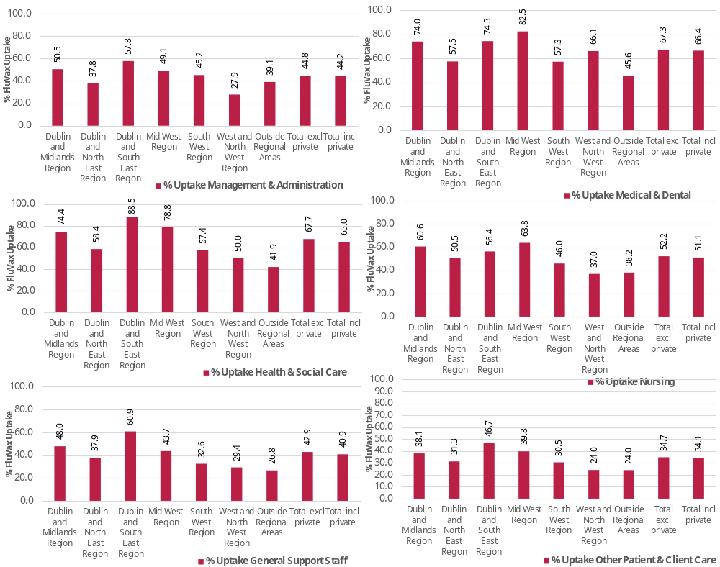
Results
Part 6 of 8
Figures 5a-5f. Uptake among hospital–based HCWs for the seasonal influenza vaccine by HSE region, and staff type, 2025-2026
SECTION A: SEASONAL INFLUENZA
Seasonal influenza vaccine uptake among different categories of staff and HSE region
Across all categories of staff, uptake was highest in the Dublin and South East and Mid West regions (Figures 5a-5f) .
Apart from the South West region, uptake was highest among medical and dental staff (see graph left in top-right hand corner) .
Uptake was lowest among other patient and client care staff in the West and North West region (see graph left in bottom-right hand corner) .
Note: Outside regional areas refers to private hospitals outside of HSE administration regions

Slide 10
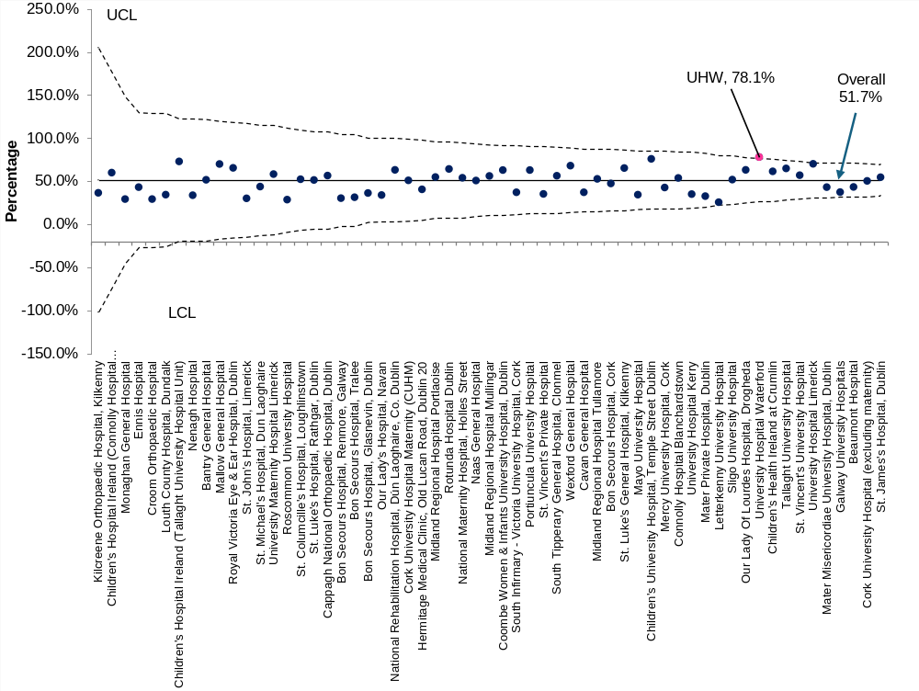
Results
Part 7 of 8
Figure 6. Funnel chart of percentage uptake of seasonal influenza vaccine among HCWs by hospital with mean uptake with 95% confidence limits (CL), 2025-2026 season
SECTION A: SEASONAL INFLUENZA
P prime funnel chart of hospital HCW seasonal influenza vaccine uptake
A funnel chart was applied to the influenza vaccine uptake among HCWs in the participating acute hospitals to identify the true performance outliers by accounting for differences in hospital size (sample size variation).
One hospital, University Hospital Waterford, reported a seasonal influenza vaccine uptake of 78.1% that was significantly above the overall uptake for all hospitals (public and private) of 51.7% (indicated in the graph).
No hospital had a significantly below this uptake level (Figure 6).
See supplementary notes on slide #22 for explanatory notes about P prime funnel charts

Slide 11
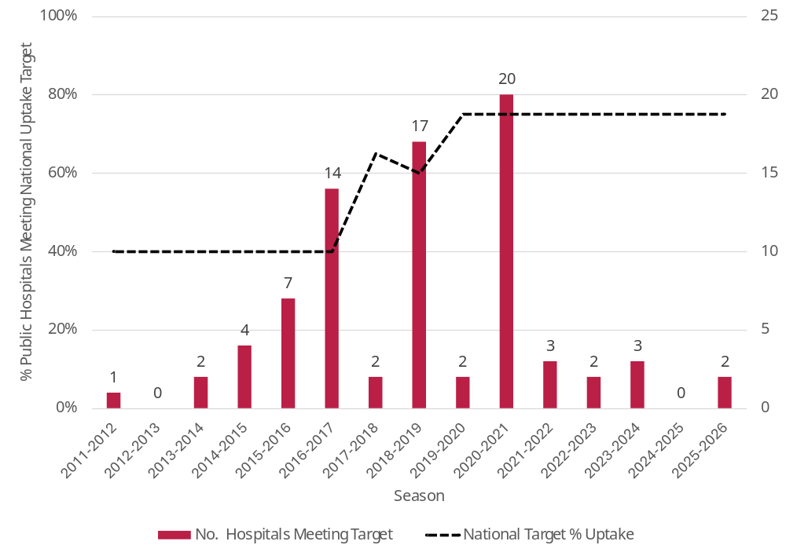
Results
Part 8 of 8
Figure 7. Number of participating public hospitals meeting the national seasonal influenza vaccine target by season, 2011-2012 to 2025-2026
SECTION B: National vaccine uptake targets
Seasonal influenza vaccination:
The number of participating public hospitals that met the national uptake of 75% reached its highest level of 20 during the 2020-2021 season when the uptake was 71.4% (Figure 7).
Since then, the number meeting that same target has fallen sharply and for the 2025-2026 season, only two hospitals met it.

Slide 12
Caveats
There are limitations in these data…
Reporting bias
Acute hospitals that have access to NIIS§ dashboard/portal for vaccination details of their staff or that maintain their own staff vaccination records are more likely to submit a complete survey return.
2 . Representation Bias
Of the estimated 13 private hospitals, seven participated in the latest survey
Private hospitals are not obliged to report their vaccine uptake reports, but for those who do not, it means that the nationwide vaccination coverage reporting of this survey is less complete than would otherwise be the case.
The absence of reporting by any hospital, including a private one, is unfortunate. In 2025-2026, not all acute hospitals* submitted complete returns, which means that a full compliment of responses from all acute hospitals is again not reflected in the latest survey results.
There may be a number of reasons why uptake in the private hospitals was considerably lower than that of public hospitals, among these is how staff denominators are defined and the level of access to NIIS in each hospital.
* see caveat on slide #7 regarding the National Children's Hospital Ireland (NCHI)
What do I need to know about how the data for this report was collected?
Results from HPSC vaccination surveys are subject to both reporting and representation/participation bias
Factors:
  Administrative: out of date contact details held by HPSC, high turnover in local reporting staff
  Technical: Lack of IT hardware, software, knowhow by local staff, online access
3. Sources of Information-Limited access to NIIS/COVAX portal or dashboard
47 of the 59 (79.7%) survey participating hospitals in 2025-2026 cited the HR office as the sole source of information for vaccinated staff counts by staff category, possibly because the quality of their own staff vaccination data sources was more accurate (or there was no other alternative available to them).
§ NIIS -National Integrated Information System, formerly called COVAX/IIS= HSE Integrated Information Services (IIS) and COVAX Implementation system,

Slide 13
General Conclusions
The recent upward swing in HCW seasonal influenza vaccine uptake is a positive development
Factors that impact negatively on the capture of influenza vaccine uptake in HCWs’ place of work
What can we interpret from the findings in this report about vaccination?
Between 2024-2025 and 2025-2026, uptake among all hospital-based HCWs rose from 44.5% (45.4% among public hospitals) to 51.7% (53.0% among public hospitals). This marked increase has occurred on foot of concerted efforts to implement a number of HSE initiatives through the allocation of considerable resources designed to arrest the downward trend observed since 2020-2021, including:
  On-going development and expansion of the National Integrated Information Service (NIIS) influenza vaccination record system
  Review and updating of infectious disease infection and control guidelines
  Improvements in the monitoring and surveillance of cases and outbreaks, including biostatistical modelling
  Concerted social media and communications campaigns to promote the protective health benefits of vaccines
Local hospital managers using the NIIS system not being able to validate where staff were working and in what capacity (staff category) if they choose to get vaccinated elsewhere, in GP clinics or in pharmacies, for example.
Local managers not having the means to query/correct inconsistencies and omissions on GP and pharmacy NIIS records.
Training of vaccinators and administrators on the NIIS input systems being subject to significant turnover and a lack of consistency in relation to how HCW details are assigned to their correct place of work/vaccination and, to a lesser extent, their staff category type.
Seasonal Influenza vaccine
The recent positive turnaround in the uptake of the influenza vaccine among hospital–based HCWs is welcome news.
This positive change was broadly seen in that it occurred across all hospital groups/regions, all types of staff and in all categories of staff compliment sizes.
Only two out of 59 hospitals (3.4%) exceeded the national influenza vaccine uptake target of 75% in the most recent 2025-2026 survey
No hospital group/region reported an uptake that was significantly above (or below) the overall mean uptake.

Slide 14
General Conclusions
Underlying factors that impact vaccine uptake
Implications of low vaccine uptake among hospital-based HCWs
What can we interpret from the findings in this report about vaccination?
The decline uptake among HCWs in hospitals between the 2020-2021 and 2024-2025 can partly be attributed to a range of technical, administrative and behavioural factors (see also slide #18), but many of these have been targeted for improvement during the 2025-2026 season
Bridging the gap between actual and reported uptake is an on-going technical challenge for any data collection process, but as long as it is undertaken consistently over time, the trends observed in this survey are likely to be genuine.
Greater pressure on hospital services during the peak winter months arising from unvaccinated HCWs transmitting infection to each other and to their patients and, also, arising from staff who are absent from sick leave.
The positive inflexion in the uptake of the seasonal influenza vaccine among hospital-based HCWs is welcome news following the considerable resources and efforts that have been assigned to addressing the downward trend observed between 2020-2021 and 2024-2025 seasons.
The likelihood that the key performance target of 75% for seasonal influenza vaccine uptake will be reached in the next few seasons, however, remains low without a sustained public health effort, he maintenance of significant input of resources, including financial, and a change in vaccine hesitancy views held by some HCWs.
Importance of HPSC vaccine uptake survey
The survey itself fulfils a useful purpose as it provides a comprehensive profile of acute hospital HCW uptake that other reports do not provide

Slide 15
General Conclusions
Increasing hospital survey participation/reporting and their access to the NIIS portal/vaccination dashboards
Addressing data reporting/validation concerns
Recommendations
Increasing hospital survey participation/reporting and their access to the NIIS portal/vaccination dashboards
Address data reporting/validation concerns
Further research to guide more effective public health strategies
Ensure HCW status is accurately captured on NIIS
In order to minimise reporting and representation bias in future surveys and improve vaccination coverage
  All private hospitals need to be encouraged to report their HCW vaccination figures
  Access to NIIS resources should be granted to all hospitals, including private ones, in relation to their staff seasonal influenza vaccination uptake counts, regardless of whether the hospitals themselves conduct clinics or not
Need for data providers to access one single source of information, rather than a range of different data sources, in order to compile an accurate set of staff uptake figures that can then be reported.
Need for agreement among data providers that denominator values (eligible staff counts) are taken at the same point in time, for example, either from the beginning of the winter vaccination campaign or at the end of it and, also, that the same rules around how denominators are defined are universally applied for both public and private acute hospitals
Need for greater consistency with which HCW job titles are assigned by data providers to their correct HSE official category of staff.
Role of Research help gain insights that can guide more effective public health strategies
There is a need for ongoing, in-depth understanding of the personal, cultural, and contextual factors influencing HCWs' vaccination decisions and underlying barriers to vaccination

Slide 16
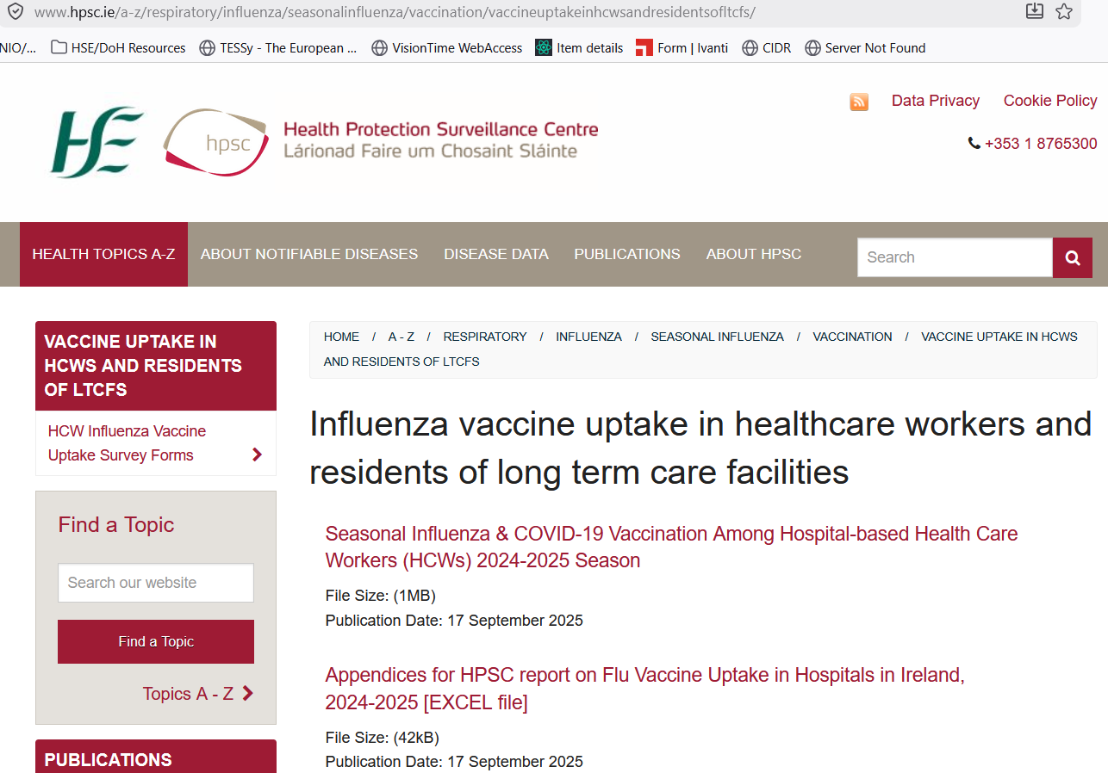
Acknowledgements & Further Information
Acknowledgements
Thanks to all acute hospitals that provided information for this report. All gratefully received.
Further information available on HPSC website:
Link here to survey reports on seasonal influenza vaccine uptake in healthcare workers and residents of long-term care residential facilities

Slide 17
Appendices (continued)
Hospital Group | Hospital | Total Eligible | Total Vaccinated | % Total FluVaxUptake
Dublin and Midlands Hospitals | Tallaght University Hospital | 3694 | 2405 | 65.1
 | Naas General Hospital | 1088 | 555 | 51.0
 | Coombe Women & Infants University Hospital, Dublin | 1177 | 742 | 63.0
 | St. Luke's Hospital, Rathgar, Dublin | 608 | 314 | 51.6
 | Children's Health Ireland at Crumlin | 3249 | 2003 | 61.6
 | Children's Hospital Ireland (Tallaght University Hospital Unit) | 384 | 281 | 73.2
 | Children's University Hospital, Temple Street Dublin | 1728 | 1315 | 76.1
 | St. James's Hospital, Dublin | 5863 | 3213 | 54.8
 | Midland Regional Hospital Mullingar | 1161 | 654 | 56.3
 | Midland Regional Hospital Portlaoise | 996 | 548 | 55.0
 | Midland Regional Hospital Tullamore | 1480 | 784 | 53.0
Dublin and Midlands Hospitals Total |  | 21428 | 12814 | 59.8
Dublin and North East Hospitals | Rotunda Hospital Dublin | 1000 | 644 | 64.4
 | Our Lady's Hospital, Navan | 814 | 278 | 34.2
 | Cappagh National Orthopaedic Hospital, Dublin | 608 | 345 | 56.7
 | Children's Hospital Ireland (Connolly Hospital Blanchardstown) | 123 | 74 | 60.2
 | Cavan General Hospital | 1470 | 547 | 37.2
 | Our Lady Of Lourdes Hospital, Drogheda | 2811 | 1782 | 63.4
 | Louth County Hospital, Dundalk | 324 | 112 | 34.6
 | Mater Misericordiae University Hospital, Dublin | 4808 | 2085 | 43.4
 | Connolly Hospital Blanchardstown | 1793 | 967 | 53.9
 | Beaumont Hospital | 5111 | 2223 | 43.5
 | Monaghan General Hospital | 207 | 61 | 29.5
Dublin and North East Hospitals Total |  | 19069 | 9118 | 47.8
Dublin and South East Hospitals | South Tipperary General Hospital, Clonmel | 1314 | 741 | 56.4
 | St. Vincent's University Hospital | 4040 | 2308 | 57.1
 | University Hospital Waterford | 3024 | 2363 | 78.1
 | St. Luke's General Hospital, Kilkenny | 1567 | 1026 | 65.5
 | Wexford General Hospital | 1380 | 941 | 68.2
 | St. Columcille's Hospital, Loughlinstown | 574 | 301 | 52.4
 | St. Michael's Hospital, Dun Laoghaire | 469 | 206 | 43.9
 | Kilcreene Orthopaedic Hospital, Kilkenny | 82 | 30 | 36.6
 | National Maternity Hospital, Holles Street | 1023 | 554 | 54.2
 | National Rehabilitation Hospital, Dún Laoghaire, Co. Dublin | 822 | 520 | 63.3
 | Royal Victoria Eye & Ear Hospital, Dublin | 430 | 282 | 65.6
Dublin and South East Hospitals Total |  | 14725 | 9272 | 63.0
Mid West Hospitals | University Hospital Limerick | 4613 | 3248 | 70.4
 | University Maternity Hospital Limerick | 481 | 281 | 58.4
 | Croom Orthopaedic Hospital | 319 | 94 | 29.5
 | Ennis Hospital | 315 | 136 | 43.2
 | Nenagh Hospital | 384 | 130 | 33.9
 | St. John’s Hospital, Limerick | 443 | 134 | 30.2
Mid West Hospitals Total |  | 6555 | 4023 | 61.4
South West Hospitals | South Infirmary - Victoria University Hospital, Cork | 1214 | 453 | 37.3
 | Cork University Hospital (excluding maternity) | 5304 | 2675 | 50.4
 | University Hospital Kerry | 1827 | 643 | 35.2
 | Cork University Hospital Maternity (CUHM) | 852 | 436 | 51.2
 | Mallow General Hospital | 414 | 290 | 70.0
 | Mercy University Hospital, Cork | 1739 | 746 | 42.9
 | Bantry General Hospital | 390 | 202 | 51.8
South West Hospitals Total |  | 11740 | 5445 | 46.4
West and North West Hospitals | Sligo University Hospital | 2441 | 1272 | 52.1
 | Portiuncula University Hospital | 1269 | 800 | 63.0
 | Galway University Hospitals | 4975 | 1865 | 37.5
 | Letterkenny University Hospital | 2329 | 602 | 25.8
 | Mayo University Hospital | 1684 | 581 | 34.5
 | Roscommon University Hospital | 529 | 152 | 28.7
West and North West Hospitals Total |  | 13227 | 5272 | 39.9
Outside Regional Areas | Hermitage Medical Clinic, Old Lucan Road, Dublin 20 | 893 | 364 | 40.8
 | Mater Private Hospital, Dublin | 1964 | 647 | 32.9
 | St. Vincent's Private Hospital | 1271 | 449 | 35.3
 | Bon Secours Hospital, Glasnevin, Dublin | 811 | 295 | 36.4
 | Bon Secours Hospital, Cork | 1515 | 721 | 47.6
 | Bon Secours Hospital, Tralee | 676 | 214 | 31.7
 | Bon Secours Hospital, Renmore, Galway | 675 | 206 | 30.5
Outside Regional Areas Total |  | 7805 | 2896 | 37.1
Regional Areas Only |  | 86744 | 45944 | 53.0
Total |  | 94549 | 48840 | 51.7
Appendix 2: List of participating hospitals in the 2025-2026 survey with details of their overall eligible and vaccinated staff numbers for seasonal influenza
An excel file listing of the 59 participating hospitals in the 2025-2026 survey with details of the eligible and influenza (flu) vaccinated staff by HSE category is available to download here

Slide 18
Supplementary Materials
Part 1 of 6
Supplementary Table 1. Eligible and vaccinated hospital–based HCWs for the seasonal influenza vaccine by staff type and HSE region, 2025-2026 season
Hospital Group/Region | No. Hospitals | Total Eligible | Total Vaccinated | Eligible Management & Administration | Vaccinated Management & Administration | Eligible Medical & Dental | Vaccinated Medical & Dental | Eligible Health & SocialCare | Vaccinated Health & SocialCare | Eligible Nursing | Vaccinated Nursing | Eligible General Support | Vaccinated General Support | Eligible Other Patient & ClientCare | Vaccinated Other Patient & ClientCare | Other VaccinatedStaff Not On HR payroll
Dublin and Midlands Hospitals | 11 | 21428 | 12814 | 3483 | 1759 | 3033 | 2243 | 3117 | 2320 | 8218 | 4978 | 1541 | 739 | 2036 | 775 | 1117
Dublin and North East Hospitals | 11 | 19069 | 9118 | 2775 | 1050 | 3008 | 1730 | 2397 | 1401 | 7411 | 3739 | 1667 | 631 | 1811 | 567 | 857
Dublin and South East Hospitals | 11 | 14725 | 9272 | 2100 | 1214 | 2134 | 1585 | 1848 | 1636 | 5973 | 3368 | 1566 | 953 | 1104 | 516 | 390
Mid West Hospitals | 6 | 6555 | 4023 | 904 | 444 | 935 | 771 | 680 | 536 | 2639 | 1684 | 829 | 362 | 568 | 226 | 34
South West Hospitals | 7 | 11740 | 5445 | 1565 | 708 | 1693 | 970 | 1522 | 874 | 4789 | 2203 | 1310 | 427 | 861 | 263 | 58
West and North West Hospitals | 6 | 13227 | 5272 | 1913 | 533 | 1992 | 1317 | 1667 | 834 | 5314 | 1966 | 1106 | 325 | 1235 | 297 | 44
Outside Regional Areas | 7 | 7805 | 2896 | 1444 | 565 | 568 | 259 | 1290 | 541 | 2955 | 1129 | 1114 | 298 | 434 | 104 | 149
Total excl private | 52 | 86744 | 45944 | 12740 | 5708 | 12795 | 8616 | 11231 | 7601 | 34344 | 17938 | 8019 | 3437 | 7615 | 2644 | 2500
Total incl private | 59 | 94549 | 48840 | 14184 | 6273 | 13363 | 8875 | 12521 | 8142 | 37299 | 19067 | 9133 | 3735 | 8049 | 2748 | 2649
Seasonal influenza vaccine uptake among hospital-based HCWs by HSE region

Slide 19
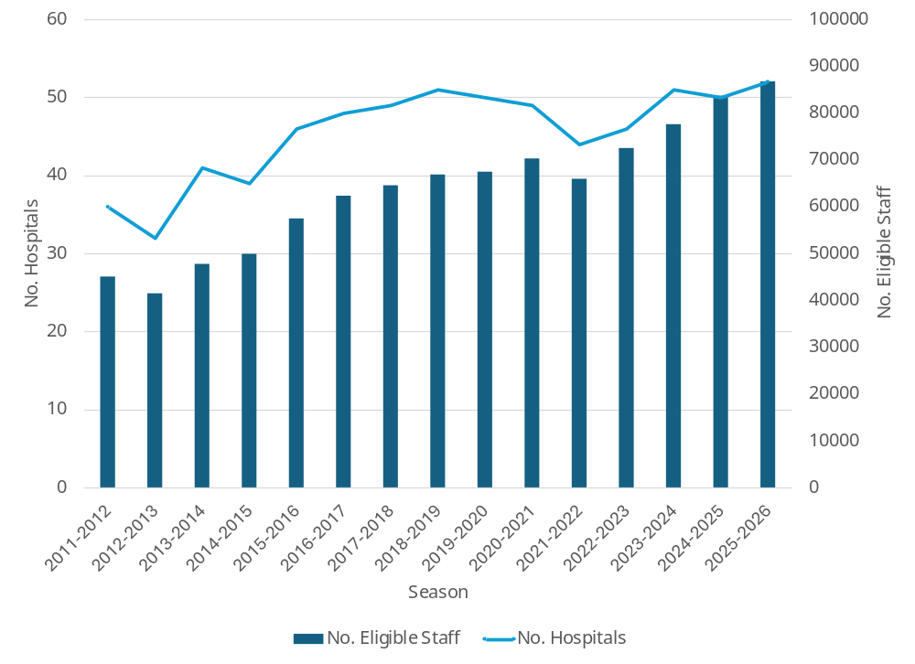
Supplementary Materials
Part 2 of 6
Supplementary Figure 1 Number of participating public hospitals and eligible HCWs by season, 2011-2012 to 2025-2026 seasons
Seasonal influenza vaccine uptake among hospital-based HCWs-The overall picture
Since 2021-2022 the number of eligible staff in the participating hospitals has risen.
While the downward trend in overall vaccine uptake levels have been halted (see next slide #6), the overall eligible staff count has risen because the number of participating hospitals has risen, which means that in 2025-2026, the absolute number of vaccinated HCWs has also increased (Supplementary Figure 1).

Slide 20
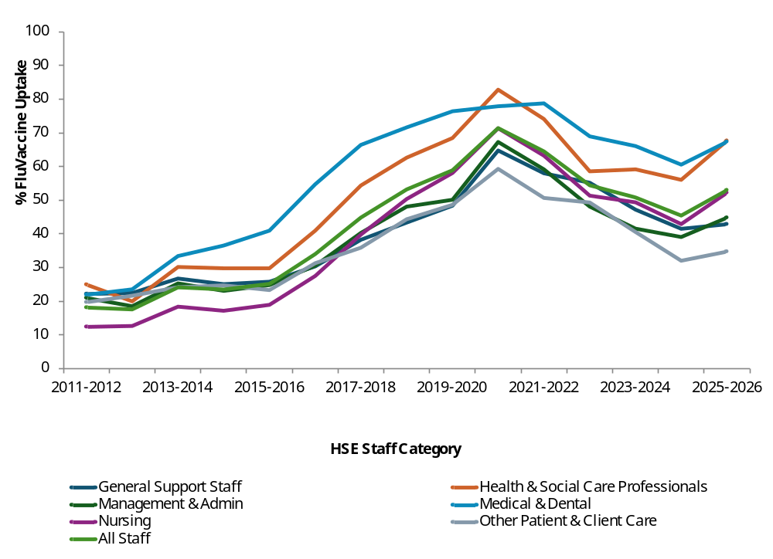
Supplementary Materials
Part 3 of 6
Supplementary Figure 2 Percentage uptake of seasonal influenza vaccine among HCWs in public hospitals by staff type and season, 2011-2012 to 2025-2026
Seasonal influenza vaccine uptake by staff type-Seasonal Trends
Apart from three seasons, 2011-2012, 2020-2021 and 2025-2026, uptake of the influenza vaccine was consistently highest among medical and dental staff irrespective of the overall uptake level reported each season (Supplementary Figure 2).
See supplementary Figure 3 on slide # 26 for details of seasonal influenza vaccine uptake by hospitals staff compliment size by season

Slide 21
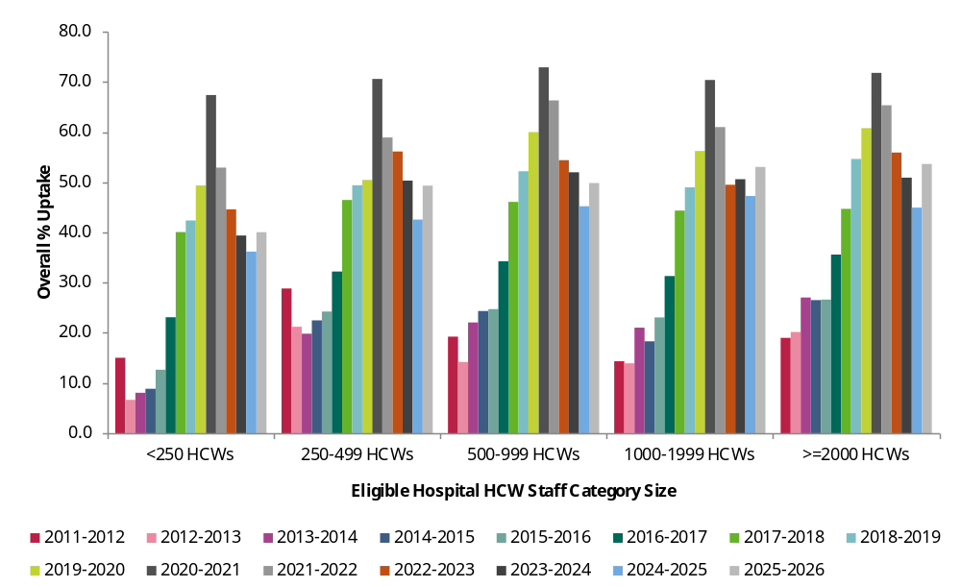
Supplementary Figure 3 Percentage uptake of seasonal influenza vaccine among HCWs in public hospitals by staff compliment size and season, 2011-2012 to 2025-2026
Supplementary Materials
Part 4 of 6
Seasonal influenza vaccine uptake by staff compliment size-Seasonal Trends
No obvious difference in seasonal influenza vaccine uptake between the different categories of staff compliment sizes in public hospitals is discernible since 2011-2012 (Supplementary Figure 1 ) but each show an improvement in uptake in the latest season following a downward trend observed since 2020-2021

Slide 22
Supplementary Materials
Part 5 of 6
Eligible hospital staff denominator data used in this graph have been sorted from smallest to highest
Funnel plots are a form of scatter plot in which observed area rates are plotted against area populations. Control limits are then overlaid on the scatter plot. The control limits represent the expected variation in rates assuming that the only source of variation is stochastic (i.e. having a random probability distribution or pattern that may be analysed statistically but may not be predicted precisely).
A p chart is an attributes control chart used with data collected in subgroups of varying sizes such as counties with different population densities.
A p prime chart is an alternative to the standard P chart when the denominators are large and when there is over or under dispersion in the data.
A p prime funnel chart is a variation of the p prime chart.
For more information on SPC charts and funnel plots, please refer to the Quality and Patient Safety Data for Decision Making Toolkit, available here: https://www.lenus.ie/bitstream/handle/10147/635034/Quality%20and%20Patient%20Safety%20Data%20for%20Decision%20Making%20Toolkit.pdf?sequence=10&isAllowed=y.
Explanatory notes about P prime funnel charts on slides #10

Slide 23
Supplementary Materials
Part 6 of 6
Supplementary Table 2. Sources of eligible and vaccinated hospital-based HCW figures cited by participating hospitals, 2025-2026 season
Sources of information used to collate the number of ELIGIBLE hospital-based HCWs | Sources of information used to collate the number of VACCINATED hospital-based HCWs | Total | % Total
Hospital group HR office | COVAX/IIS system Excel reports,COVAX/IIS dashboard | 1 | 1.7
Hospital group HR office | COVAX/IIS dashboard | 4 | 6.8
Hospital group HR office | COVAX/IIS system Excel reports | 4 | 6.8
Hospital group HR office Total | - | 9 | 15.3
Hospital HR office | COVAX/IIS system Excel reports,COVAX/IIS dashboard | 16 | 27.1
Hospital HR office | COVAX/IIS dashboard | 9 | 15.3
Hospital HR office | COVAX/IIS dashboard | 9 | 15.3
Hospital HR office | Local hospital records | 6 | 10.2
Hospital HR office | Local hospital records,Self-reporting by HCWs | 4 | 6.8
Hospital HR office | COVAX/IIS dashboard,Local hospital records | 1 | 1.7
Hospital HR office | COVAX/IIS dashboard,Self-reporting by HCWs | 1 | 1.7
Hospital HR office | COVAX/IIS system Excel reports,Other | 1 | 1.7
Hospital HR office | Local hospital records,Other | 1 | 1.7
Hospital HR office | Other | 1 | 1.7
Hospital HR office Total | - | 47 | 79.7
Hospital HR office,Hospital group HR office | COVAX/IIS system Excel reports | 1 | 1.7
Hospital HR office,Hospital group HR office Total |  | 1 | 1.7
Other | COVAX/IIS dashboard | 1 | 1.7
Other | COVAX/IIS system Excel reports | 1 | 1.7
Other Total | - | 2 | 3.4
Total | - | 59 | 100.0
Sources of eligible HCWs and vaccine uptake information cited by participating hospitals
47 of the 59 (79.7%) survey participating hospitals cited their HR office as the sole source of information for eligible staff counts, followed by the hospital group HR office (9/59=15.2%) (Table 4).
17 of the 59 (79.7%) survey participating hospitals cited a combination COVAX/IIS§ system’s excel reports and dashboard as their source of vaccination data, followed by the dashboard only (n=14; 23.7%) , excel reports only (n=13; 22.0%) and local hospital records only (n=6; 10.2%) Supplementary Table 2).
§ COVAX/IIS= HSE Integrated Information Services (IIS) and COVAX Implementation system, now called ‘NIIS (National Integrated Information System)

