Slide 1

Gonorrhoea antimicrobial resistance in Ireland, 2010 – 2017
On behalf of the National Forum on Antimicrobial Resistance in Neisseria gonorrhoeae
Health Protection Surveillance Centre
Department of Clinical Microbiology, St. James’s Hospital
Interim National Gonococcal Reference Laboratory, St. James’s Hospital

Slide 2
Euro-GASP
The European Gonococcal Antimicrobial Surveillance Programme
Ireland participating since 2010
Department of Clinical Microbiology, SJH, is sentinel laboratory
    Participated via de-centralised testing since 2013
Interim National Gonococcal Reference Laboratory located within Department of Clinical Microbiology, SJH, since 2017
Coordinates Irish Euro-GASP submission with HPSC
Data submitted annually to ECDC via TESSy by HPSC

Slide 3
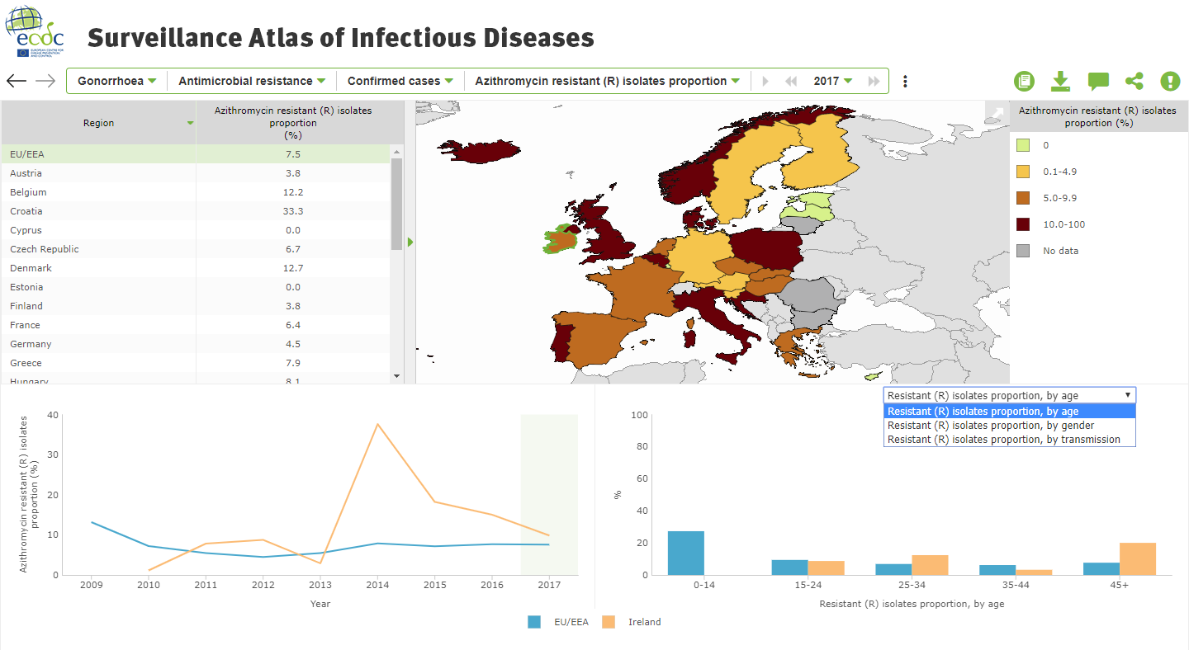
Euro-GASP outputs

Slide 4
Trend analysis of Irish data submitted to Euro-GASP, 2010 – 2017

Slide 5
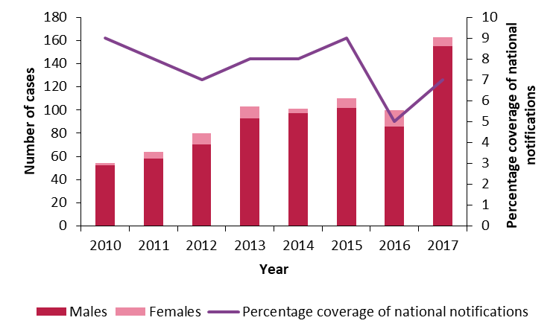
National data, 2010 – 2017: Summary
Data on 775 Irish isolates submitted to Euro-GASP 2010 – 2017
    92% males, 8% females
Euro-GASP guidelines recommend collecting data on 10% of the total number of cases nationally
    Irish data have covered 5-9% of total number of notifications

Slide 6
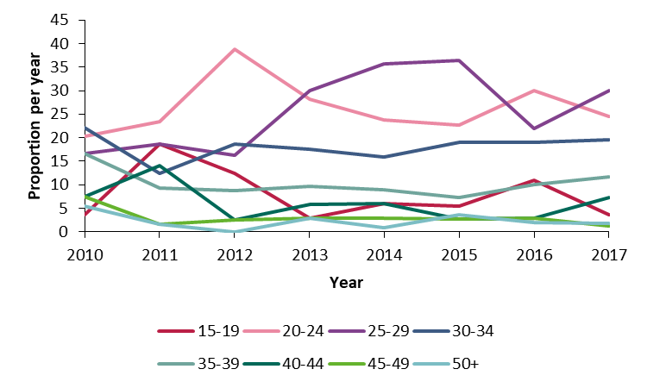
Age distribution, 2010 – 2017
Median age of cases: 27 years
Age range: 15-65 years
Median age of males: 28 years
Median age of females: 23 years

Slide 7
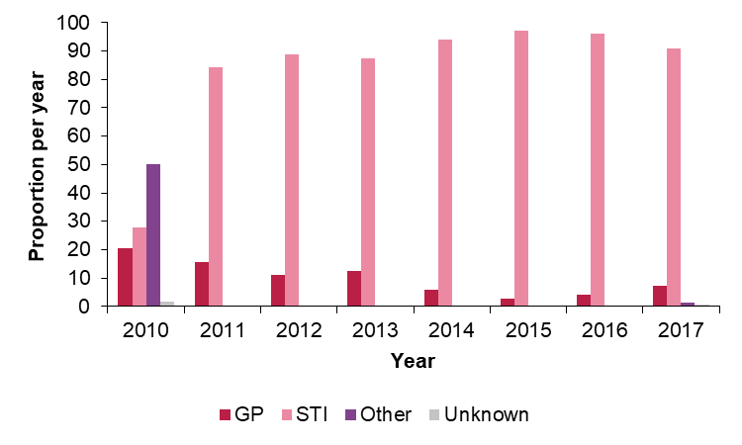
Clinical service type, 2010 – 2017
87% attended STI clinic, 9% attended primary care

Slide 8
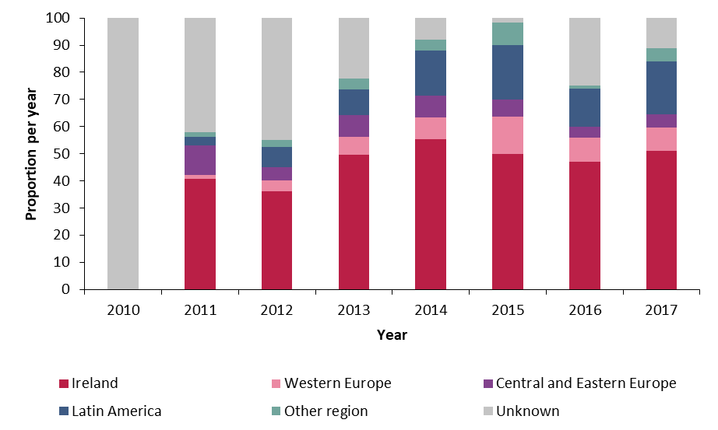
Region of birth, 2010 – 2017
Region of birth available for 75%, where known:
    60% born in Ireland
    18% born in Latin America
    10% Western Europe
    8% Central or Eastern Europe
*Other regions include Asia, Africa, North America & Canada, the Middle East, Australia & New Zealand

Slide 9
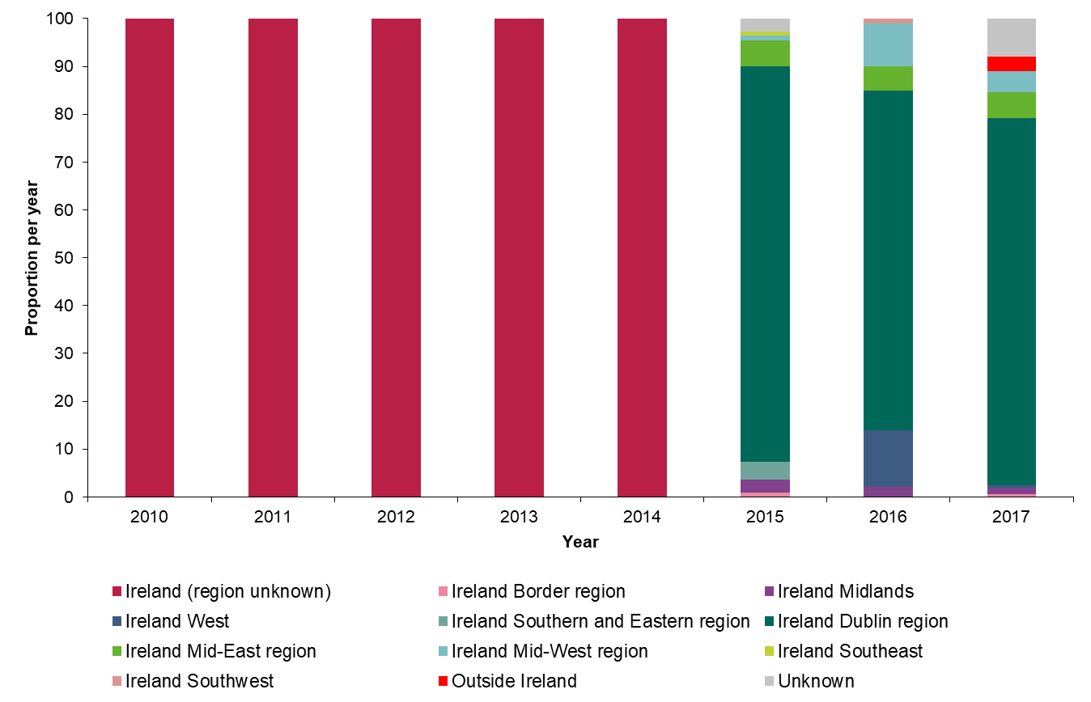
Area of residence, 2010 – 2017
Area of residence was known for 98% of patients and 97% of patients were resident in Ireland at the time of infection
Between 2010 – 2014, region within Ireland was not collected
Between 2015 – 2017, 77% of cases were resident in the Dublin region

Slide 10
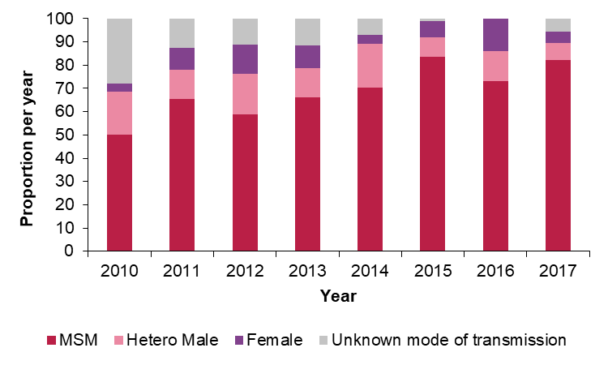
Mode of transmission, 2010 – 2017
Mode of transmission was available for 92%, where known:
    77% MSM
    14% heterosexual males
    9% females

Slide 11
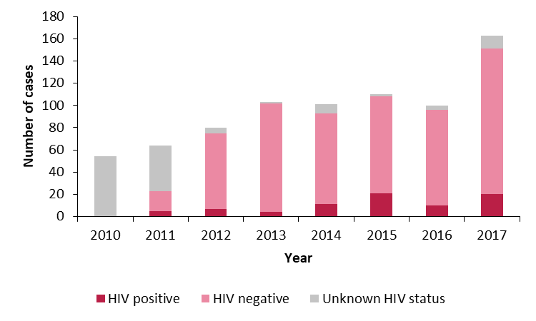
HIV status, 2010 – 2017
HIV status available for 84%, where known:
    12% HIV positive
    All HIV positive cases were among MSM

Slide 12
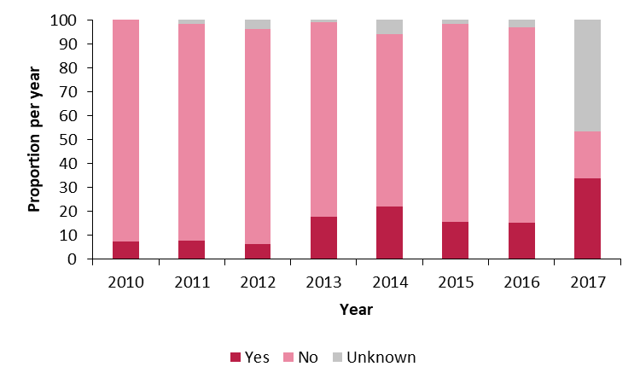
Previous gonorrhoea infection, 2010 – 2017
Data on previous gonorrhoea infection available for 88%, where known:
    21% reported previous gonorrhoea infection

Slide 13
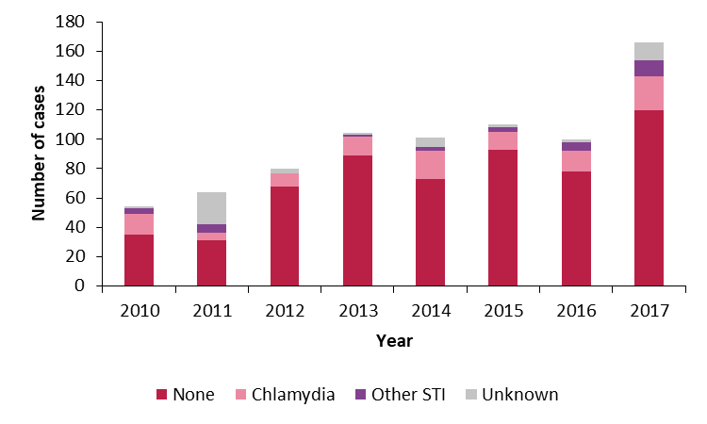
Concurrent STI, 2010 – 2017
Data on concurrent infection available for 94%, where known:
    18% diagnosed with concurrent STI
    Chlamydia was diagnosed in 76% of concurrent infections
*Other STIs diagnosed included Herpes, Hepatitis C, LGV and Syphilis

Slide 14
Compliance with recommended treatment*, 2015 – 2017
Data on treatment used were collected since 2015
Data were available for 36%, 100% and 97% of isolates in 2015, 2016 and 2017, respectively
Where known, there was 80%, 93% and 89% compliance with recommended treatment
*Recommended treatment for gonorrhoea infection was changed in December 2018 to monotherapy with ceftriaxone (1g). Dual therapy with azithromycin is no longer recommended.

Slide 15
Cefixime susceptibility, 2010 – 2017
1% (n=8) of isolates were resistant to cefixime (MIC ≥0.125 mg/L)
No resistant isolates have been reported since 2015
The distribution of the cefixime MIC ranges had decreased since 2013
Susceptible
Resistant

Slide 16
Ceftriaxone susceptibility, 2010 – 2017
99.9% (n=774) of isolates were susceptible to ceftriaxone (MIC ≤0.125 mg/L)
1 resistant isolate reported in 2012
The proportion of isolates with reduced ceftriaxone susceptibility (MIC ≥0.032 mg/L) was 10% in 2017, compared with 7% in 2016
Susceptible
Resistant

Slide 17
Azithromycin susceptibility, 2010 – 2017
13% (n=104) of isolates were resistant to azithromycin (MIC >0.5 mg/L)
Azithromycin resistance in Ireland has been above the European average since 2014
The proportion of isolates with MIC>2.0mg/L has ranged from 7-9% since 2015
Susceptible
Resistant

Slide 18
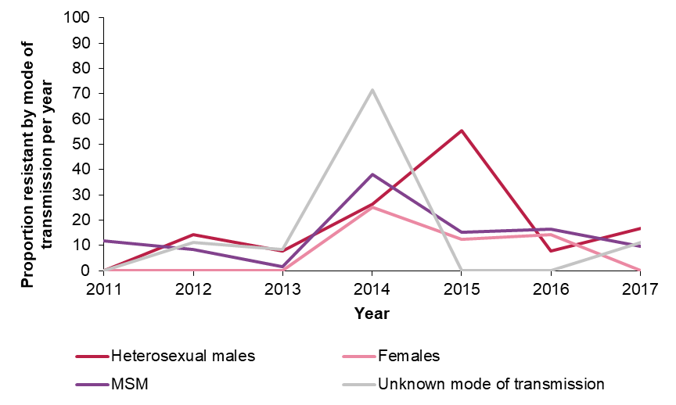
Azithromycin susceptibility, 2010 – 2017
14% of isolates among males and 7% of isolates among females were azithromycin resistant
16% of heterosexual males and 14% of MSM had azithromycin resistant gonorrhoea

Slide 19
Susceptibility to recommended treatment
There have been no reported cases of treatment failure following treatment with the dual therapy regimen to date in Ireland
Decreasing susceptibility
Decreasing susceptibility

Slide 20
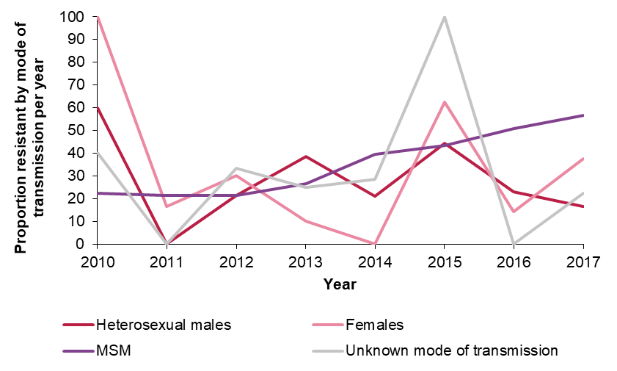
Ciprofloxacin susceptibility, 2010 – 2017
37% of isolates were resistant to ciprofloxacin and in 2017 there was a higher proportion resistant than susceptible
Resistance among MSM was more likely as 40% of isolates from MSM were resistant, compared to 28% from heterosexual males and 27% from females

Slide 21
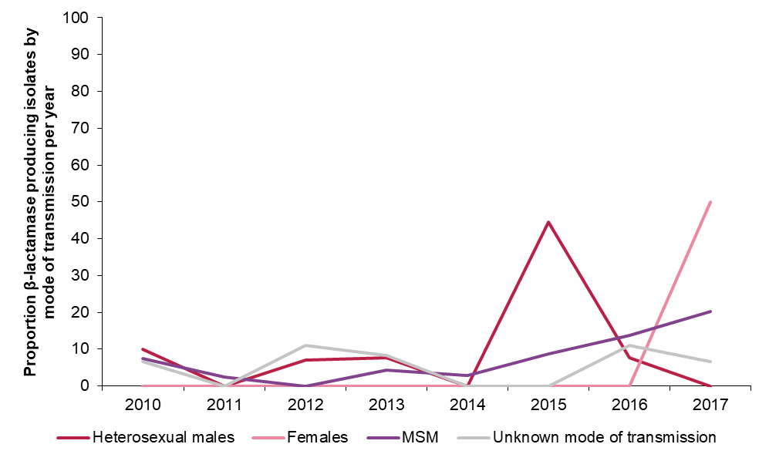
β-lactamase production, 2010 – 2017
9% of isolates produced β-lactamase and 20% of isolates reported in 2017 produced β-lactamase
The proportion of β-lactamase producing isolates among MSM was 10%, compared with 8% among heterosexual males and 6% among females

Slide 22
Conclusions
Ireland has contributed data on 7% of total national notifications to Euro‑GASP, 2010 – 2017
Susceptibility to cephalosporins remains high among Irish isolates
Resistance to azithromycin was at 10% in 2017 and higher than the European average since 2014
Resistance to ciprofloxacin and production of β-lactamase/penicillinase has been increasing in recent years
These data have important implications for the clinical management of gonorrhoea in Ireland
Continued national and international surveillance of gonorrhoea antimicrobial resistance is necessary to inform gonorrhoea treatment guidelines and public health interventions targeting at-risk groups

Slide 23
Acknowledgements
We would sincerely like to thank all those who provided data used for this national trend analysis:
Staff of the Department of Clinical Microbiology, SJH
Staff of the Interim Gonococcal Reference Laboratory, SJH
HPSC
Public Health England
Microbiology laboratories
Consultants in Infectious Diseases/GU Medicine
STI clinics
GPs
Personnel within Departments of Public Health

