Slide 1
Health Protection Surveillance Centre
Surveillance of Infectious Intestinal Disease (IID) in Ireland:
Q2 2019 provisional data
October, 2019

Slide 2
Provisional data, Q2 2019

Slide 3
Key Points

Slide 4
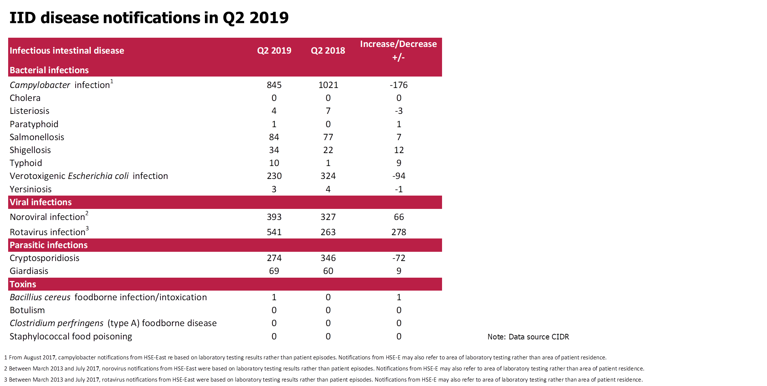

Slide 5
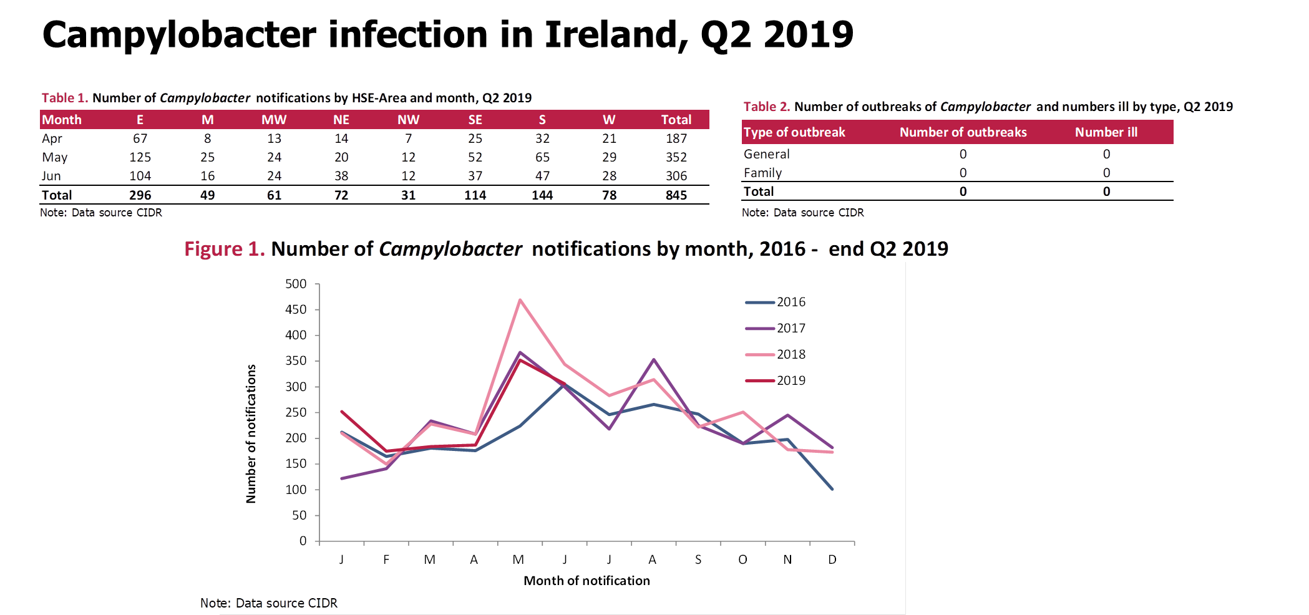

Slide 6
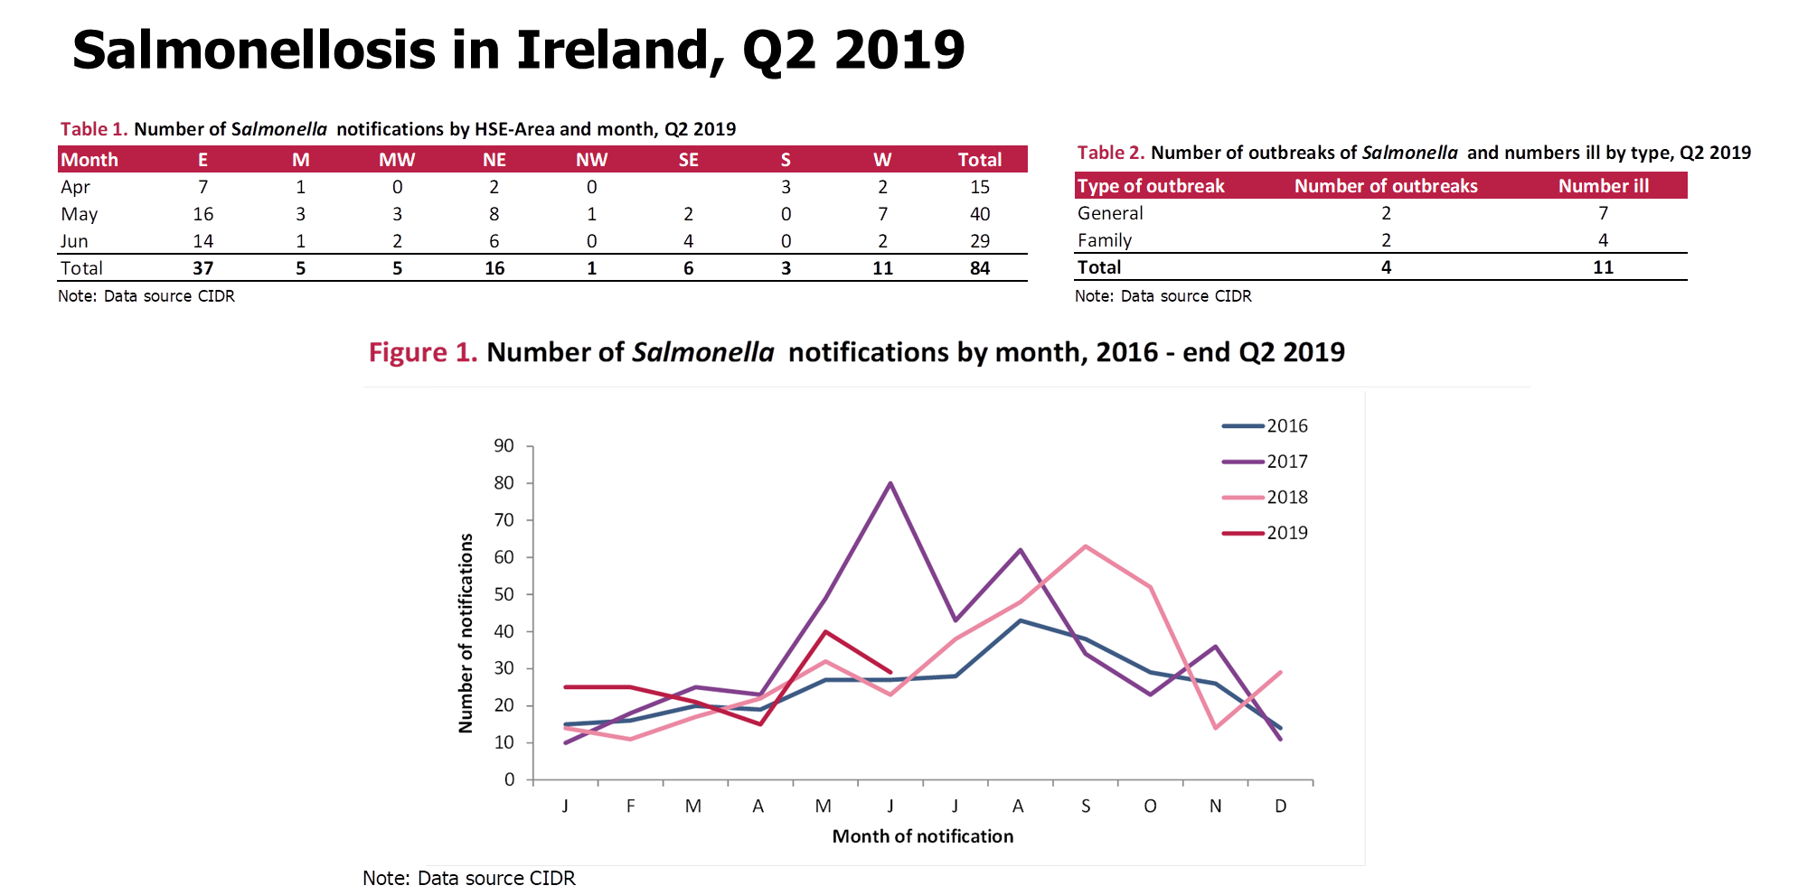

Slide 7
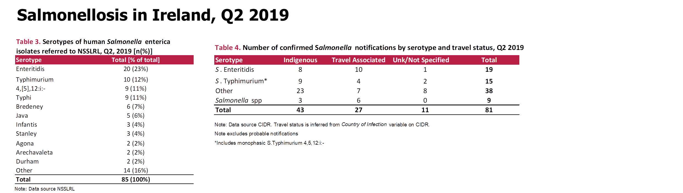

Slide 8
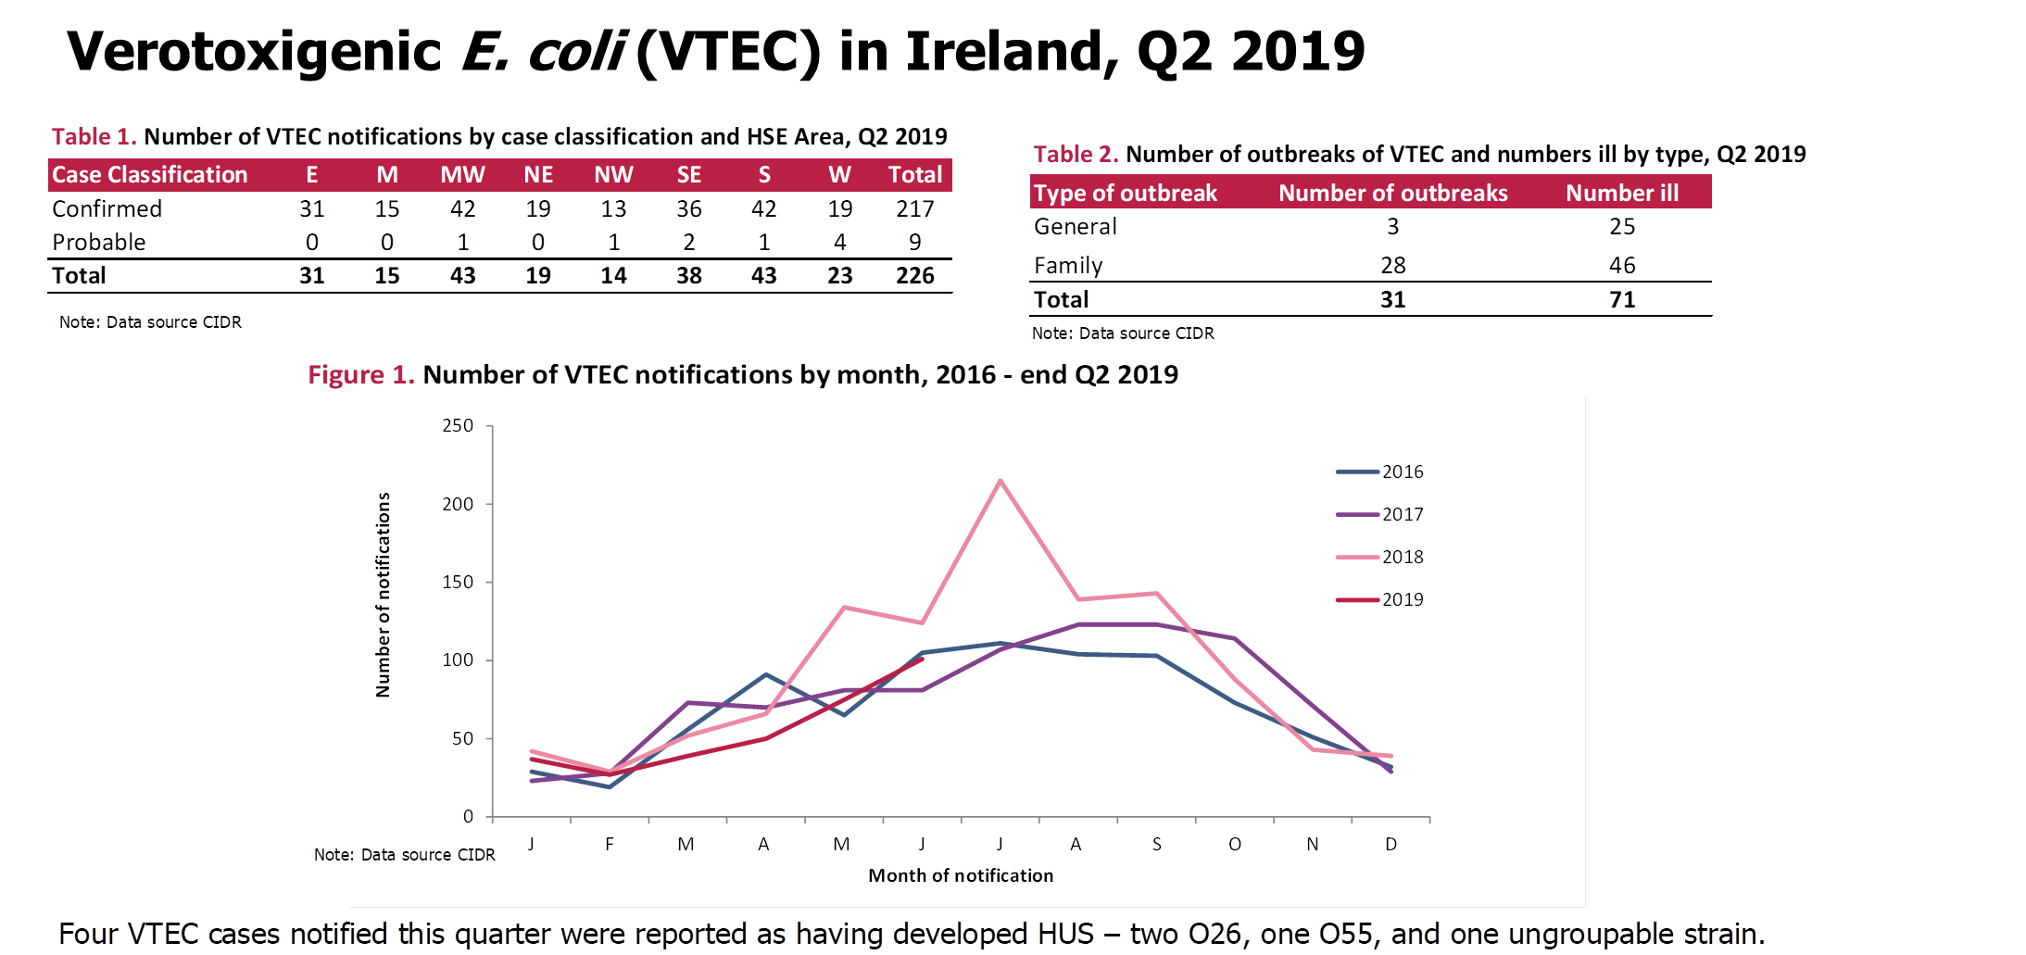

Slide 9
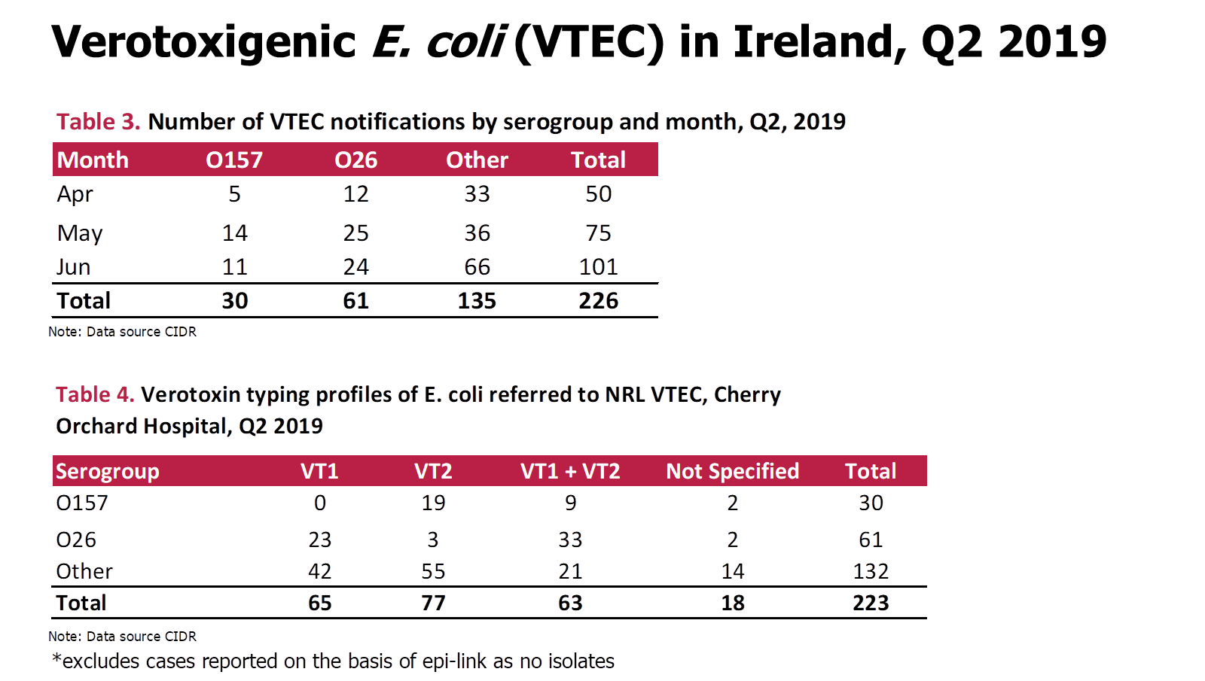

Slide 10
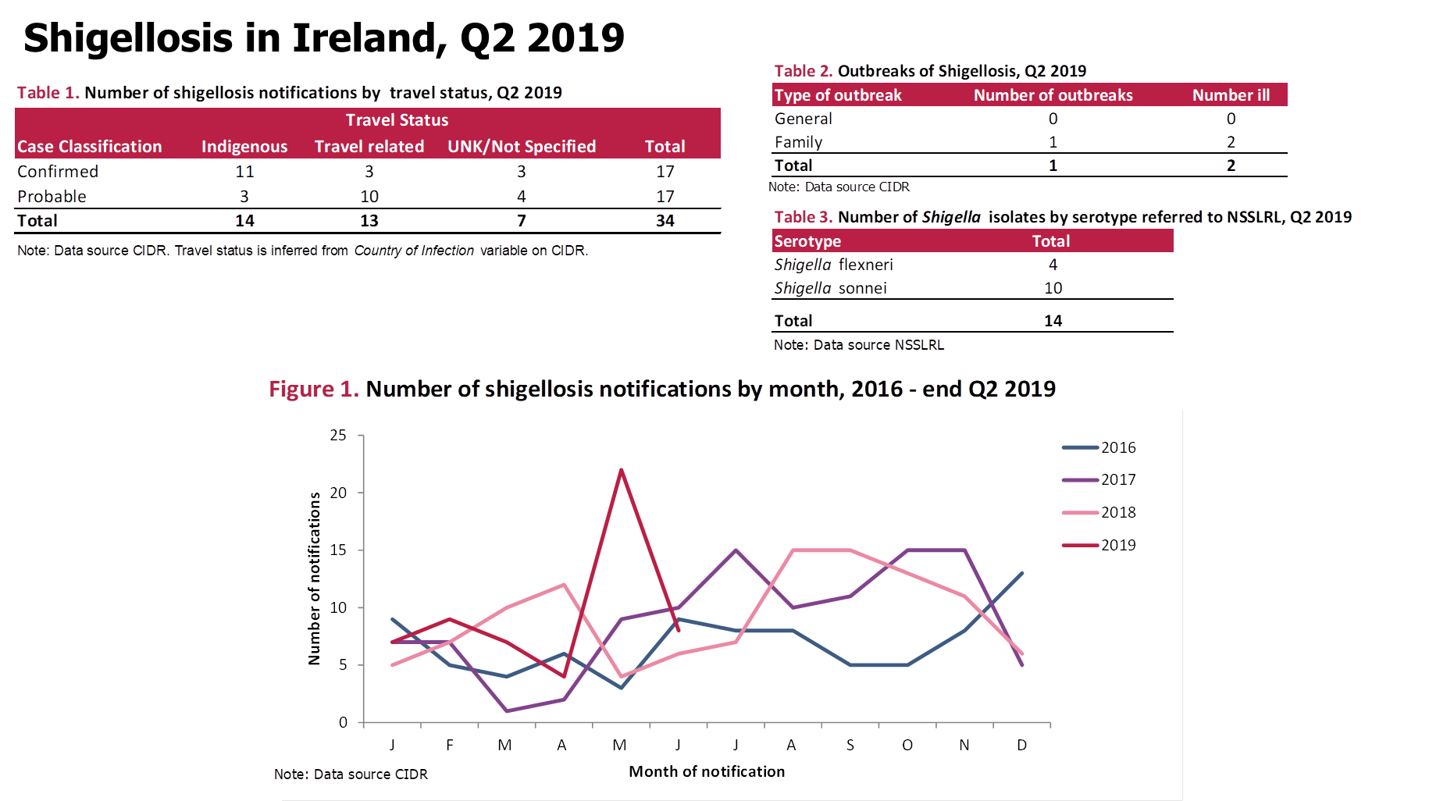

Slide 11
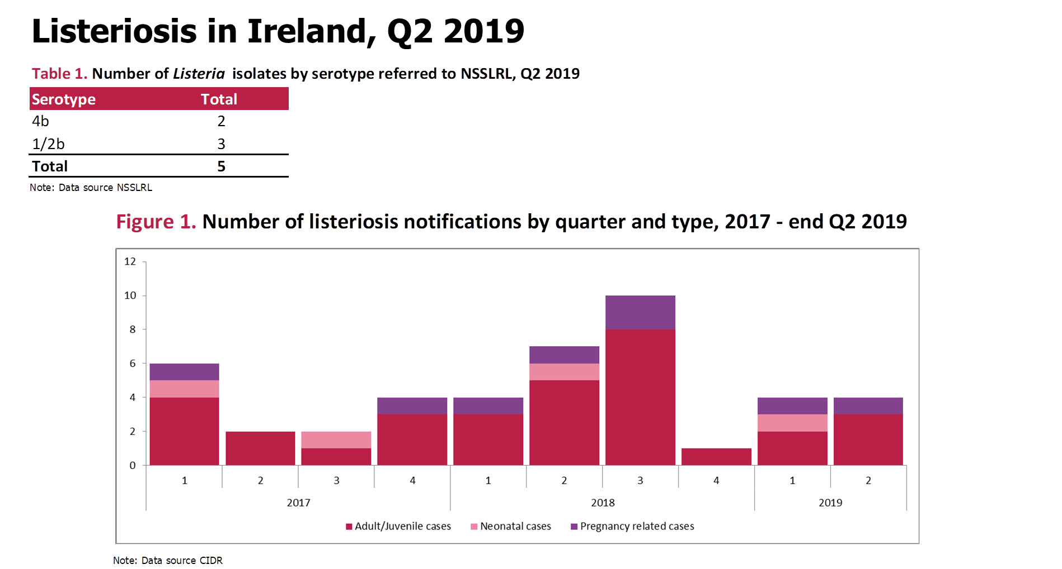

Slide 12
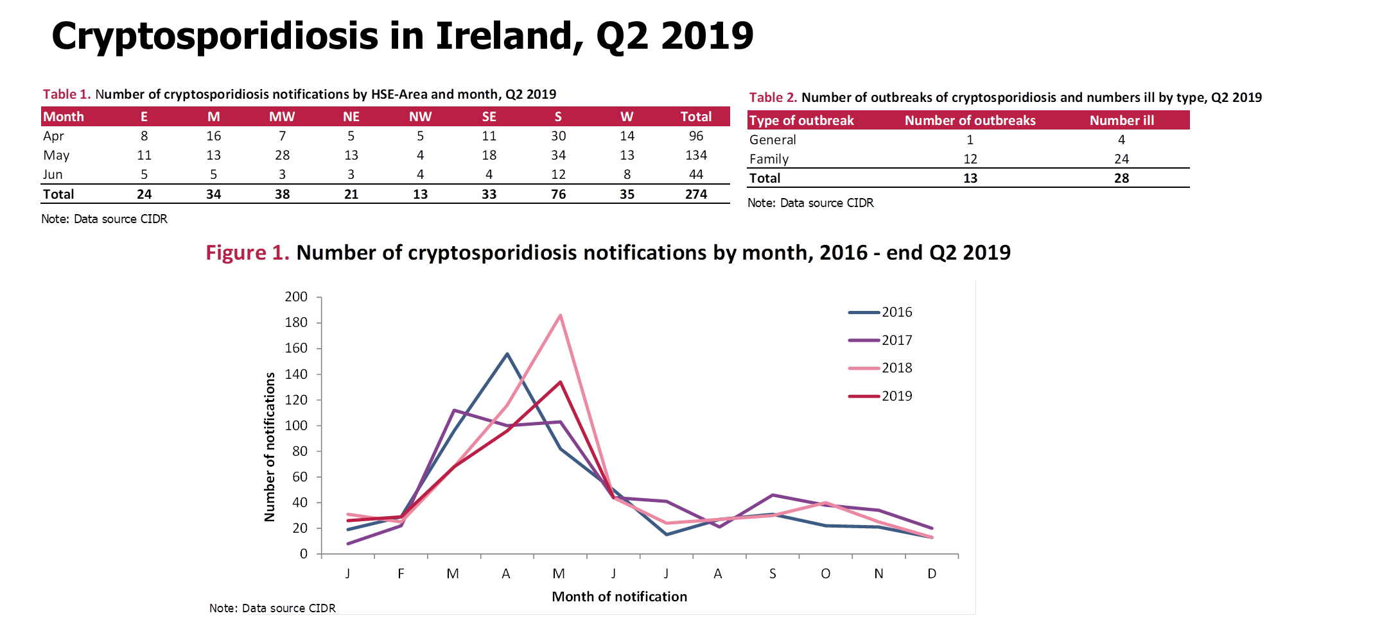

Slide 13
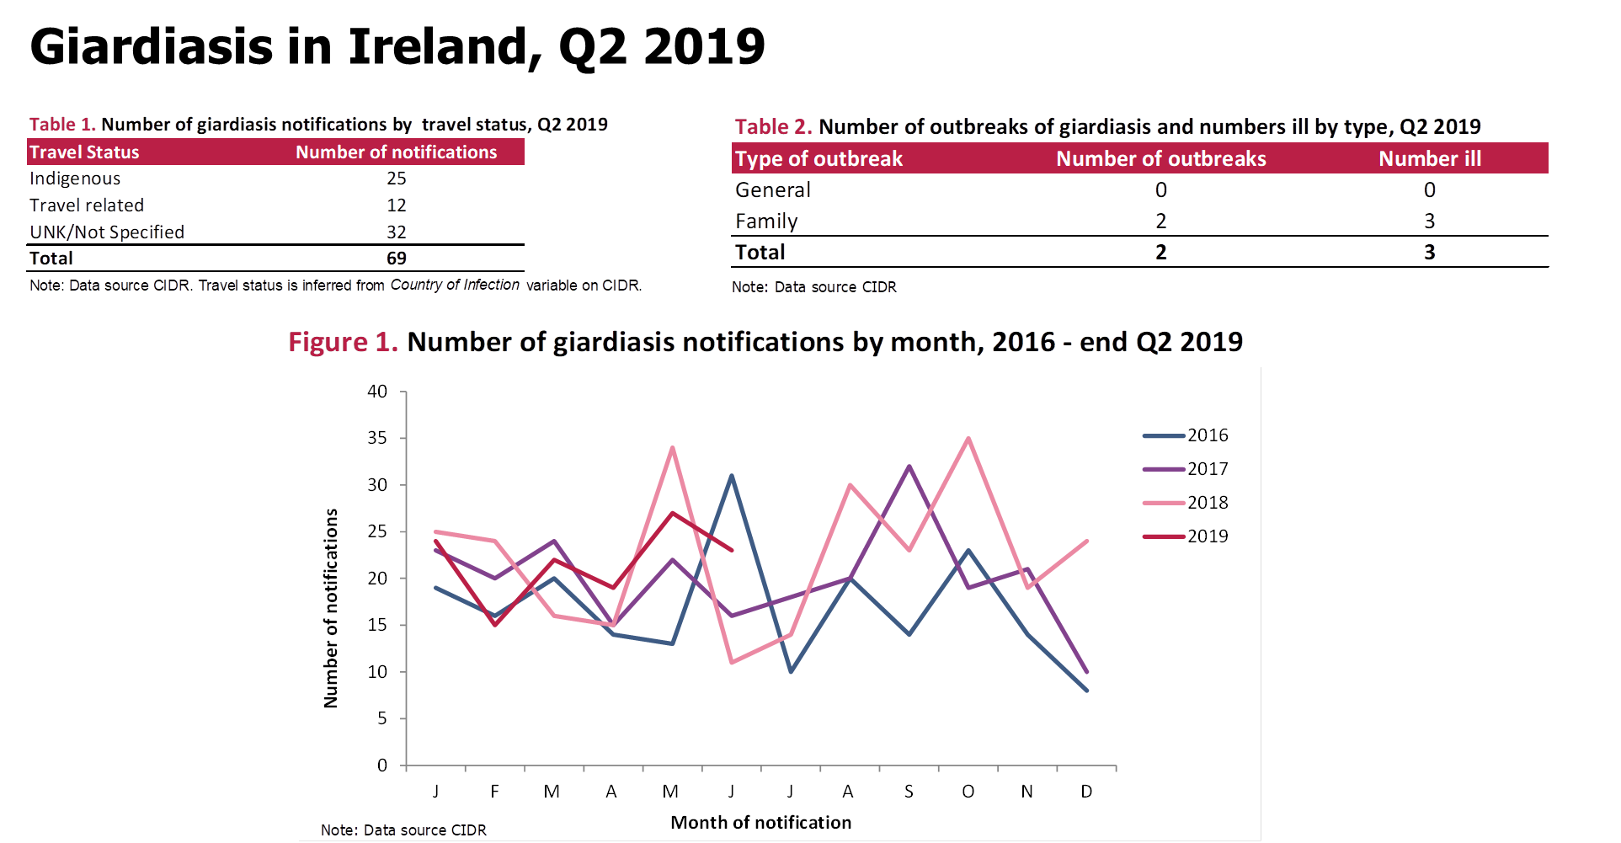

Slide 14
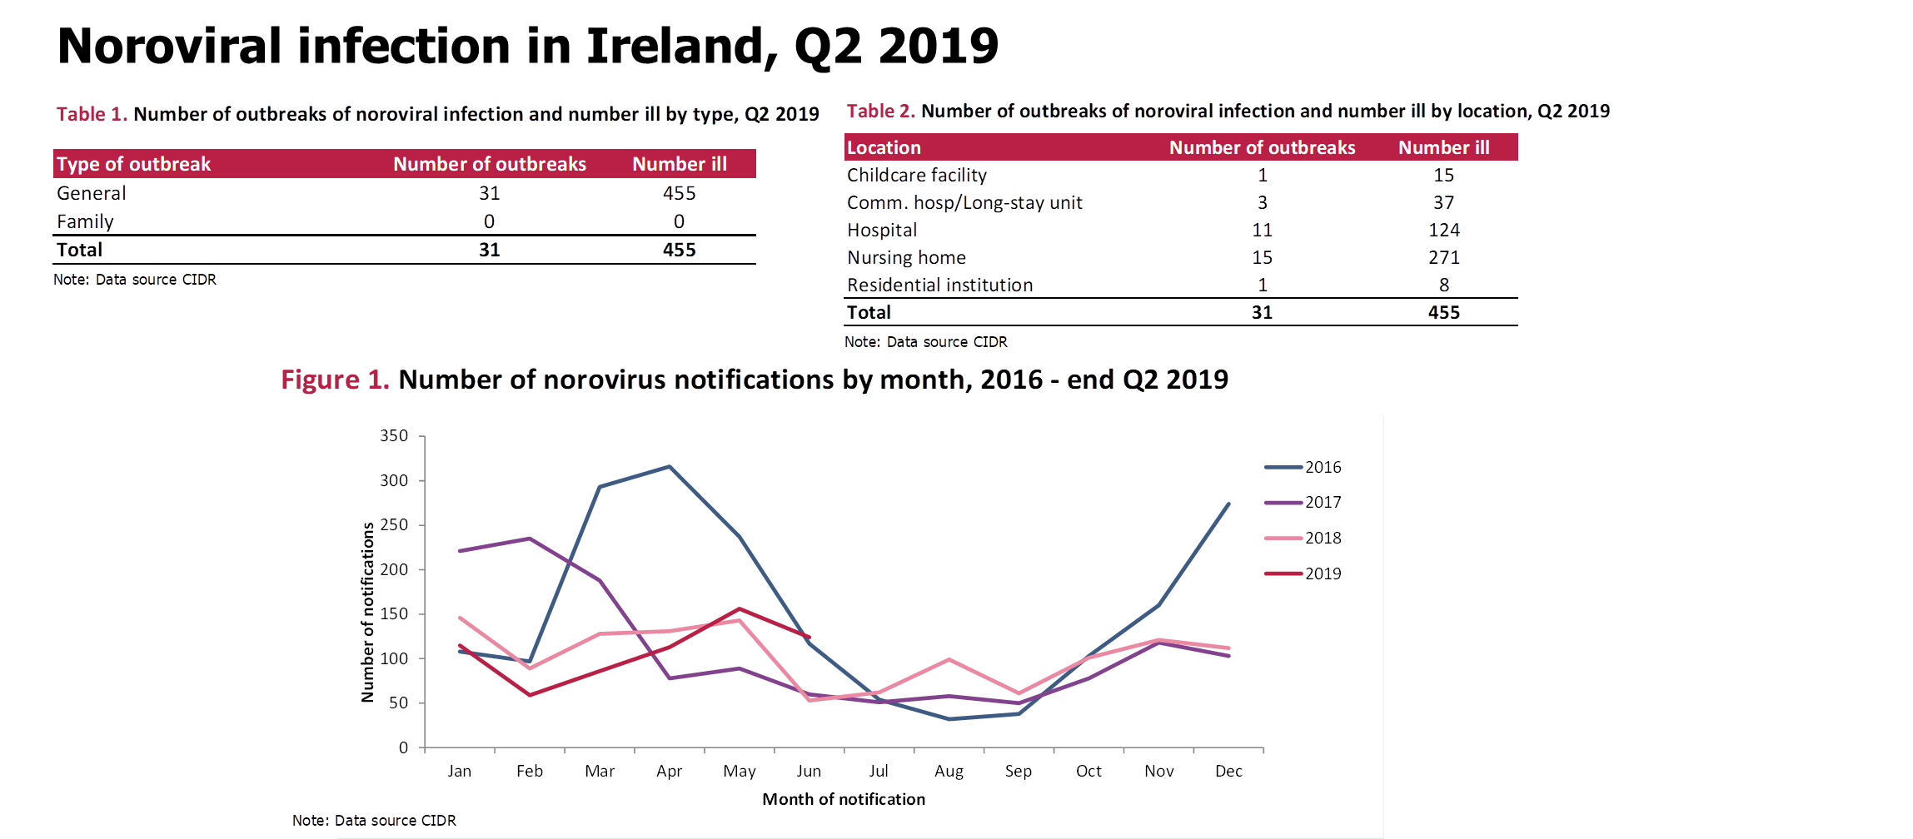

Slide 15
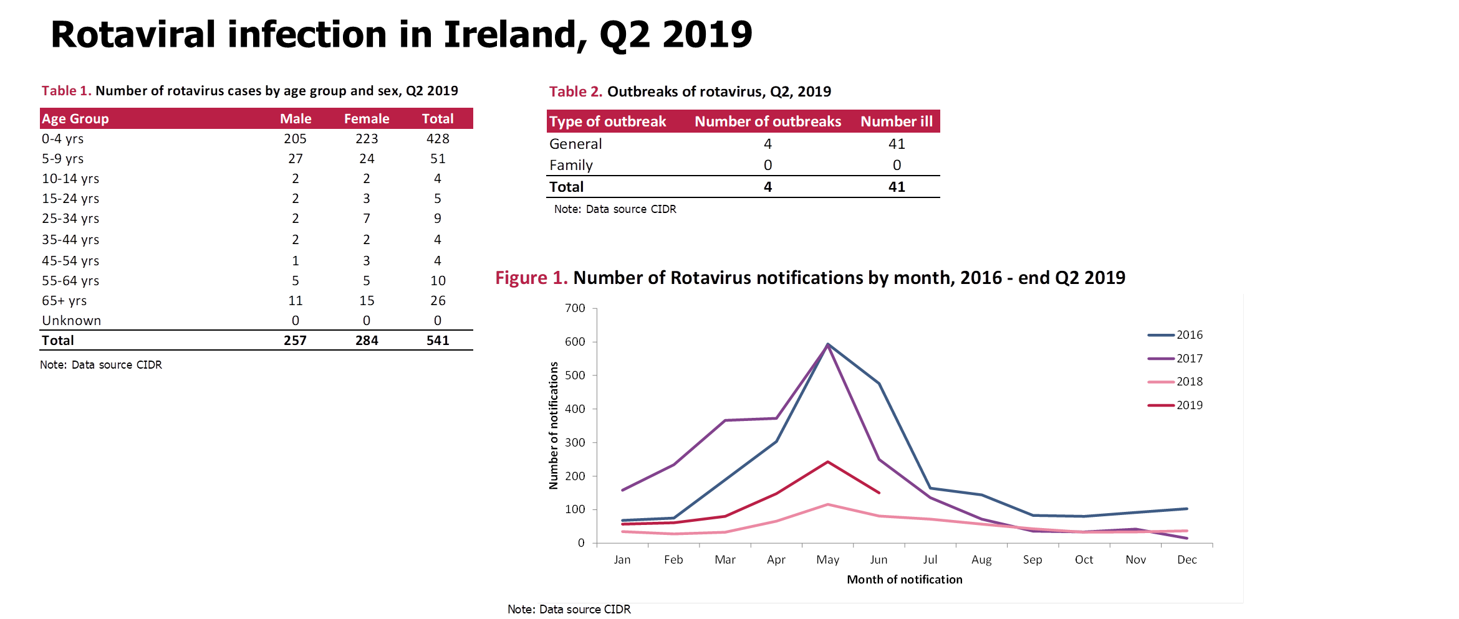

Slide 16
Further Information
Further information on IID pathogens can be found at
https://www.hpsc.ie/a-z/gastroenteric/

