Slide 1
Antimicrobial resistance (EARS-Net) data in Ireland, 2024
Last updated 6th October 2025

Slide 2
Key points, 2024: Population coverage by EARS-Net
Laboratory Participation & Population Coverage
32 (of 36) microbiology laboratories reported data
Coverage dropped to ~82% of Irish population
↓ from 96–100% coverage over previous 4 years
4 labs (including 2 tertiary hospitals) did not submit data due to staffing issues
EQA Participation:
  31 of 34 EUCAST labs took part in mandatory EARS-Net external quality assurance (EQA)
Use of EUCAST Guidelines
Since 2022, ECDC has mandated EUCAST methods for EARS-Net submissions
By end of 2024, 2 Irish labs still using CLSI guidelines
  Causes minor discrepancies between national and ECDC-reported data
2025 Proposal:
  Only data from EUCAST-compliant labs to be accepted by HPSC

Slide 3
Key points, 2024: Case numbers
EARS-Net Pathogens
Total Cases Reported:
  6,138 invasive isolates from 32 labs
  ↓ from 6,980 in 2023 (34 labs; 96% coverage)
Consistent Lab Comparison:
  Among 31 labs reporting both years:
    4% increase in cases (2023: 5,860)
Pathogen-Specific Trends
Increased Case Numbers:
  S. pneumoniae: +19%
  P. aeruginosa: +9%
  K. pneumoniae: +7%
  E. coli: +6%
Decreased Case Numbers:
  E. faecalis: −12%
  S. aureus: −3%
Stable Numbers:
  E. faecium
  Acinetobacter spp.
Additional Pathogens (Non-EARS-Net)
Group B streptococci: +17%
Group A streptococci: −46%
  Reflects post-surge decline after iGAS peak (late 2022 – summer 2023)
Candida spp.: −27%

Slide 4
Key points, 2024: Resistance highlights
S. aureus / MRSA
%MRSA increased to 10.7% (2023: 9.6%)
MRSA incidence rate ↑ to 0.31 per 1,000 patient days (2023: 0.30)
MSSA and overall S. aureus BSI incidence rates ↓ over same period
E. faecium / VRE
%VREfm slightly ↑ to 21.8% (2023: 21.4%)
  5-year trend remains significantly downward
VREfm incidence rate ↓ to 0.30 per 1,000 patient days (2023: 0.31)
VSEfm and total E. faecium incidence rates also decreased
Carbapenem-Resistant Organisms
Carbapenem resistance levels in Ireland (2024):
  E. coli: 0.1%
  K. pneumoniae: 1.2%
  P. aeruginosa: 5.2%
  Acinetobacter spp.: 0%
EU/EEA 2023 comparison:
  E. coli: 0.3%, K. pneumoniae: 13.3%,
  P. aeruginosa: 18.6%, Acinetobacter spp.: 40.1%
K. pneumoniae and Acinetobacter spp. remain critical public health threats (WHO 2024 priority list)
Candida auris
No Candida auris isolates reported in 2024
  Typically resistant to fluconazole

Slide 5
Abbreviations

Slide 6
Introduction to Antimicrobial Resistance Surveillance
Context & Importance
Purpose of Surveillance:
  Tracks emerging patterns and trends in infectious diseases
  Enables timely action through data collection, validation, analysis, and reporting
  Supports:
    Describing disease burden and epidemiology
    Monitoring long-term trends
    Detecting new pathogens/variants
    Informing policy decisions
    Evaluating intervention impact
Policy & Legal Framework:
  Surveillance is central to the European One Health Action Plan against AMR
  Listed as a special health issue in Regulation (EU) 2022/2371 on serious cross-border health threats
Global Relevance:
  WHO uses surveillance data to identify priority pathogens needing new antibiotics
  Many EARS-Net pathogens are classified as “high” or “critical” priority by WHO
Main EU Surveillance System:
  EARS-Net (European Antimicrobial Resistance Surveillance Network)

Slide 7
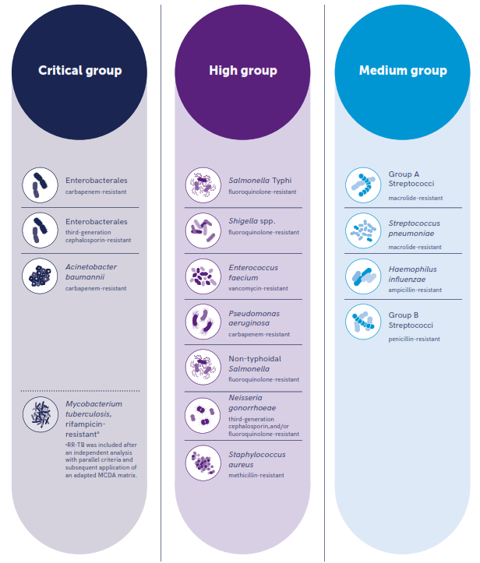
WHO Bacterial Priority Pathogen List, 2024

Slide 8
EARS-Net background
History & Development
Established as EARSS in 1998
Initially funded by:
  European Commission’s Directorate General for Health and Consumer Affairs
  Dutch Ministry of Health, Welfare and Sports
Transition to ECDC:
  On 1 January 2010, EARSS became EARS-Net
  Now coordinated by the European Centre for Disease Prevention and Control (ECDC)
Network Scope
Largest publicly funded AMR surveillance system in Europe
Objectives of EARS-Net
Collect comparable, representative, and accurate AMR data
Analyse temporal and spatial trends of AMR across Europe
Provide timely data to support policy decisions
Promote and improve national AMR surveillance programmes
Support diagnostic accuracy via annual external quality assessments (EQA)
More information on EARS-Net can be found on ECDC’s website.

Slide 9
Methodology
National AMR Data Management & Reporting
Data Storage & Analysis
Data stored in:
  WHONET format (WHO’s free software for AMR data)
  Access Database at HPSC
Data analysis and reporting done using RStudio (statistical computing & graphics)
Guideline Compliance
ECDC requires data submission only from labs using EUCAST guidelines
Labs using CLSI guidelines:
  Included in national report
  Excluded from ECDC submissions
  Results in differences between national and ECDC reports
Reporting Timeline
ECDC 2024 Annual Epidemiological Report to be published in November 2025
  Ahead of European Antibiotic Awareness Day
Quality Assurance
EARS-Net labs must participate in the annual EARS-Net EQA exercise

Slide 10
National Results

Slide 11
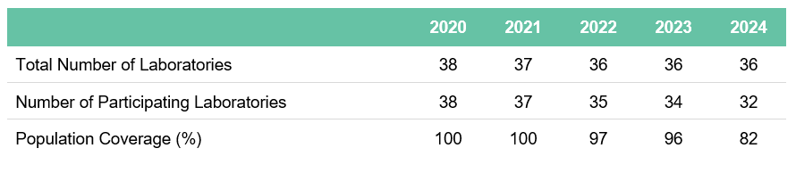
Number of laboratories participating over the past 5 years; and overall population coverage by EARS-Net
Commentary:
In 2024, EARS-Net coverage of the Irish population dropped to its lowest level for many years.
Two of the largest labs in tertiary care hospitals were unable to participate;
In addition, one lab in a secondary care hospital has not participated for the past 3 years;
Non-participation of labs is due to local resource issues, primarily staffing levels

Slide 12
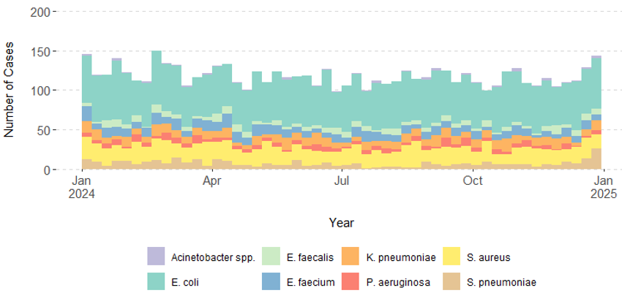
Distribution of bloodstream infections in Ireland over the latest year by
EARS-Net pathogen and week

Slide 13
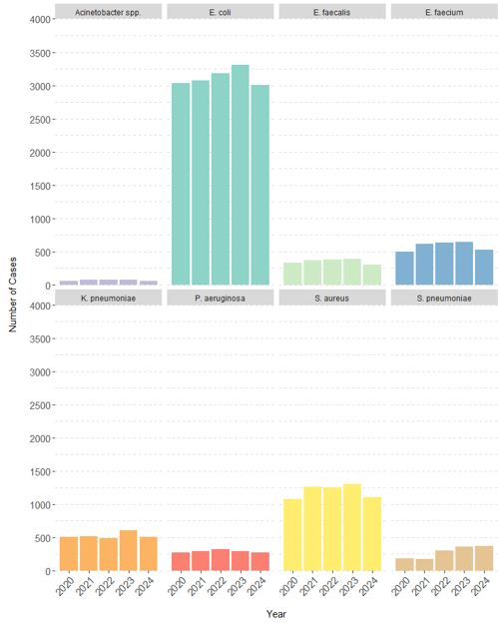
Number of bloodstream infections (BSIs) in Ireland in the last 5 years by EARS-Net pathogen and year
Note:
The numbers for 2024 are lower than expected due to the overall lower coverage of the population (82% in 2024 compared with >95% for 2020-2023)

Slide 14
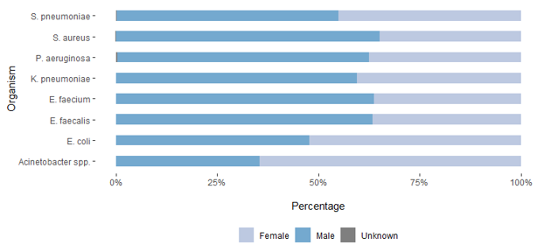
Gender distribution of cases by EARS-Net pathogen in Ireland, 2024
Commentary:
The majority of bloodstream infections occurred in male patients.
The only exceptions were E. coli infections, where just over 50% of the infections occurred in females; and Acinetobacter spp., where 65% of infections were in females but the overall numbers were low.

Slide 15
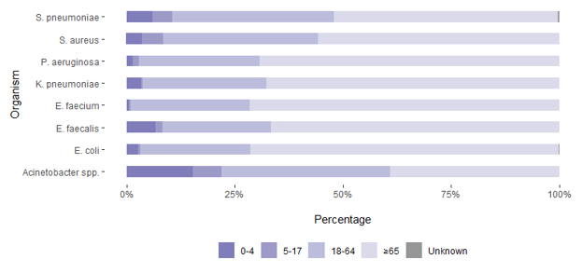
Age distribution of cases by EARS-Net pathogen in Ireland, 2024
Commentary:
The burden was highest among the older population (aged >65 years) for nearly all pathogens. The only exception was Acinetobacter spp. infections, where there was a higher proportion of infections in younger age groups.

Slide 16
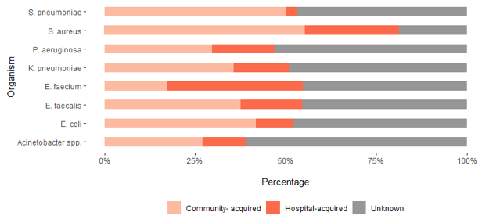

HAI status of cases by EARS-net pathogen in Ireland, 2024
Definitions:
Hospital-acquired infection (HAI) was defined as an infection where the specimen date was more than two days after the admission date (i.e., more than 48 hours after admission).
Community-acquired infection (CAI) was defined as an infection where the specimen date was less than or equal to two days before the admission date (i.e., within 48 hours of admission).
The admission date was missing for many patients (43%), preventing their categorization as either CAI or HAI.
Commentary: When isolates with missing admission dates are excluded, CAIs were most common in S. pneumoniae and E. coli infections. In contrast, E. faecium infections had the highest proportion of HAIs.

Slide 17
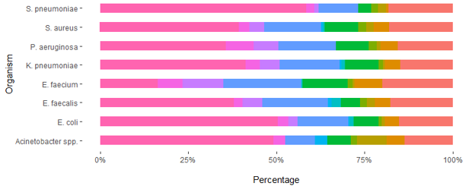
Ward type of cases by EARS-Net pathogen in Ireland, 2024
Commentary:
Almost 84% of the cases (patients with an invasive infection, primarily BSI, due to an EARS-Net pathogen) had information on their location (department within the hospital, or elsewhere) completed.
Of those cases for which department was provided, the majority of positive specimens were taken for patients in emergency wards (53%), followed by medical wards (19%). ICU patients accounted for almost 5% of all cases.

Slide 18
EU/EEA targets on AMR

Slide 19
EU/EEA targets on AMR
In 2023, following a proposal from the European Commission, the Council of the European Union set targets to reduce the total EU incidence of the following AMR organisms from bloodstream infections across the EU/EEA by 2030 compared with the baseline year of 2019*:
Meticillin-resistant S. aureus (MRSA) by 15%
3rd-generation cephalosporin-resistant E. coli by 10%
Carbapenem-resistant K. pneumoniae by 5%
For Ireland, the target reductions were set at 6%, 10% and 2%, respectively.
*The 'Council recommendation on stepping up EU actions to combat antimicrobial resistance in a One Health Approach' (2023/C220/01) includes 2030 EU targets, with 2019 as the baseline year:
https://eur-lex.europa.eu/legal-content/EN/TXT/?uri=oj:JOC_2023_220_R_0001

Slide 20
EU/EEA targets on AMR: latest data for Ireland
Estimated total incidence of bloodstream infections in Ireland (number per 100 000 population) for the 3 EU/EEA targets, including the 2019 baseline and 2030 target, as well as the 2020–2024 trend
The 2024 data shows that Ireland has already met two of the three targets on AMR as set by the European Commission/ Council of the European Union .
While MRSA has decreased across the EU/EEA in recent years, 3rd-generation cephalosporin-resistant E. coli and carbapenem-resistant K. pneumoniae have increased. The data from Ireland are encouraging but vigilance is required.

Slide 21
Latest data by pathogen

Slide 22
Escherichia coli invasive infections
Key points, 2024
Total Reports:
  3,004 cases from 32 labs in 2024
  ↓ from 3,312 cases from 35 labs in 2023
Consistent Lab Comparison:
  ↑ 6% increase among 31 labs reporting both years
Antibiotic Resistance Trends:
  Mostly stable or slightly increased resistance proportions
Key Resistance Indicators:
  3GC resistance: ↑ to 12% (from 10%)
  ESBL producers: ↑ to 10% (from 9%)
  MDR: ↑ to 4% (from 3%)
  Carbapenem resistance: Stable at 0.1%
  CPE isolates: 5 total (3 OXA-48, 1 KPC, 1 NDM)
5-Year Trends:
  Ciprofloxacin, aminoglycosides, and MDR show downward trends
  None are statistically significant
Comparison to Previous Years:
  2024 resistance levels are similar or slightly lower than 2020
EU/EEA Comparison:
  AMR levels in E. coli BSIs are moderately low

Slide 23
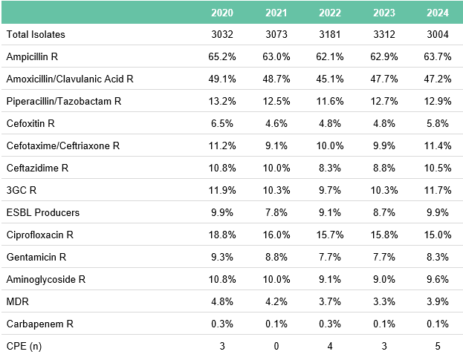
Antimicrobial resistance in invasive E. coli infections in Ireland
Note: Coverage of the population was only 82% in 2024, compared with 96-100% for 2020-2023; hence, lower total number of isolates in 2024

Slide 24
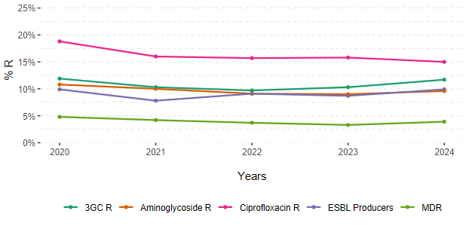
Key resistance indicators in invasive E. coli infections in Ireland

Slide 25
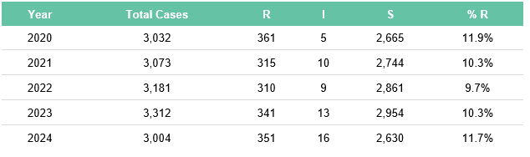
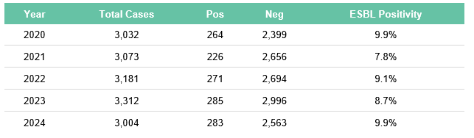
3rd-generation cephalosporin resistance and ESBL-production in invasive E. coli infections in Ireland
3rd-generation resistance
ESBL-production (or positivity)

Slide 26
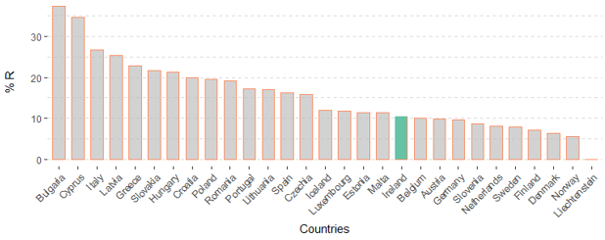
3rd-generation cephalosporin resistance in invasive E. coli infections in the EU/EEA in 2023

Slide 27
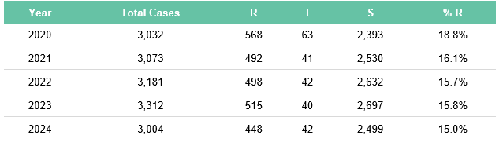
Fluoroquinolone resistance in invasive E. coli infections in Ireland

Slide 28
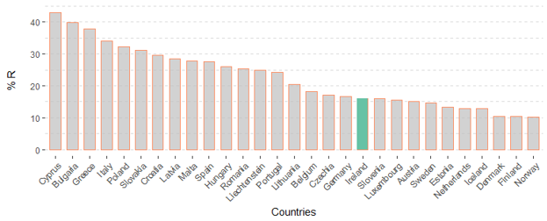
Fluoroquinolone resistance in invasive E. coli infections in the EU/EEA in 2023

Slide 29
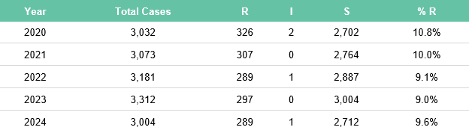
Aminoglycoside resistance in invasive E. coli infections in Ireland

Slide 30
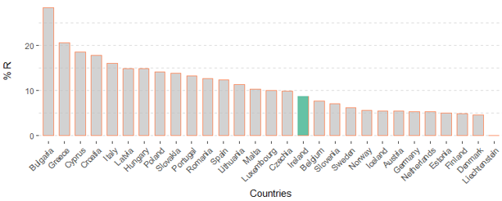
Aminoglycoside resistance in invasive E. coli infections in the EU/EEA in 2023

Slide 31
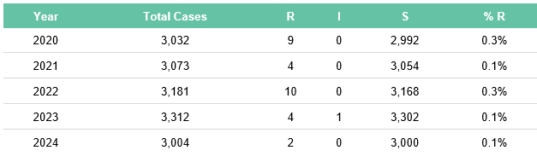
Carbapenem resistance in invasive E. coli infections in Ireland
Commentary: Carbapenem resistance among invasive E. coli isolates remains at very low levels.
Note: In Ireland, we include ertapenem results when looking at carbapenem resistance in invasive K. pneumoniae isolates. This increases the sensitivity. Some isolates that produce the OXA-48 carbapenemase may be susceptible to the other carbapenems but resistant to ertapenem.

Slide 32
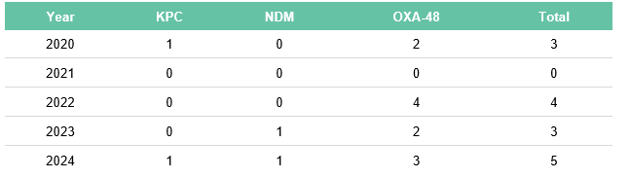
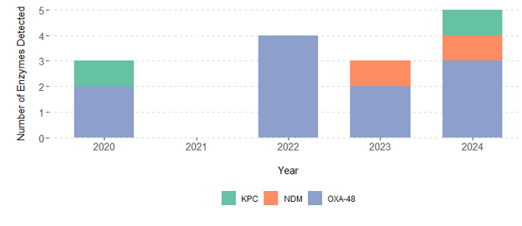
Carbapenemase-producing E. coli infections by enzyme type in Ireland
Commentary:
OXA-48 is the predominant carbapenemase reported among invasive E. coli isolates

Slide 33
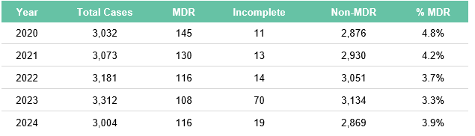
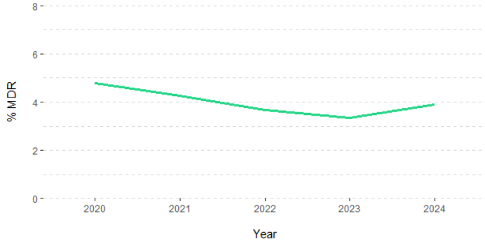
Multi-drug resistance in invasive E. coli infections in Ireland
Commentary:
%MDR decreased between 2020 and 2023, but increased slightly in 2024

Slide 34
Staphylococcus aureus invasive infections
Key points, 2024
Total Reports:
  1,103 cases from 32 labs in 2024
  ↓ from 1,307 cases from 35 labs in 2023
Consistent Lab Comparison:
  3% decrease in cases among 31 labs reporting both years
MRSA Proportion (%MRSA):
  ↑ to 10.7% in 2024 (from 9.6% in 2023)
  2023 had the lowest %MRSA in 26 years of EARS-Net surveillance
5-Year Trend for %MRSA:
  %MRSA shows a downward trend, but not statistically significant
Incidence Rates (per 1,000 patient days):
  MRSA: ↑ to 0.031 (from 0.029)
  MSSA: ↓ to 0.257 (from 0.269)
  Overall S. aureus: ↓ to 0.288 (from 0.298)
Antibiotic Resistance:
  MRSA levels remain moderately low compared to other EU/EEA countries

Slide 35
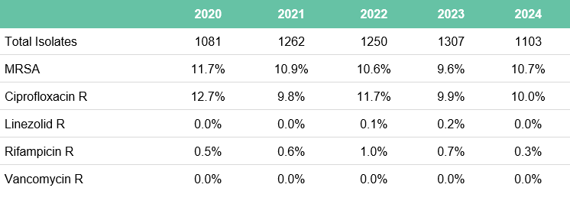
Antimicrobial resistance in invasive S. aureus infections in Ireland

Slide 36
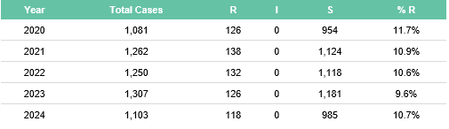
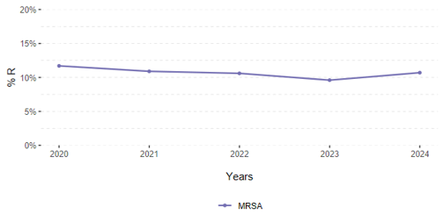
Meticillin resistance proportions in invasive S. aureus infections in Ireland
Commentary:
%MRSA decreased between 2020 and 2023, but increased slightly in 2024
The lowest %MRSA in 26 years of EARS-Net surveillance in Ireland was observed in 2023

Slide 37
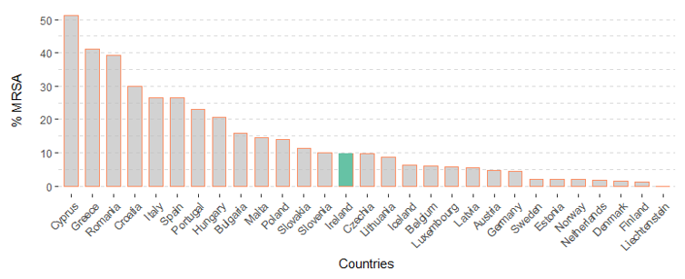
Meticillin resistance in invasive S. aureus infections in the EU/EEA in 2023
Commentary:
Ireland has moderately-low levels of MRSA compared to other EU/EEA countries

Slide 38
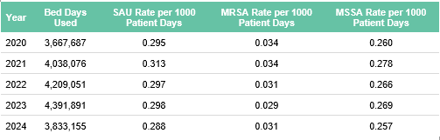
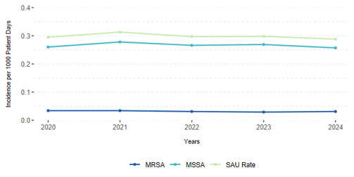
Invasive S. aureus incidence rates in Ireland
Commentary:
The trends in the MRSA rate per 1000 patient days mirrors that for %MRSA

Slide 39
Klebsiella pneumoniae invasive infections
Key points, 2024
Total Reports:
  511 cases from 32 labs in 2024
  ↓ from 604 cases from 35 labs in 2023
Consistent Lab Comparison:
  7% increase among 31 labs reporting both years
Antibiotic Resistance Trends:
  ↓ Resistance to most key antibiotics from 2023 to 2024
  ↓ 3GC resistance to 15% (from 16%)
  ↓ ESBL producers to 11% (from 12%)
  ↓ MDR to 3% (from 6%)
Carbapenem Resistance:
  ↓ to 1.2% (from 1.4%)
  Only 6 CPE isolates: 5 OXA-48, 1 KPC
5-Year Trend:
  Most indicators show a downward trend
  Of which, only aminoglycoside resistance shows statistical significance
Long-Term Variation:
  2024 resistance levels are lower than in 2020
  High year-to-year variation limits statistical significance
EU/EEA Comparison:
  AMR levels remain low for most key antibiotics

Slide 40
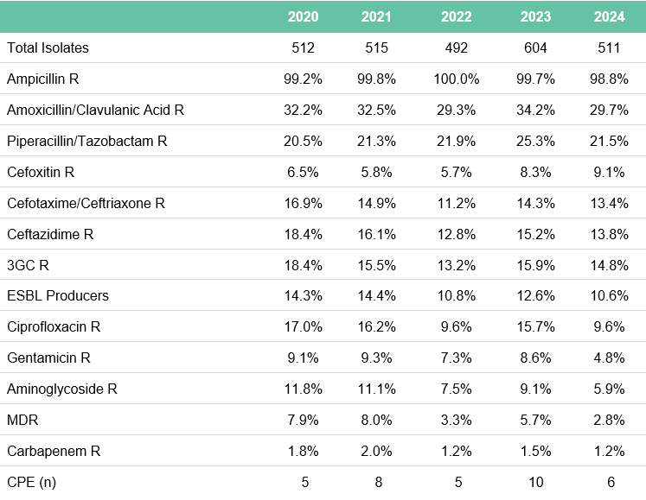
Antimicrobial resistance in invasive K. pneumoniae infections in Ireland

Slide 41
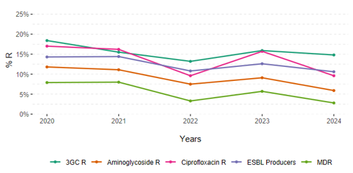
Key resistance indicators in invasive K. pneumoniae infections in Ireland

Slide 42
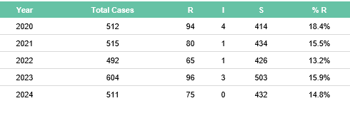
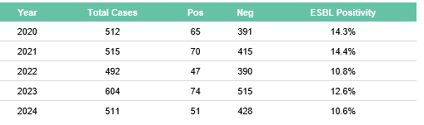
3rd-generation cephalosporin resistance and ESBL-production in invasive K. pneumoniae infections in Ireland
3rd-generation resistance
ESBL-production (or positivity)

Slide 43
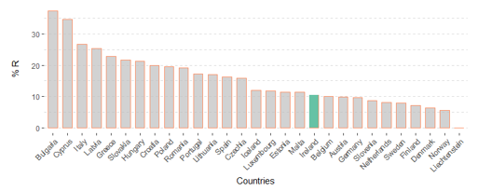
3rd-generation cephalosporin resistance in invasive K. pneumoniae infections in the EU/EEA in 2023

Slide 44
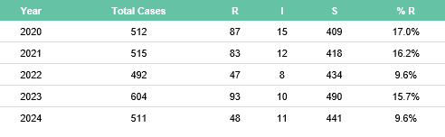
Fluoroquinolone resistance in invasive K. pneumoniae infections in Ireland

Slide 45
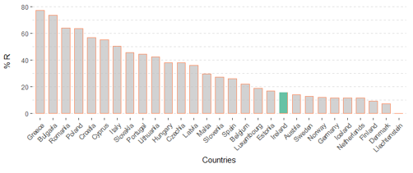
Fluoroquinolone resistance in invasive K. pneumoniae infections in the EU/EEA in 2023

Slide 46
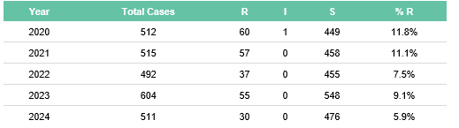
Aminoglycoside resistance in invasive K. pneumoniae infections in Ireland
Commentary:
Aminoglycoside resistance among invasive K. pneumoniae isolates shows a statistically significant downward trend over the past 5 years

Slide 47
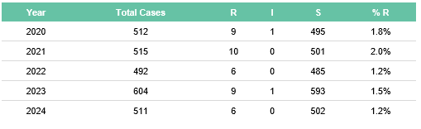
Carbapenem resistance in invasive K. pneumoniae infections in Ireland
Commentary: Carbapenem resistance among invasive K. pneumoniae remains at low levels
Note: In Ireland, we include ertapenem results when looking at carbapenem resistance in invasive K. pneumoniae isolates. This increases the sensitivity. Some isolates that produce the OXA-48 carbapenemase may be susceptible to the other carbapenems but resistant to ertapenem.

Slide 48
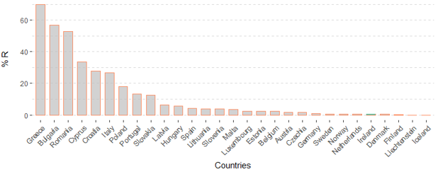
Carbapenem resistance in invasive K. pneumoniae infections in the EU/EEA in 2023
Commentary:
Ireland has one of the lowest levels of carbapenem-resistant K. pneumoniae among EU/EEA countries

Slide 49
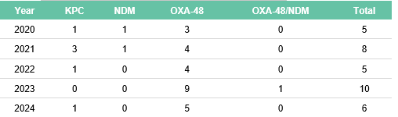
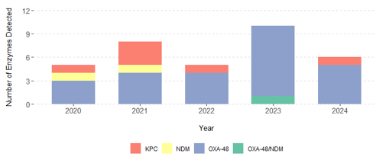
Carbapenemase-producing K. pneumoniae infections by enzyme type in Ireland
Commentary:
OXA-48 is the predominant carbapenemase reported among invasive K. pneumoniae isolates

Slide 50
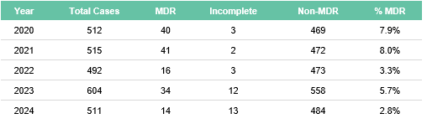
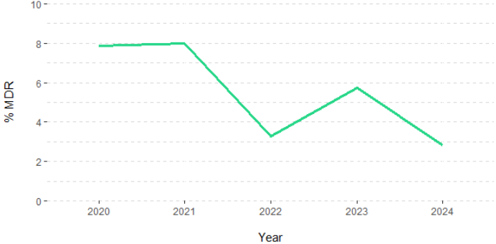
Multi-drug resistance in invasive K. pneumoniae infections in Ireland

Slide 51
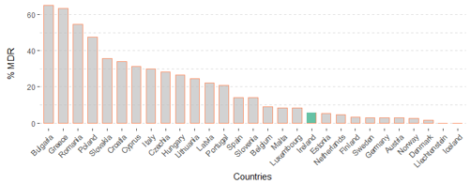
Multi-drug resistance in invasive K. pneumoniae infections in the EU/EEA in 2023
Commentary:
Ireland has low levels of MDR K. pneumoniae compared to other EU/EEA countries

Slide 52
Enterococcus faecium invasive infections
Key points, 2024
Total Reports:
  523 invasive E. faecium infections from 32 labs
  ↓ from 639 cases in 2023 (35 labs)
  Among 31 labs reporting for both 2023 and 2024: numbers stable
Vancomycin Resistance (%VREfm):
  ↑ slightly to 21.8% (2023: 21.4%)
  2023 had the lowest %VREfm in 20 years
  5-year trend shows significant decrease
Incidence Rates (per 1,000 patient days):
  VREfm: ↓ to 0.030 (2023: 0.031)
  VSEfm: ↓ to 0.107 (2023: 0.114)
  Total E. faecium: ↓ to 0.136 (2023: 0.145)
EU/EEA Context:
  VREfm is a growing problem across Europe
  Ireland shows a decreasing trend, but
  VREfm remains a significant challenge to Irish healthcare

Slide 53
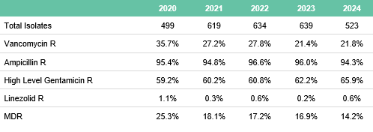
Antimicrobial resistance in invasive E. faecium infections in Ireland

Slide 54
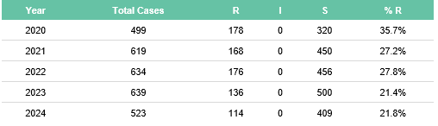
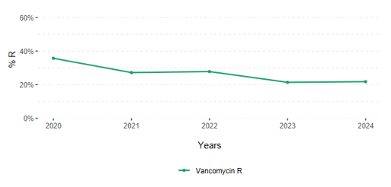
Vancomycin resistance in invasive E. faecium infections in Ireland
Commentary:
Although the %VREfm increased slightly in 2024, there is a statistically significant downward trend over the past 5 years

Slide 55
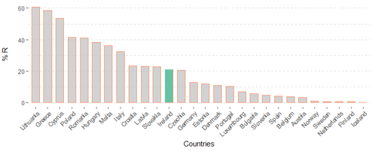
Vancomycin resistance in invasive E. faecium infections in the EU/EEA in 2023
Commentary:
Ireland has moderate levels of VREfm compared to other EU/EEA countries; while Ireland has seen decreasing resistance in recent years, many EU/EEA countries have experienced increasing trends

Slide 56
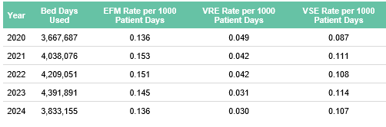
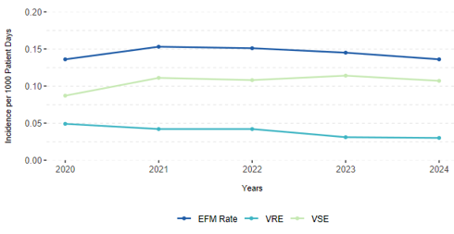
Invasive E. faecium incidence rates in Ireland
Commentary:
The trends in the VREfm rate per 1000 patient days mirror that for %VREfm

Slide 57
Pseudomonas aeruginosa invasive infections
Key points, 2024
269 invasive P. aeruginosa infections reported from 32 laboratories
↓ from 297 cases in 2023 (35 laboratories)
Among 31 labs reporting for both 2023 and 2024: 9% increase in reported cases
Multi-drug resistance (MDR) ↓ to 1.2% (2023: 3.4%)
AMR levels among invasive P. aeruginosa infections are low-to-moderate for most key antibiotics compared to most EU/EEA countries

Slide 58
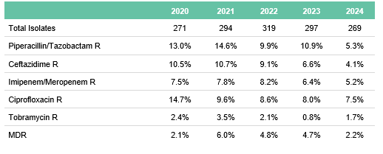
Antimicrobial resistance in invasive P. aeruginosa infections in Ireland

Slide 59

Key resistance indicators in invasive P. aeruginosa infections in Ireland
Commentary:
MDR among invasive P. aeruginosa isolates has decreased for the past 4 years,

Slide 60


Multi-drug resistance in invasive P. aeruginosa infections in Ireland

Slide 61
Enterococcus faecalis invasive infections
Key points, 2024
300 invasive E. faecalis infections reported from 32 laboratories
↓ from 389 cases in 2023 (35 laboratories)
Among 31 labs reporting for both 2023 and 2024: 12% reduction in reported cases
Vancomycin resistance: Only 1 isolate reported (0.3%)
High-level gentamicin resistance ↓ to 12% (2023: 17%)
Linezolid resistance: Only 1 isolate reported

Slide 62

Antimicrobial resistance in invasive E. faecalis infections in Ireland

Slide 63

Key resistance indicators in invasive E. faecalis infections in Ireland

Slide 64

High-level gentamicin resistance in invasive E. faecalis infections in Ireland

Slide 65

High-level gentamicin resistance in invasive E. faecalis infections in the EU/EEA in 2023

Slide 66
Acinetobacter species invasive infections
Key points, 2024
59 invasive Acinetobacter spp. infections reported from 32 laboratories
↓ from 71 cases in 2023 (35 laboratories)
Among 31 labs reporting for both 2023 and 2024: numbers stable
Resistance to key antibiotics, including carbapenems, remains low
No MDR or carbapenem resistance reported among invasive Acinetobacter spp. infections in Ireland in 2024
MDR and carbapenem-resistant Acinetobacter spp. are a major problem in Southern and Eastern Europe
  In 2023, 6 countries reported MDR rates >75%
  8 countries reported carbapenem resistance >75%

Slide 67

Antimicrobial resistance in invasive Acinetobacter infections in Ireland

Slide 68

Key resistance indicators in invasive Acinetobacter infections in Ireland
Commentary:
Resistance proportions for all the key antibiotics remain at low levels in Ireland

Slide 69

Carbapenem resistance in invasive Acinetobacter infections in the EU/EEA in 2023
Commentary:
Ireland had 0% carbapenem resistance among Acinetobacter spp. in both 2023 and 2024, among the lowest levels in the EU/EEA.

Slide 70
Streptococcus pneumoniae invasive infections
Key points, 2024
369 invasive S. pneumoniae infections reported from 32 laboratories
↑ from 361 cases in 2023 (35 laboratories)
Among 31 labs consistently reporting for both 2023 and 2024: 19% increase in reported cases
Penicillin non-wild type (Pen-NWT) refers to isolates with MIC > 0.06 mg/L, classified as “susceptible, increased exposure” (I) or resistant (R)
Wild type (WT) strains have no detectable resistance mechanisms and are typically susceptible to penicillin
21% of isolates were Pen-NWT in 2024
↑ from 17% in 2023

Slide 71

Antimicrobial resistance in invasive Streptococcus pneumoniae infections in Ireland

Slide 72

Key resistance indicators in invasive Streptococcus pneumoniae infections in Ireland

Slide 73

Penicillin non-susceptibility (or non-wild-type) in invasive
Streptococcus pneumoniae infections in the EU/EEA in 2023
Commentary:
Ireland has one of the higher proportions of penicillin-non-wild-type (or isolates that are not penicillin-susceptible) among invasive S. pneumoniae in the EU/EEA.

Slide 74
Invasive Group A Streptococcus (iGAS) infections (for AMR)
Key points, 2024
As of 2024, the case definition of iGAS for AMR surveillance was amended to include blood and CSF isolates only, aligning with other EARS-Net pathogens
Historical data in this report have been adjusted accordingly
92 invasive GAS infections reported from 32 laboratories
↓ from 182 cases in 2023 (35 laboratories)
Among 31 labs consistently reporting for both 2023 and 2024: 46% reduction in reported cases
  Reflects decline following iGAS upsurge from late 2022 to summer 2023 (post-COVID-19)
Erythromycin resistance among invasive GAS infections ↑ to 9% (2023: 4%)

Slide 75

Antimicrobial resistance in iGAS infections in Ireland

Slide 76

Number of iGAS infections (submitted to EARS-Net for the purpose of AMR surveillance) in Ireland in the last 5 years
Commentary:
The low numbers in 2020 and 2021 correspond to the COVID-19 pandemic period. At the end of 2022 and throughout 2023, Ireland experienced an upsurge in iGAS infections.

Slide 77
Invasive Group B Streptococcus (iGBS) infections (for AMR)
Key points, 2024
For AMR surveillance, data on invasive GBS (iGBS) infections are collected from all age groups, not just infants <90 days (which is the current notifiable group in Ireland)
136 iGBS infections reported from 32 laboratories
↑ from 125 cases in 2023 (35 laboratories)
Among 31 labs consistently reporting for both 2023 and 2024: 17% increase in reported cases
Erythromycin resistance among invasive GBS infections ↑ to 47% (2023: 41%)

Slide 78

Antimicrobial resistance in iGBS infections in Ireland

Slide 79

Number of iGBS infections (submitted to EARS-Net for the purpose of AMR surveillance) in Ireland in the last 5 years

Slide 80
Candida spp. invasive infections
Key points, 2024
211 invasive Candida spp. infections reported from 32 laboratories
↓ from 363 cases in 2023 (35 laboratories)
Among 31 consistent labs: 27% decrease in reported cases
Candida auris is a recently emerged pathogen causing severe hospital-acquired infections
  Important to speciate candida isolates to exclude C. auris
In 2024, all but one candida isolate was speciated
Since surveillance began in 2017, no invasive C. auris infections have been reported in Ireland

Slide 81


Breakdown of invasive Candida spp. infections by species in Ireland
Invasive Candida spp. infections by species in the latest year in Ireland

Slide 82
Acknowledgements
Sincere thanks to
all microbiology laboratories for their continued support for EARS-Net and for providing data for this report;
the National MRSA Refence Laboratory;
the Irish Meningitis and Sepsis Reference Laboratory (IMSRL);
the National Carbapenemase-Producing Enterobacterales Reference Laboratory Service (CPEaRLS);
EARS-Net at ECDC for providing the European data

