Slide 1
National Environmental Incidents Surveillance - Technical notes

Slide 2
Introduction
Background
Prior to 2025, information on environmental incidents and the public health responses was captured in regional logs only, without collation of information at national level. Since March 2025, the Health Protection Surveillance Centre (HPSC) in collaboration with the Regional Public health departments (RHS’s) established a new national approach for the collection of information on the Public Health investigations and response to Environmental incidents with the potential to impact public health in Ireland. The overarching aim of collecting this information is to protect the Irish population against harm from any environmental hazards. Following a nine month pilot period ending December 2025, formal data collection commenced and is published on a quarterly basis.
Inclusion Criteria
Any environmental incidents for which Public Health Departments are asked for advice and /or participated in investigations and there is the potential for impact on public health including: drinking water, bathing water, Legionella detections, other water incidents, extreme weather events, air quality anomalies, land/soil contamination, poisonings and other incidents.
System description
All environmental incidents where advice is sought from Regional public health departments are logged locally on a standardised excel sheet. Information is captured on the incident type, population potentially affected, actions taken, health and health service impact and recommendations. On a quarterly basis, data is collated from regional logs and added to the national database housed at HPSC. This centralised national database enables us to better understand the number of incidents managed by public health departments, their impact on health and health services, and actions undertaken to protect the public and any recommendations arising from them. Surveillance reports summarising the distribution of incidents and trends will be produced quarterly by HPSC.

Slide 3
Acknowledgements and guidance resources
Sincere thanks are extended to all those who participated in the development of the Environmental incidents database and creation of this report. These include the Environmental and Health subgroup of the National All Hazards Surveillance Group, and clinical and epidemiological staff in public health departments.
These slides and corresponding were prepared by staff in the Environment and Health Surveillance Unit at HSE HPSC and National Health Protection Office. These slides may be copied and reproduced, provided HPSC is acknowledged.
See HPSC website for more information on Environmental and Health including guidance and resources.

Slide 4
Drinking water - Guidance resources and regulations
The European Union (Drinking Water) Regulations 2023 establish a comprehensive legal framework to ensure the safety, quality, and accessibility of drinking water in Ireland, aligning with EU Directive 2020/2184. These regulations mandate a risk-based approach to water safety across the entire supply chain—from source protection to distribution—requiring regular monitoring, public transparency, and strict parametric standards for microbiological, chemical, and indicator parameters. They define responsibilities for water suppliers, supervisory authorities, and other stakeholders, introduce minimum hygiene standards for materials and treatment chemicals, and set out enforcement mechanisms including penalties and authorised inspections. The regulations also aim to improve access to safe drinking water, especially for vulnerable groups, and promote public awareness and data sharing to protect human health.
In Ireland, The Health Service Executive (HSE) must be consulted by water suppliers (e.g., Uisce Éireann) whenever a potential public health risk is identified. The HSE are responsible for risk assessment, directing, and advising on emergency measures like Boil Water Notices (BWN) when water quality fails to meet legal standards.
Irish drinking water is tested for microbiological contaminants, such as E. coli, coliform bacteria, and enterococci, to ensure it is safe to drink. It is also tested for chemical parameters including metals like lead, copper, and iron, disinfectants like chlorine, and other substances like nitrates, fluoride, and Trihalomethanes (THMs). The specific tests conducted are based on the Drinking Water Regulations (S.I. No. 278 of 2007), and the frequency of testing depends on the size and type of the water supply.

Slide 5
Drinking Water - Examples of hazards for which parameters are tested
Biological contaminants | These indicate faecal contamination and are crucial for determining the presence of harmful pathogens e.g E. coli, Coliforms, Enterococci, Cryptosporidium, Giardia
Disinfection byproducts | Byproducts of the disinfection process, which need to be monitored e.g Trihalomethanes (THMs)
Turbidity | Measures the cloudiness or haziness of the water
Nitrates & Nitrites | Can indicate agricultural or sewage pollution e.g Fertilizers
Pesticide | Can contaminate water through direct sources such as spills and indirect sources like spray drift and runoff
System failure | Mechanical issues at the water plant e.g Chlorine dosing pump failure
Taste & Staining issue | Metals and compounds that can affect taste, colour, and water quality . These can cause health issues if exposed over a long time or at high levels e.g. Ammonium, Aluminium, Manganese, Chloride
Metals originating from pipes | Metals that can leach from pipes and fittings, especially in older buildings e.g. Lead, Nickle, Iron and Copper
Hydrocarbons | May be present if there is a fuel spill into the water system
Other | Herbicide

Slide 6
Monitoring drinking water – types of water supply
Water supplies covered under EU and Irish legislation
The Public Water Supply service approximately 80% of the population and is managed by Uisce Éireann (Irish Water), the national water services utility. Uisce Éireann handles the abstraction, treatment, and distribution of public drinking water across the country through a network of supply zones, treatment plants, and pumping stations. The water quality in these public supplies is regulated by the Environmental Protection Agency (EPA) and is generally high and safe to drink
Public Group Schemes service approximately 4.3% of the population are supplies where the abstraction and treatment of the water is managed by Irish Water and the distribution of treated water to the users is managed by a local community group.
Private Group Schemes service approximately 3.4% of the population are supplies where the abstraction, treatment and distribution of treated water are all managed by a local community group.
Small Private Supplies are supplies serving a commercial or public activity, and the abstraction, treatment and distribution of treated water are managed by the commercial or public entity. Examples of commercial or public activities served by small private supplies include pubs and restaurants, crèches and national schools.
Other private source are made up primarily of private household wells supply 9.9 % of households. Household Wells are supplies that supply a volume of water less than 10 cubic metres a day or serve fewer than 50 people, and do not supply a commercial or public activity. Other private source can also include water sources from, for example: rivers, streams or temporary tankers. In rural Ireland where households are supplied by other private source the responsibility for managing the supply lies with the householder, testing frequency varies; households are advised to test for microbial contamination annually and chemical contamination every three years, while larger private supplies and those serving public/commercial premises are legally required to be tested twice a year for microbial contaminants like E. coli.
Source: Ireland's UN SDGs - Goal 6 Clean Water and Sanitation 2024

Slide 7
Bathing Water - Guidance resources and regulations
Bathing water quality can be impacted by heavy rainfall, agricultural and urban runoff, wastewater treatment failures, and contamination from animal or bird faeces.
Under the Bathing Water Quality Regulations 2008, which implement the EU Bathing Water Directive (2006/7/EC), local authorities are responsible for identifying and monitoring bathing waters, assessing water quality, managing pollution incidents, informing the public, and reporting results to the Environmental Protection Agency (EPA). The EPA assesses monitoring results and assigns bathing water classifications based on data collected over a four-year period. Bathing waters are classified as Poor, Sufficient, Good, or Excellent.
The Health Service Executive (HSE) advises local authorities on public health risks associated with bathing waters and works with environmental agencies to ensure water quality information, warnings, and bathing restrictions are communicated effectively to the public during the bathing season.
Commercial and public swimming pools are not governed by statutory water regulations; and therefore, are not included in local authority bathing water monitoring programmes. They are however, required to operate in accordance with established industry standards and comply with the Swimming Pool Safety Guidelines issued by Water Safety Ireland, as well as the Safety, Health and Welfare at Work Act 2005. The HSE and EPA may investigate a swimming pool in cases of suspected contamination or public health incidents.

Slide 8
Bathing Water Incident - Guidance resources and regulations
In Ireland, bathing water is monitored by local authorities during the bathing season (June 1st to September 15th). In this context bathing water is defined as any coastal, estuarine, or inland surface water (such as a lake or river) explicitly designated or traditionally used by a large number of bathers for swimming and recreation. The majority of BWI are therefore unlikely to be reported until Q3
There is no single piece of legislation dedicated solely to swimming pools. Instead, swimming pool operators are guided by a combination of health and safety legislation, public health requirements, and industry standards/guidelines. Incidents involving swimming pools are reported to Departments of Public Health year round.

Slide 9
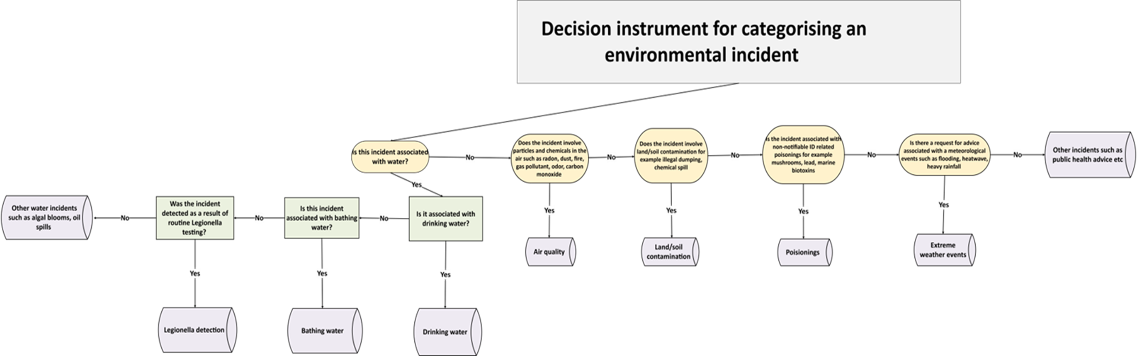
Technical notes: Categorising an incident

