Slide 1
National Environmental Incidents Surveillance
Quarter 1 2026

Slide 2
Key points for Quarter 1 2026
There were 80 recorded Environmental Incidents (EI) on which advice was sought this quarter
The highest number of Environmental incidents for which advice was sought were reported in HSE Dublin and Midlands (n= 21)
Drinking water was the highest reported incident type for which advice was sought accounting for 86% of incidents (n=69). The majority of Drinking Water Incidents (DWI) were not directly related to biological contaminants
Between January and March 2026, one Bathing Water Incident (BWI) was reported in a commercial leisure facility
HSE Public Health advice was also sought for:
  3 X Legionella incidents
  3 X Air quality incidents
  1 X Extreme weather event
  1 X Land/soil contamination incident
  2 X Other incidents

Slide 3
Environmental Incidents by type and area in Quarter 1, 2026
Drinking water incidents account for the majority of EI for which advice was sought in Q1, 2026 (86%)
Low numbers of air quality, Legionella detections, Bathing water incidents, Land/soil contamination and other incidents were recorded. Advice was sought on one extreme weather incident
No poisonings were reported
Incident type | Public Health HSE Dublin and North East | Public Health HSE Dublin and Midlands | Public Health HSE Dublin and South East | Public Health HSE South West | Public Health HSE Mid West | Public Health HSE West and North West | Total Q1
Drinking water | 4 | 18 | 16 | 16 | - | 15 | 69
Bathing water | 0 | 0 | 0 | 1 | - | 0 | 1
Legionella incidents | 0 | 0 | 0 | 0 | - | 3 | 3
Other water incidents | 0 | 0 | 0 | 0 | - | 0 | 0
Air quality | 0 | 1 | 1 | 0 | - | 1 | 3
Extreme weather events | 0 | 0 | 1 | 0 | - | 0 | 1
Land/soil contamination | 0 | 0 | 0 | 0 | - | 1 | 1
Poisonings | 0 | 0 | 0 | 0 | - | 0 | 0
Other incidents | 0 | 2 | 0 | 0 | - | 0 | 2
Category not recorded | 0 | 0 | 0 | 0 | - | 0 | 0
Total | 4 | 21 | 18 | 17 | - | 20 | 80
*No data available for Public Health HSE Mid West during Q1 2026

Slide 4
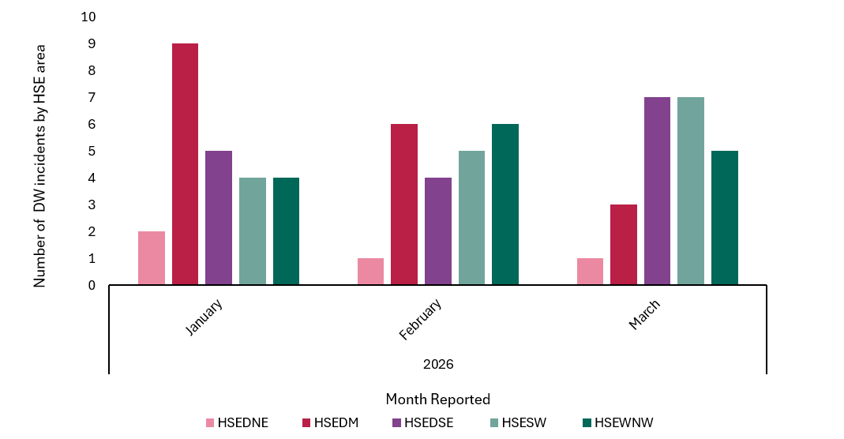
Drinking Water Incidents Quarter 1, 2026
Between January and March 2026, advice was sought for 69 DWI incidents
Similar number of incidents were reported each month; 35% (n= 24) of DWI were in January, 32% (n= 22) in February and 33% (n= 23) in March
The highest number of DWI for which advice was sought were recorded in HSE Dublin and Midlands (n=18)

Slide 5
Of the 69 drinking water incidents (DWIs) for which Public Health were consulted, biological contamination was the most frequently reported notification category, accounting for 30% of incidents (n=21). The majority of biological contamination incidents (12/21; 57%) involved coliforms, E. coli, enterococci, or a combination of these organisms
Other commonly reported notification categories included:
  Taste and staining issues: 17 incidents (25%), of which 88% were associated with exceedances of naturally occurring inorganic chemicals
  Metals originating from pipes: 9 incidents (13%), with lead and/or iron identified as the cause in 8 of the 9 incidents
  System failures: 7 incidents (10%)
Drinking Water Incidents Quarter 1, 2026 cont.
 | Water Supply Type
Drinking Water Notification Category | Public water supplies | Public group scheme | Small public supplies | Private group water schemes | Small private supplies | Other private source | Other | Total
Biological contaminants | 15 | 0 | 0 | 1 | 5 | 0 | 0 | 21
Disinfection byproducts | 1 | 2 | 0 | 0 | 0 | 0 | 0 | 3
Hydrocarbons | 1 | 0 | 0 | 0 | 0 | 0 | 0 | 1
Metals originating from pipes | 8 | 0 | 0 | 0 | 1 | 0 | 0 | 9
Nitrates & Nitrites | 1 | 1 | 0 | 1 | 2 | 0 | 0 | 5
Pesticide | 0 | 0 | 0 | 0 | 1 | 0 | 0 | 1
System failure | 6 | 0 | 0 | 0 | 0 | 0 | 1 | 7
Taste & Staining issue | 11 | 0 | 0 | 0 | 6 | 0 | 0 | 17
Turbidity | 3 | 0 | 0 | 0 | 0 | 0 | 0 | 3
Other | 2 | 0 | 0 | 0 | 0 | 0 | 0 | 2
Total | 48 | 3 | 0 | 2 | 15 | 0 | 1 | 69
HSE - Health Protection Surveillance Centre.

Slide 6
Drinking Water Incidents Quarter 1, 2026 cont.
Information on advice for the public was available for 64 of the 69 DWIs. Of those with recorded information, 53% resulted in advice being issued for the public
A total of 17 BWN, 14 DNCs, and 3 other advisories for the public were issued in response to DWIs
For incidents involving biological contaminants, information on public advice was available for 20 of the 21 incidents. Of these, 55% resulted in immediate action or advice being issued for the public
Systems failures (83%) and nitrate/nitrite-related incidents (80%) were more likely to result in immediate actions for the public than taste and staining incidents, which although reported more frequently, only resulted in immediate advice or action for the public 35% of the time.
Thirty DWIs were deemed to not require any immediate action by the public
 | Advice issued by Public Health Department to the Public
Drinking Water Notification Category | Boil water notice | Do Not Consume notice | No public action advised | Other | Action not reported | Total
Biological contaminants | 9 | 2 | 9 | 0 | 1 | 21
Disinfection byproducts | 0 | 0 | 3 | 0 | 0 | 3
Hydrocarbons | 0 | 0 | 0 | 1 | 0 | 1
Metals originating from pipes | 1 | 3 | 3 | 1 | 1 | 9
Nitrates & Nitrites | 0 | 4 | 0 | 0 | 1 | 5
Pesticide | 0 | 0 | 0 | 0 | 1 | 1
System failure | 4 | 1 | 1 | 0 | 1 | 7
Taste & Staining issue | 1 | 4 | 11 | 1 | 0 | 17
Turbidity | 1 | 0 | 2 | 0 | 0 | 3
Other | 1 | 0 | 1 | 0 | 0 | 2
Total | 17 | 14 | 30 | 3 | 5 | 69
HSE - Health Protection Surveillance Centre.

Slide 7
Summary of additional Incidents reported, Quarter 1, 2026
Public Health advice also sought on:
  One Bathing Water incident at a leisure facility
  Three Legionella incidents
  Three Air quality incidents relating to a fire, PM10 and an undisclosed pollutant
  One Extreme weather event involving flooding
  One Land/soil contamination incident related to illegal dumping
  PH were consulted for advice on two incidents in the Other category involving infectious disease in animals that had the potential to affect persons in close proximity to the animals
    Advice was issued for the general public for one of these incidents and targeted for another three incidents

Slide 8
Technical notes
Data are based on notifications to the National Environmental Incidents Database. Data are provisional and subject to ongoing review, validation and update
Suggested report citation: HSE-Health Protection Surveillance Centre. National Environmental Incidents Surveillance in Ireland, Q1 2026. Dublin, HPSC, October 2026.
Extended technical notes can be found in the National Environmental Incidents Surveillance Report Technical notes document

