Slide 1


Antimicrobial resistance in Neisseria gonorrhoeae, Ireland 2010-2024
Health Protection Surveillance Centre & National Gonococcal Reference Laboratory, SJH.
Based on data from isolates submitted to EURO-GASP
January 2026

Slide 2


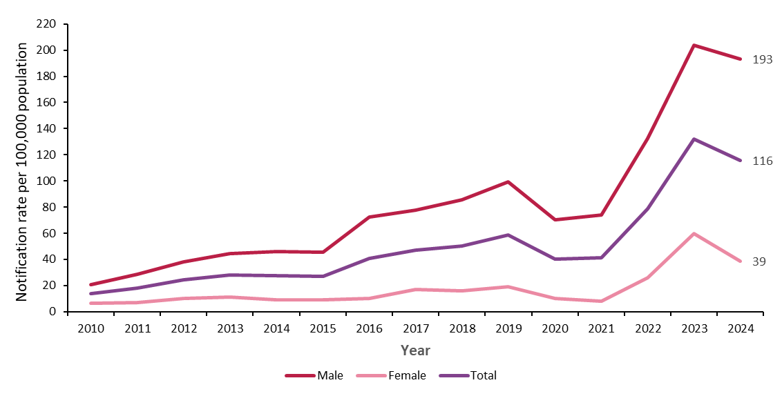
Gonorrhoea in Ireland
Trend in notification rate of gonorrhoea by gender, 2010-2024
Introduction of case-based reporting
Introduction of SH24 home sampling
There were 5,960 cases of gonorrhoea notified in 2024
Further information on epidemiology of gonorrhoea in 2024 can be found in the Sexually Transmitted Infections (STIs) in Ireland:
Trends to the end of 2024 report
Male includes cis male and trans male (where known) and female includes cis female and trans female (where known)
Rates calculated: 2010-2013=2011 census, 2014-2019= 2016 census, 2020-2024= 2022 census
Between 2021 and 2022 free home Sexually Transmitted Infections (STI) sampling was introduced www.sexualwellbeing.ie

Slide 3

Antimicrobial resistance (AMR) in Neisseria gonorrhoeae, a World Health Organization priority
Gonorrhoea infection is becoming increasingly difficult to treat due to the development of antimicrobial resistance to all major drug classes used to treat infection
The extended spectrum cephalosporin (ESC), ceftriaxone, is the current last remaining option for first-line treatment
The WHO Bacterial Priority Pathogen List, 2024, includes 15 families of antibiotic-resistant pathogens, grouped into critical, high and medium categories of priority for research and development and for public health measures. N. gonorrhoeae, of which multidrug-resistant strains have emerged, limiting treatment options has been listed in the high priority category

Slide 4
Euro-GASP
European Gonococcal Antimicrobial Surveillance Programme
Euro-GASP monitors trends in gonococcal antimicrobial susceptibility to detect increasing and emerging antimicrobial resistance and to provide quality-assured data to inform national and international treatment guidelines
European Gonococcal Antimicrobial Surveillance Programme (Euro-GASP) (europa.eu)
Euro-GASP is a sentinel surveillance programme involving centralised or de-centralised antimicrobial susceptibility testing of N. gonorrhoeae isolates in participating countries
EU/EEA Member States participate in Euro-GASP’s annual survey conducted over 3 month period (September-November)
Countries should aim to report AMR and linked epidemiological data for 100 cases (or 10%) of total national notifications and up to 200 cases for countries with a higher number of national notifications

Slide 5
Irish participation Euro-GASP
Participating since 2010
Antimicrobial susceptibility testing performed by National Gonococcal Reference Laboratory (NGRL), St James’s Hospital (2017-present), Department of Clinical Microbiology St James's Hospital (SJH) (2013-2016), and Public Health England (2010-2012)
Linked epidemiological data is collated from isolate referral forms, enhanced surveillance forms and clinical notes (where available)
Data source: All isolates received and tested in the NGRL over Euro-GASP survey period. Most recent data presented in this report are on 243 Irish isolates reported for 2024 (September-November): they represent 4% of total national gonorrhoea notifications and 20% of isolates tested at NGRL in 2024
This report is based on data submitted to Euro-GASP and does not represent the total antimicrobial resistant profile nationally for 2024

Slide 6
Epidemiological characteristics of individuals with isolates submitted to Euro-GASP by gender and mode of transmission, 2024
Comparing 2023* and 2024 isolates:
The proportion of isolates from females remains stable,11% in 2023 to 12% in 2024
The age distribution of all isolates remains relatively unchanged; the median age has increased slightly from 29 yrs in 2023 to 31 yrs in 2024
The proportion of isolates from people living in Dublin has increased from 79% in 2023 to 81% in 2024
  The large proportion of isolates from the Dublin area is not unexpected. The NGRL test samples predominantly from STI clinics in Dublin
~ gbMSM: gay, bisexual and other men who have sex with men
*Antimicrobial resistance in Neisseria gonorrhoeae, Ireland 2010-2023

Slide 7

Epidemiological characteristics of individuals with isolates submitted to Euro-GASP by gender and mode of transmission, 2024
Note: Direct comparison with previous years is not advised due to lack of completeness in enhanced data
From the available enhanced data:
12% of isolates are from individuals who are living with HIV
47% of isolates were obtained from genital swabs
12% of individuals were co infected with chlamydia
27% of individuals had a previous gonorrhoea infection
ⴕ Not all individuals are tested for gonorrhoea at each site, and individuals can be infected at more than one site
^ Concurrent STI: another STI diagnosed within 4 weeks of the positive gonorrhoea notification
~ gbMSM: gay, bisexual and other men who have sex with men

Slide 8
Epidemiological antimicrobial resistance definitions
To allow for European comparison, results from antimicrobial susceptibility testing were interpreted in line with Euro-GASP analysis, using breakpoints from the European Committee on Antimicrobial Susceptibility Testing (EUCAST):
cefixime resistance, MIC* >0.125 mg/L
ceftriaxone resistance, MIC >0.125 mg/L
tetracycline resistance, MIC> 0.5mg/L
ciprofloxacin resistance, MIC >0.06 mg/L
β-lactamase production for detection of high-level penicillin resistance, penicillinase screen positive
azithromycin epidemiological cut-off value (ECOFF), MIC >1 mg/L^
*MIC: Minimum Inhibitory Concentration
^Until 2018, EUCAST set a breakpoint of MIC 0.5 mg/L for N. gonorrhoeae azithromycin resistance. This has since been replaced with an 'epidemiological cut-off’ (ECOFF) of >1.0 mg/L
European Committee on Antimicrobial Susceptibility Testing (EUCAST). ‘Breakpoint tables for interpretation of MICs and zone diameters, version 14’ EUCAST

Slide 9
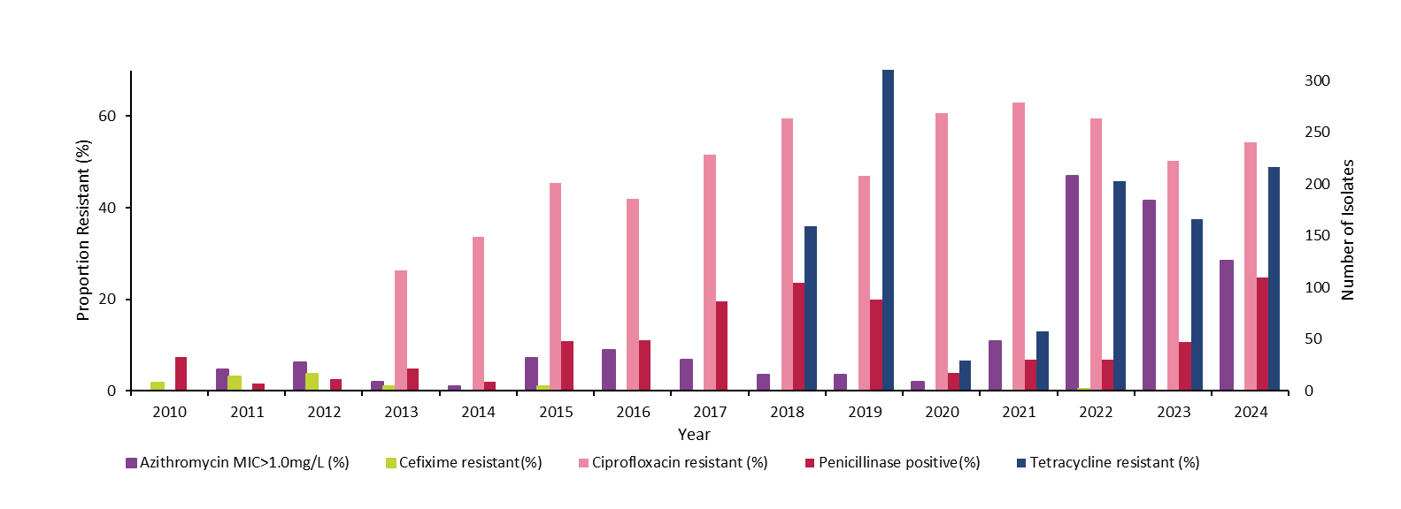
Trends in gonorrhoea antimicrobial resistance in Ireland* (Euro-GASP, 2010-2024)
^
**
*EUCAST guidelines, version 14’ EUCAST
**Azithromycin MIC above ECOFF (>1 mg/L)
^1 cefixime resistant isolate in 2022

Slide 10
Trends in gonorrhoea antimicrobial resistance in Ireland* (Euro-GASP, 2010-2024)
AZM- MIC>1.0mg/L – above ECOFF; CFM-R, cefixime- resistant; CIP-R, ciprofloxacin-resistant; PPNG, penicillinase positive, TET-R, tetracycline resistance
*EUCAST guidelines, version 14’ EUCAST

Slide 11
Cefixime and Ceftriaxone
In 2024, one extended cephalosporin resistant isolate was reported in Ireland outside the study period (Sept-Nov 2024). This isolate exhibited resistance to both cefixime and ceftriaxone.
Ceftriaxone is the only recommended empirical monotherapy for treatment of gonorrhoea at present (for treatment guidelines, see Gonorrhoea - HSE.ie)
One ceftriaxone resistant isolate was reported in Ireland in 2018 (outside Euro-GASP survey period): http://ndsc.newsweaver.ie/epiinsight/bv8rkspoij310gkzp9yxn5?a=1&p=53827183&t=17517774
Ireland has not yet reported a ceftriaxone resistant isolate to the Euro-GASP programme

Slide 12
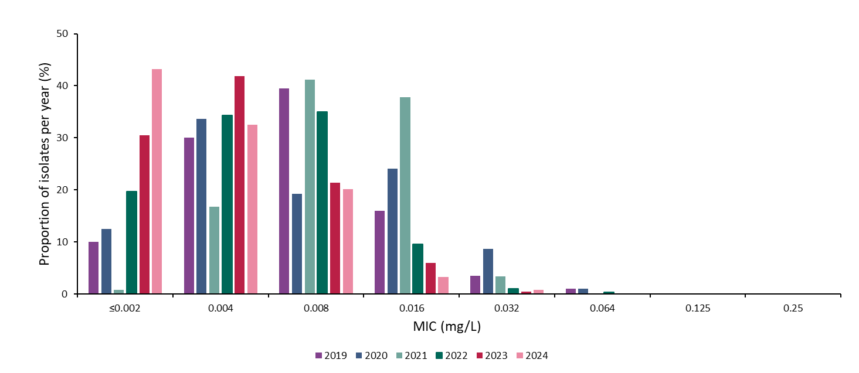
Ceftriaxone MIC (mg/L) among gonococcal isolates in Ireland, (Euro-GASP, 2019-2024)
Resistant
The line indicates the threshold for antimicrobial resistance according to EUCAST guidelines.

Slide 13
Azithromycin
Dual therapy including azithromycin is no longer recommended as first-line treatment for gonorrhoea
-for treatment guidelines, see Gonorrhoea - HSE.ie
The European Committee on Antimicrobial Susceptibility Testing (EUCAST) removed the clinical resistance breakpoint of >0.5mg/L for azithromycin treatment of gonorrhoea
  Use of the Epidemiological Cut-Off Value (ECOFF) of >1.0mg/L is now recommended.
Interpretation using the ECOFF was retrospectively applied for analysis of trends in azithromycin susceptibility
The proportion of isolates exhibiting MICs above the ECOFF decreased to 28% in 2024
  Compared with 42% in 2023, 47% in 2022, 11% in 2021, 2% in 2020 and 4% in 2019
  Although there has been a decrease in proportion of isolates exhibiting MICs above the ECOFF in 2024, the increase above 2020 levels may reflect use of azithromycin for non-genital infections
Isolates with MICs above the ECOFF by sex and mode of transmission in 2024

Slide 14
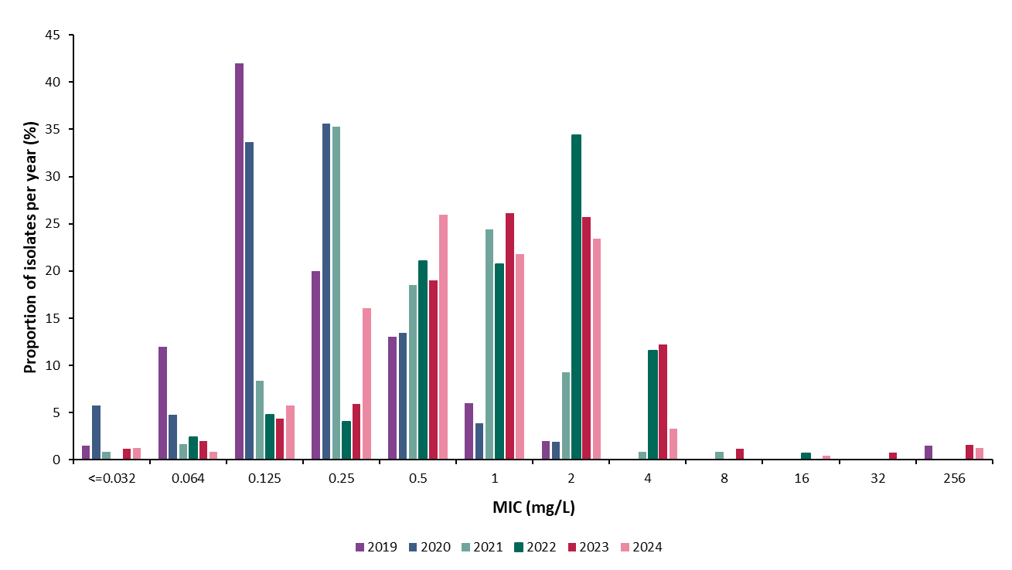
Azithromycin MIC (mg/L) among gonococcal isolates in Ireland (Euro-GASP, 2019-2024)
ECOFF value >1mg/L

Slide 15

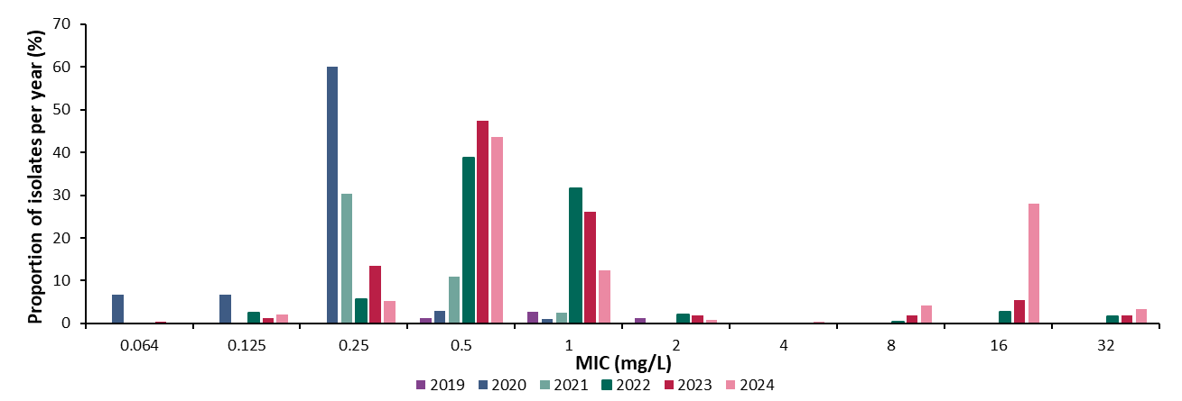
Tetracycline resistance MICs among gonococcal isolates in Ireland, 2019-2024
The European Committee on Antimicrobial Susceptibility Testing (EUCAST) updated the resistance breakpoint to > 0.5mg/L for tetracycline treatment of gonorrhoea in 2023. Interpretation using the new breakpoint was retrospectively applied for analysis of trends in tetracycline resistance

Slide 16
Other antimicrobials
Ciprofloxacin may be recommended for treatment of gonorrhoea in cases of cephalosporin allergy if the isolate is known to be quinolone sensitive
54% of isolates were resistant to ciprofloxacin in 2024, an increase of 4% from 2023
The percentage of female isolates with Ciprofloxacin resistance increased from 33% in 2023 to 57% in 2024
The percentage of gbMSM isolates with Ciprofloxacin resistance increased from 59% in 2023 to 70% in 2024
Isolates resistant to ciprofloxacin by sex and mode of transmission in 2024
Production of β-lactamase confers high level resistance to penicillin
25% of isolates produced β-lactamase (i.e. penicillinase screen positive) in 2024
  Increased proportion from 11% in 2023

Slide 17
Key points summary
These data have important implications for the clinical management of gonorrhoea in Ireland:
Gonorrhoea notifications have risen by 112.5% from 2019 (n=2805) to 2024 (n=5,961)
Data submitted to Euro-GASP covered 4% of all 2024 gonorrhoea notification
One case of extended spectrum cephalosporin resistant N. gonorrhoeae was reported outside the study period (Sept-Nov 2024)
Azithromycin ECOFF above (MIC >1 mg/L) in 28% of isolates, a reduction of 33% from 2023
Ciprofloxacin resistance (MIC >0.06 mg/L) in 54% of isolates, an increase of 4% from 2023
Tetracycline resistance (MIC >0.5 mg/L) in 49% of isolates, an increase of 29% from 2023
β-lactamase (i.e. penicillinase screen positive) in 25% of isolates, an increase of 127% from 2023

Slide 18
Summary of Gonorrhoea Surveillance Evaluation
An evaluation of gonorrhoea surveillance in Ireland was carried out in late 2024 and early 2025 to assess the current surveillance system from the perspective of laboratory, clinical, and public health professionals. It found that while core laboratory data reporting is robust, enhanced surveillance data—such as partner notification, ethnicity, and mode of transmission was often incomplete, especially in high-burden regions like Dublin and during the COVID-19 pandemic. The system is generally considered acceptable to staff working within the public health system, but manual data entry and lack of integration between IT systems were major challenges.
These findings are timely as Ireland prepares to transition to the new Outbreak, Case and Incident Management and Surveillance System (OCIMS). The evaluation highlights the need for automation, better interoperability between systems, and streamlined data collection processes to reduce burden and improve data quality. Strengthening these areas will enhance Ireland’s ability to respond to rising gonorrhoea cases and antimicrobial resistance, ensuring both national oversight and effective local action.

Slide 19
Public health implications and key recommendations for Public Health
Surveillance of AMR in N. gonorrhoeae is crucial for monitoring national and international trends in antimicrobial resistance. Strengthening N. gonorrhoeae and N. gonorrhoeae AMR surveillance should be a priority to safeguard existing antimicrobial drugs and deliver effective public health measures
Lack of complete enhanced data on N. gonorrhoeae notifications make it difficult to interpret data trends and effectively monitor disease transmission dynamics
Initiatives to improve data collection and completeness:
  HPSC along with colleagues in Public Health and the Gay Men’s Health Service (GMHS) are participating in a European Centre for Disease Prevention and Control (ECDC) project designed to improve national surveillance systems for STIs through using electronic health records (EHR) (EHR-STI). The aim is to identify a data flow process that will improve the timeliness, and completeness for enhanced data on STI notifications. The project has directly informed the development of the HIV/STI component in the new Outbreak, Case and Incident Management and Surveillance System (OCIMS) OCIMS will replace CIDR and is due to go live in 2026 OCIMS has been developed to future proof, digitalise and strengthen our national surveillance system, providing benefits to both clinics and public health.

Slide 20
Public health implications and key recommendations for Public Health Cont.
Current submissions to EuroGASP only include isolates tested at the NGRL during Sept-Nov annually, expansion of surveillance to include regional laboratories and year round surveillance would increase understanding of AMR in N. gonorrhoeae at a national level
It is important to monitor tetracycline resistance in N. gonorrhoeae in light of the evolving role and use of doxycycline as post-exposure prophylaxis for STIs (DoxyPEP)
Support the development of comprehensive sexual health services that are appropriately funded and resourced to meet sexual health needs.
Clinicians should ensure that all cases of gonorrhoea are managed according to national guidelines and that samples for culture and antimicrobial susceptibility testing are taken as recommended in the national guidelines
All laboratories should ensure isolates are tested for susceptibility to ceftriaxone and azithromycin, the recommended antimicrobials for first and second-line use in the treatment of gonorrhoea infection. Ciprofloxacin or cefixime may be considered as alternative options (only if shown to be sensitive on MIC testing, and where ceftriaxone is unsuitable)
Isolates suspected of resistance should be submitted to the NGRL for confirmation, determination of antibiogram and molecular analysis
A focus on prevention of gonorrhoea should be maintained through promotion of public health messages on safer sex and regular testing for STI
Possible cases of treatment failure should be reported to the HPSC. The treatment failure form, enhanced Euro-GASP Surveillance form and the protocol for surveillance of ceftriaxone resistant gonorrhoea and Surveillance of High Level Azithromycin Resistant (HL-AziR) Gonorrhoea can be found on the HPSC website

Slide 21
Further information
Further information on gonorrhoea and gonorrhoea antimicrobial resistance can be found on the HPSC website
National Gonococcal Reference Laboratory, SJH
https://www.hpsc.ie/a-z/sexuallytransmittedinfections/gonorrhoea/
National Gonococcal Reference Laboratory | St James's Hospital
https://www.hpsc.ie/a-z/sexuallytransmittedinfections/gonorrhoea/amrgonorrhoea/amrgonorrhoeaguidance/
https://www.gov.ie/en/policy-information/8feae9-national-sexual-health-strategy/?referrer=/wp-content/uploads/2015/10/national-sexual-health-strategy.pdf/
https://www.ecdc.europa.eu/en/publications-data/response-plan-control-and-manage-threat-multi-and-extensively-drug-resistant
Man2Man.ie
Sexualwellbeing.ie
National guidelines for the prevention and control of gonorrhoea and for managing the impact of antimicrobial resistance in Neisseria gonorrhoeae
National framework for sexual health and wellbeing
ECDC response plan to control and manage the threat of MDR and XDR gonorrhoea
The Man2Man campaign for gbMSM aged 18+
The HSE Sexual Health Programme (SHP)

Slide 22
Technical notes
This report is based on data submitted to Euro-GASP and does not represent the total antimicrobial resistant profile nationally for 2024
Slide 2: Gonorrhoea in Ireland
Please note that the information from previous years is updated on an ongoing basis in the Computerised Infectious Disease Reporting (CIDR) system, and so information on previous years represents our current understanding and most up to date data as of 1st August 2025 and may not correspond exactly with what was reported in previous annual reports. Similarly, data for 2024 may be updated further in due course and will be reported on in subsequent annual reports.
While efforts are made to remove duplicate records from these data, it is not always possible to link and remove all duplicate records and some patients or disease events may be counted more than once.
Abbreviations
gbMSM: gay, bisexual and other men who have sex with men
Trans female: Assigned sex at birth is male and gender identity is female
Trans male: Assigned sex at birth is female and gender identity is male

Slide 23
Acknowledgements
Laboratory data were provided by Public Health England, Brendan Crowley, Antoinette Power, Sinéad Saab, Candice Principe, and members of the Central Pathology Laboratory, SJH and the National Gonococcal Reference Laboratory, SJH
Surveillance data were provided by GUIDE, Gay Men’s Health Service, STI/GUM clinicians, GPs and personnel in Departments of Public Health
We would sincerely like to thank all who provided data for this report; the National Gonococcal Reference Laboratory in SJH, other hospital microbiology laboratories, personnel within the Departments of Public Health, Consultants in Infectious Disease/Genitourinary Medicine, personnel within STI clinics and GPs.
These slides may be copied and reproduced, provided HPSC is acknowledged. Suggested citation: HSE-Health Protection Surveillance Centre. Antimicrobial resistance in Neisseria gonorrhoeae, Ireland 2010-2024. Dublin: HPSC; January 2026.

